Slide 1
The inhabitancy conditions in EU countries
Paweł Ulman
Cracow University of Economics

Slide 2
Definitions – dwelling
A dwelling is a place comprising one or several rooms including auxiliary spaces, built or remodelled for residential purposes, structurally separated (by permanent walls) within a building, into which a separate access leads from a staircase, passage, common hall or directly from the street, courtyard or garden.
Source:
Methodological instruction for the National Census of Population and Housing in 2002; Statistical Yearbook of The Republic of Poland 2015, p. 321

Slide 3
Definitions – dwelling
The definition used by Eurostat
Buildings, or designated parts of buildings, that are used entirely or primarily as residences, including any associated structures, such as garages, and all permanent fixtures customarily installed in residences (SNA 2008, § 10.68).
Notes:
Budynki lub wyznaczone części budynków, które są całkowicie lub głównie wykorzystywane jako miejsce zamieszkania, włączając w to wszelkie powiązane struktury takie jak garaże i wszystkie te, które zwykle instalowane w domach wbudowane są w nich na stałe.

Slide 4
Definitions – housing needs
Housing needs are the feeling of a lack of housing or a lack of suitable housing for a given person(s).
Stone (1993, s. 13):
„Housing is more than physical shelter. The residential environment consists of not only the dwelling unit but the site and setting, neighbours and community, municipality and public services, habitability and accessibility, rights and responsibilities, costs and benefits. Yet housing is even more than the residential environment, for it is only in relation to those who inhabit and use it that housing has meaning and significance – not only physical and economic, but emotional, symbolic and expressive”
Notes:
Mieszkanie to coś więcej niż fizyczne schronienie. Środowisko zamieszkania obejmuje nie tylko jednostkę mieszkalną, ale także lokalizację i otoczenie, sąsiadów i społeczność, gminę i usługi publiczne, zdolność do zamieszkania i dostępność, prawa i obowiązki, koszty i korzyści. Jednak mieszkalnictwo to coś więcej niż środowisko zamieszkania, ponieważ tylko w stosunku do tych, którzy go zamieszkują i go używają, mieszkanie ma znaczenie nie tylko fizyczne i ekonomiczne, ale także emocjonalne, symboliczne i ekspresyjne.

Slide 5
Definitions – housing policy
In general, housing policy can be considered as part of the state's social policy, whose goal - based on the analysis and assessment of the housing problem (housing needs) - is to equalize social chances of obtaining housing
In a narrow sense, it is therefore one of the microeconomic policies pursued by the state (at central and local level), consisting in ensuring the functioning of the housing market.
In a broader sense, housing policy is a set of state actions that affect the functioning of the housing market and its outcome (quantity, prices and quality of the housing stock)
Notes:
Ogólnie politykę mieszkaniową można uznać za część polityki społecznej państwa, której celem – na bazie analizy i oceny problemu mieszkaniowego (potrzeb mieszkaniowych) – jest wyrównanie społecznych szans na uzyskanie mieszkania
W wąskim ujęciu jest to więc jedna z polityk mikroekonomicznych prowadzonych przez państwo (na szczeblu centralnym i lokalnym), polegająca na zapewnieniu funkcjonowania rynku mieszkaniowego.
W szerszym znaczeniu polityka mieszkaniowa jest zbiorem działań państwa, które mają wpływ na funkcjonowanie rynku mieszkaniowego i na jego wynik (ilość, ceny i jakość zasobu mieszkaniowego)

Slide 6
Housing conditions in Poland, according to data from censuses
Source: Mały rocznik Statystyczny,1935, Główny Urząd Statystyczny, Warszawa, s.18; Mieszkania 2002, 2003, Główny Urząd Statystyczny, Warszawa, tabela 1; Mieszkania. Narodowy Spis Powszechny Ludności i Mieszkań 2011, 2013, Główny Urząd Statystyczny, Warszawa, tabela 1; Rocznik statystyczny 1955, 1956, Główny Urząd Statystyczny Polskiej Rzeczypospolitej Ludowej, Warszawa s. 190; Rocznik statystyczny 1961, 1961, Główny Urząd Statystyczny Polskiej Rzeczypospolitej Ludowej, Warszawa, s. 297.
Own work for W. Wójciaczyk

Slide 7
Results of Polish National Census 2011- housing
Number of dwellings: 13 495,4 thous.
Urban area: 9 105,7 thous.
Rural area: 4389, 7 thous.
The number of dwellings unoccupied : 970 thous.
Useful floor area: 886 704,9 tys. m²,
which gives an average area of the apartment equal 65,7 m²

Slide 8
Results of Polish National Census 2011- housing
Number of rooms: 46 928,5 thous.,
which gives an average 3,75 room per dwelling
The number of people living in the dwelling:
38 121,4 thous., which gives an average 2,82 persons per dwelling
and 3,04 persons per occupied dwelling
Number of households: 13568,0 thous., which gives a little more than one household per dwelling
and 1,08 household per one occupied dwelling

Slide 9
Results of the housing balance – 2018 r.
Number of dwelling: 14 615,1 thous.
Number of rooms: 55 874,3 thous.,
which gives an average 3,82 rooms per dwelling
Useful floor area : 1 084 166, 5 thous. m²,
which gives an average area of the apartment equal 74,2 m²

Slide 10
The number of dwellings per 1000 inhabitants since the end of World War II
Source: Cesarski, 2003, s.122; Gorczyca, 2002, s. 56; Grudziński, 1991, s.14; Housing Europe Review 2012, 2011, s. 13, Housing Statistics in the European Union 2010, 2010, s. 62.
Own work for W. Wójciaczyk

Slide 11
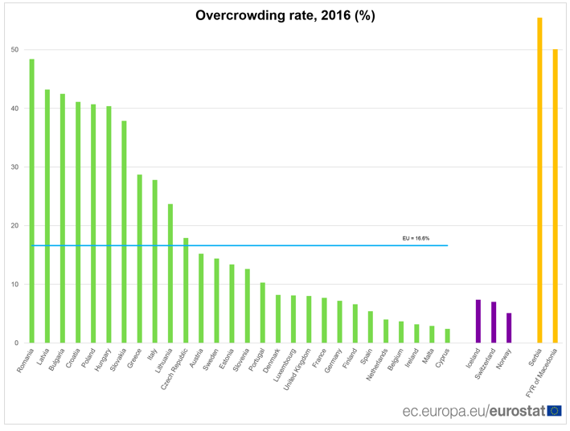
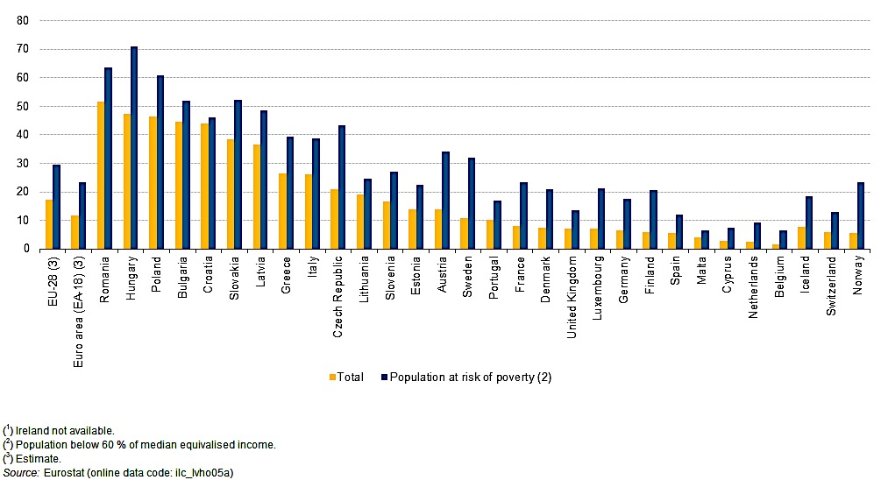
Overcrowding of housing - the percentage of people living in overcrowded dwelling

Slide 12
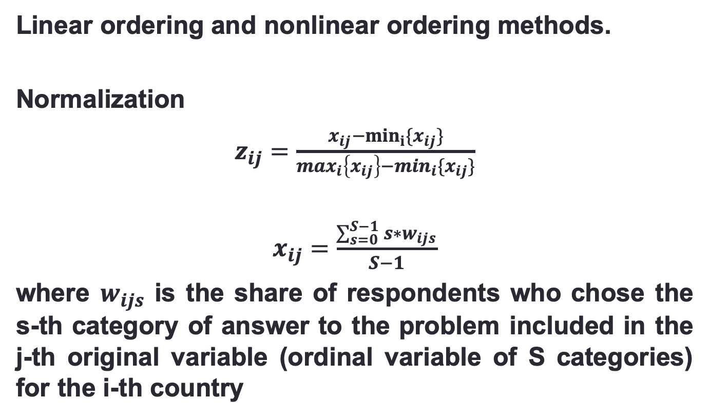
Statistical analysis methods
Linear ordering and nonlinear ordering methods.
Normalization
$z_{ij}=\frac{x_{ij}−\min_{i}\{x_{ij}\}}{\max_{i}\left\{x_{ij}\right\}−\min_{i}\{x_{ij}\}}$
$x_{ij}=\frac{\sum_{s=0}^{S−1}{s∗w_{ijs}}}{S−1}$
where $w_{ijs}$ is the share of respondents who chose the s-th category of answer to the problem included in the j-th original variable (ordinal variable of S categories) for the i-th country

Slide 13
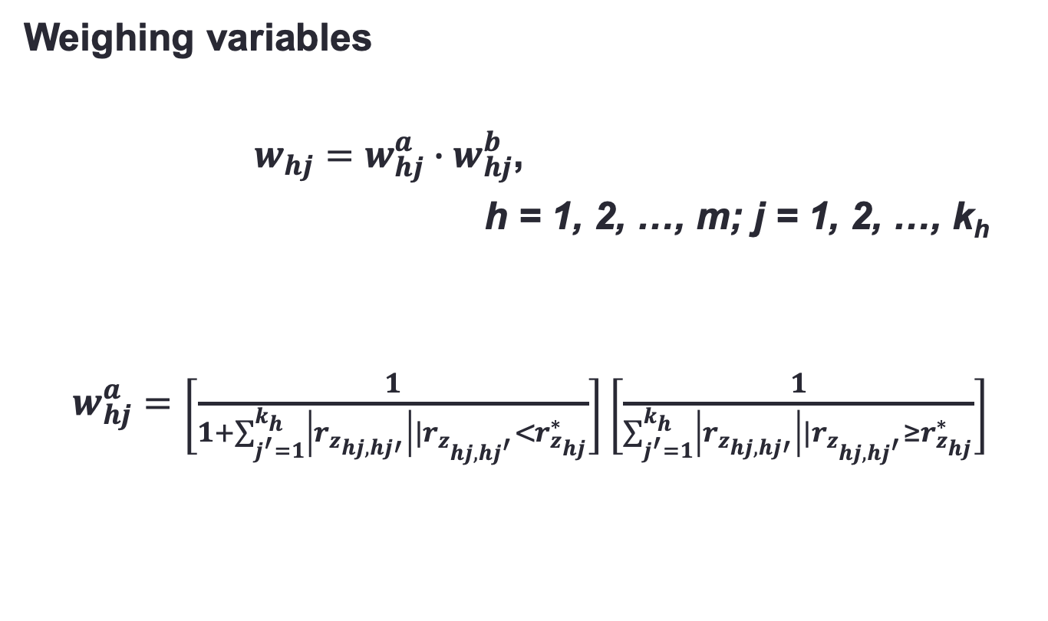
Statistical analysis methods
Weighing variables
$w_{hj}=w_{hj}^{a}∙w_{hj}^{b}$,
h = 1, 2, …, m; j = 1, 2, …, k_{h}
$w_{hj}^{a}=\left[\frac{1}{1+\sum_{j^{′}=1}^{k_{h}}{\left|r_{z_{hj,hj′}}\right||r_{z_{hj,hj^{′}}}<r_{z_{hj}}^{∗}}}\right]\left[\frac{1}{\sum_{j^{′}=1}^{k_{h}}{\left|r_{z_{hj,hj′}}\right||}r_{z_{hj,hj^{′}}}≥r_{z_{hj}}^{∗}}\right]$

Slide 14
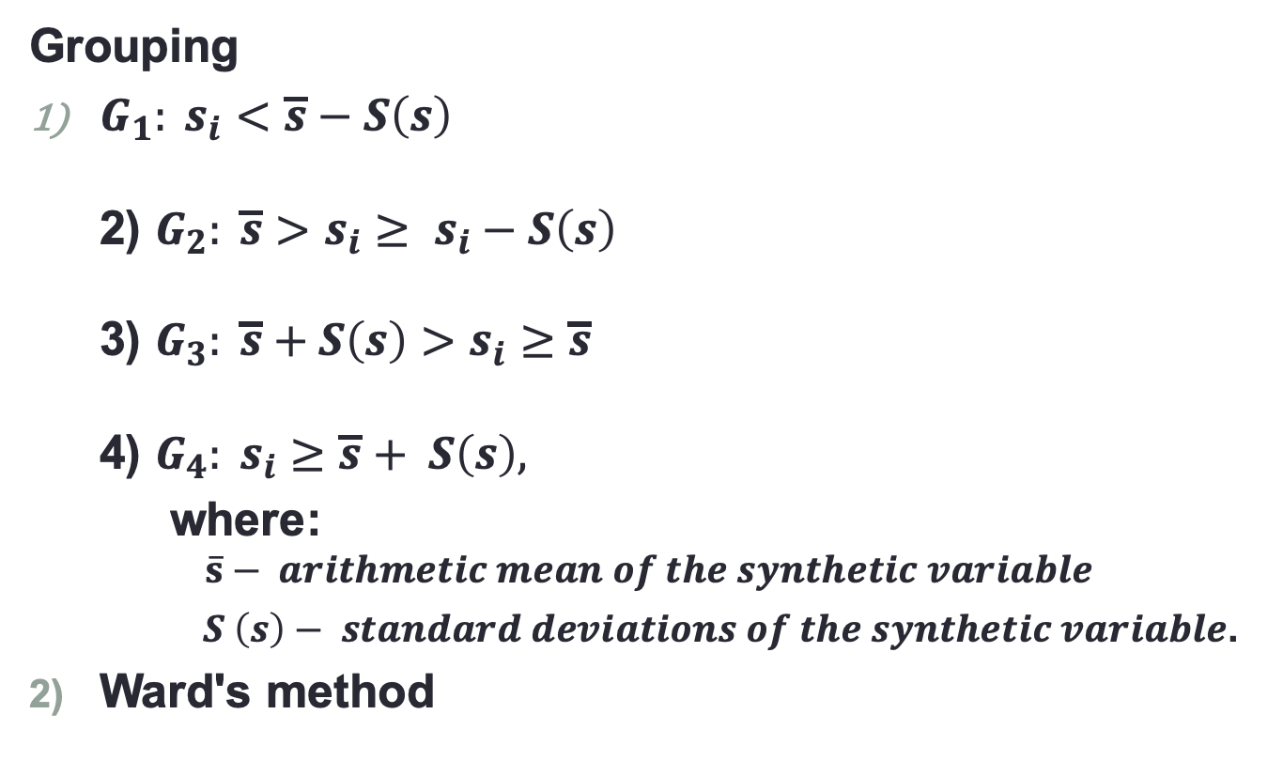
Statistical analysis methods
Grouping
$G_{1}: s_{i}<\overline{s}−S\left(s\right)$
2) $G_{2}: \overline{s}>s_{i}≥ s_{i}−S\left(s\right)$
3) $G_{3}: \overline{s}+S\left(s\right)>s_{i}≥\overline{s}$
4) $G_{4}: s_{i}≥\overline{s}+ S\left(s\right),$
where:
$$\overline{s}− arithmetic mean of the synthetic variable$$
$S \left(s\right)− standard deviations of the synthetic variable$.
Ward's method

Slide 15
Statistical data
For the purpose of the study, data from the European Quality of Life Survey (EQLS) was used, the fourth edition of which was conducted by Eurofound in 2016 and 2017 in 33 EU countries and other European countries.
The total size of the data set is 36908 observations and for individual countries the sample size is not less than 1000.
EQLS is a study on the quality of life documenting living conditions and the social situation of the population in Europe.

Slide 16
Areas of standard of residence
physical features of the apartment and the financial possibilities of its maintenance - e.g. leaking or damp roof or walls; no bathroom or shower; inability to maintain an apartment,
quality of the neighborhood and surroundings - e.g. problems in the neighborhood due to: noise, air quality, garbage, excessive traffic; environmental security,
access to services in the vicinity of the apartment - e.g. access to a bank, public transport, cultural institutions, shopping center.

Slide 17
Satisfaction with residence - results

Slide 18
Satisfaction with residence - results

Slide 19
Satisfaction with residence - results
Country | Synthetic mesure |  |  |  | Ranking
 | Field 1 | Field 2 | Field 3 | Total | Field 1 | Field 2 | Field 3 | Total
Albania | 0,524 | 0,483 | 0,366 | 0,458 | 32 | 23 | 26 | 31
Austria | 0,876 | 0,692 | 0,694 | 0,754 | 3 | 11 | 10 | 5
Belgium | 0,742 | 0,395 | 0,481 | 0,539 | 14 | 27 | 22 | 24
Bulgaria | 0,718 | 0,288 | 0,686 | 0,564 | 19 | 32 | 11 | 23
Croatia | 0,704 | 0,531 | 0,260 | 0,498 | 21 | 20 | 30 | 26
Cyprus | 0,730 | 0,545 | 0,925 | 0,734 | 17 | 18 | 2 | 8
Czech Republic | 0,738 | 0,363 | 0,594 | 0,565 | 15 | 29 | 17 | 22
Denmark | 0,832 | 0,879 | 0,877 | 0,863 | 8 | 2 | 4 | 2
Estonia | 0,708 | 0,741 | 0,603 | 0,684 | 20 | 8 | 16 | 11
Finland | 0,885 | 0,985 | 0,533 | 0,801 | 2 | 1 | 19 | 4
France | 0,696 | 0,700 | 0,371 | 0,589 | 23 | 9 | 25 | 20
FYR of Macedonia | 0,643 | 0,396 | 0,412 | 0,484 | 28 | 26 | 24 | 28
Germany | 0,876 | 0,514 | 0,629 | 0,673 | 4 | 21 | 14 | 13
Greece | 0,652 | 0,351 | 0,746 | 0,583 | 27 | 30 | 8 | 21
Hungary | 0,738 | 0,694 | 0,415 | 0,615 | 16 | 10 | 23 | 18
Ireland | 0,826 | 0,794 | 0,612 | 0,744 | 10 | 5 | 15 | 7
Italy | 0,730 | 0,383 | 0,299 | 0,471 | 18 | 28 | 29 | 30
Latvia | 0,604 | 0,667 | 0,721 | 0,664 | 30 | 14 | 9 | 15
Lithuania | 0,655 | 0,563 | 0,779 | 0,666 | 26 | 16 | 5 | 14
Luxembourg | 0,817 | 0,667 | 0,749 | 0,744 | 11 | 13 | 7 | 6
Malta | 0,842 | 0,301 | 0,634 | 0,592 | 6 | 31 | 13 | 19
Montenegro | 0,631 | 0,439 | 0,202 | 0,424 | 29 | 25 | 31 | 32
Netherlands | 0,941 | 0,784 | 0,945 | 0,890 | 1 | 6 | 1 | 1
Poland | 0,753 | 0,680 | 0,510 | 0,648 | 13 | 12 | 21 | 16
Portugal | 0,702 | 0,751 | 0,154 | 0,536 | 22 | 7 | 33 | 25
Romania | 0,580 | 0,509 | 0,354 | 0,481 | 31 | 22 | 28 | 29
Serbia | 0,658 | 0,469 | 0,365 | 0,497 | 25 | 24 | 27 | 27
Slovakia | 0,840 | 0,541 | 0,645 | 0,676 | 7 | 19 | 12 | 12
Slovenia | 0,800 | 0,807 | 0,556 | 0,721 | 12 | 4 | 18 | 9
Spain | 0,688 | 0,656 | 0,531 | 0,625 | 24 | 15 | 20 | 17
Sweden | 0,859 | 0,838 | 0,890 | 0,862 | 5 | 3 | 3 | 3
Turkey | 0,272 | 0,125 | 0,157 | 0,185 | 33 | 33 | 32 | 33
United Kingdom | 0,827 | 0,551 | 0,758 | 0,712 | 9 | 17 | 6 | 10
20
13
1
16
17
3
33
10

Slide 20
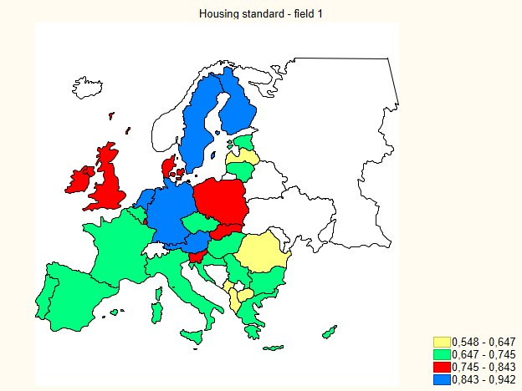
Satisfaction with residence - results

Slide 21
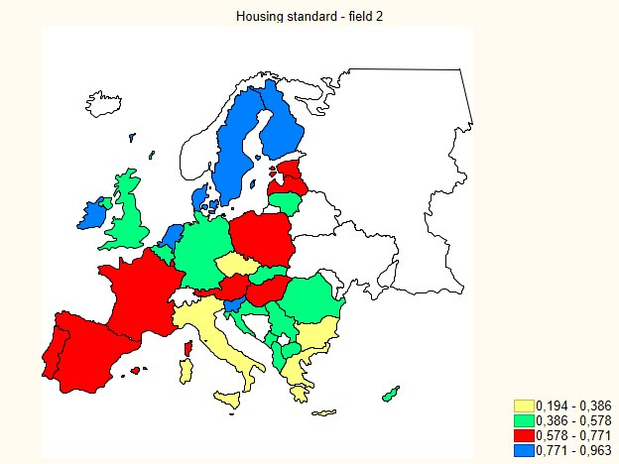
Satisfaction with residence - results

Slide 22
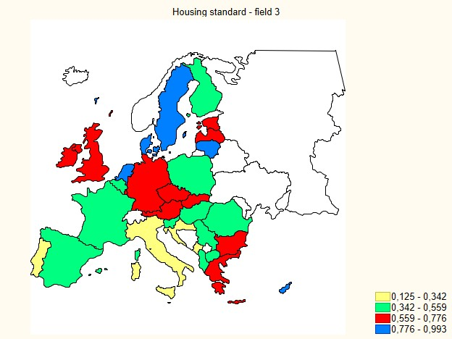
Satisfaction with residence - results

Slide 23
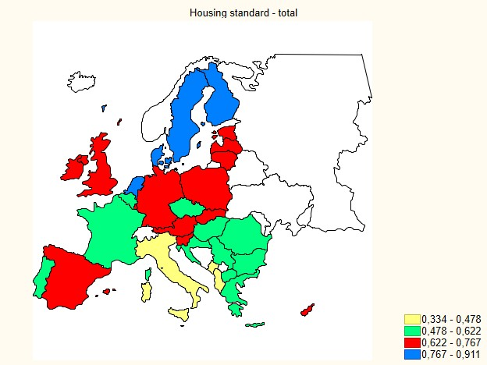
Satisfaction with residence - results

Slide 24
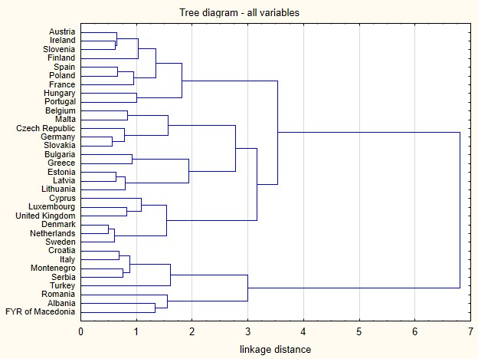
Satisfaction with residence - results

Slide 25
Summary
Housing (living) situation in Poland and other EU countries - a problem with multidimensional consequences
Measurement of the housing situation of households in its entirety - a difficult undertaking due to:
definitions
selection of indicators,
availability of relevant data,
selection of dwelling areas and their categorization.
The obtained results - despite everything - point to the legitimacy of using a multidimensional approach to assessing and comparing the housing situation in international range.

Slide 26
Thank you for your attention

