Slide 1

Contemporary migration from Ukraine to Poland
Challenges and opportunities*
Paweł Kaczmarczyk
Centre of Migration Research
University of Warsaw
Conference „Ukrainian society: the emigrational dimension”
Kyiv, 27th November 2018
* Presentation based on the research funded by the National Science Centre (project „The economic integration of immigrants in a country in the transition phase of the migration cycle - Poland versus selected EU countries”; UMO-2014/14/E/HS4/00387)

Slide 2
Agenda
Instead of introduction: a methodological comment
Immigration to Poland: challenges and opportunities
  Statistical and analytical challenges
  Labour market related issues
  Integration of immigrants
  Migration and demography
Concluding remarks

Slide 3
Instead of introduction: a methodological comment
Data used (in this presentation):
Official registers
  PESEL → Ministry of Digitalization (based on community level registers)
  POBYT → Office for Foreigners data (visas, permits, international protection)
  Ministry of Labour data (work permits, data on the simplified procedure)
  Other registers: Central Register of Insured Persons → National Insurance Institution data (insured foreigners); Central Register of Tax Payers
Other official data: Census data (NSP 2011); Polish LFS data
Estimates: CSO 2018
Dedicated surveys:
  RDS based studies (coordinated by the CMR since 2010)
  Nationally representative surveys on participation of foreigners in the labour market and importance of the simplified procedure
  Local studies (case-studies)

Slide 4
Instead of introduction: a methodological comment
What kind of migration are we talking about?
  Permanent migration (registering and de-registering for/from a permanent stay)
  Long-term migration (according to the 2007 EU definition)
  Short-term and circular migration

Slide 5
Point of departure: Immigration to Poland before 2014
Limited scale:
  National Census 2011 → 55.4 thousand of foreigners (de facto population → long-term residence)
  Eurostat → 1st of January 2015: 110 thousand foreign residents (0.3% of the total populaiton)
  CSO data → early 2016: approx. 212 thousand of foreigners with a right to stay on the Polish territory
Only a few immigrant groups
Predominance of temporary (and circular) migrants
(Very) limited settlement
Strong concentration in sectoral and spatial terms.

Slide 6
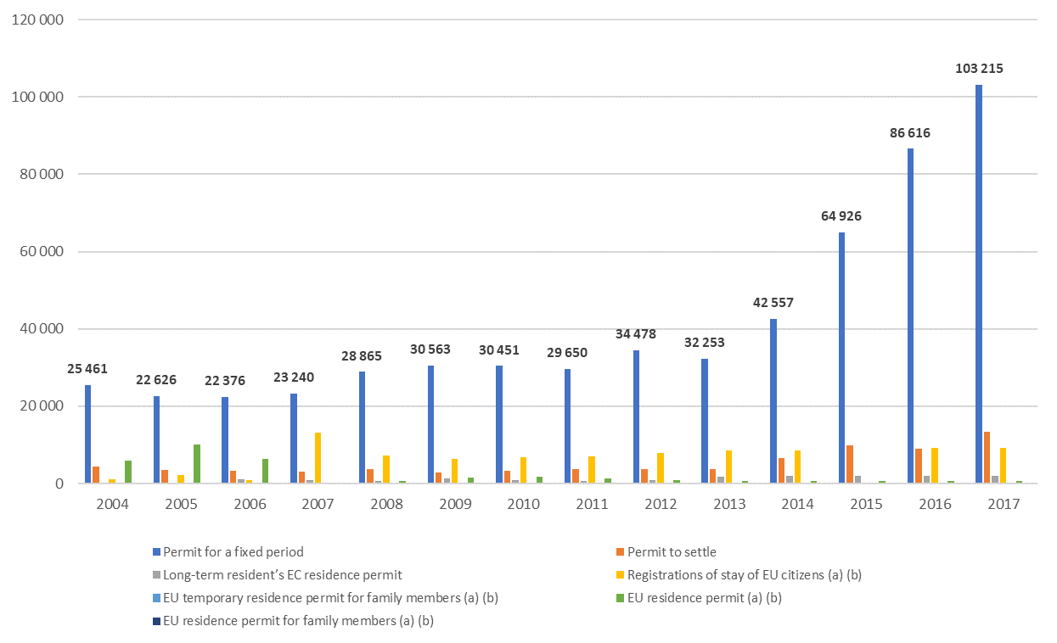
Statistical and analytical challenges: Migration flows
Residence permits issued, 2004-2017
Ukraine: 45% (2017)
Source: Office for Foreigners

Slide 7
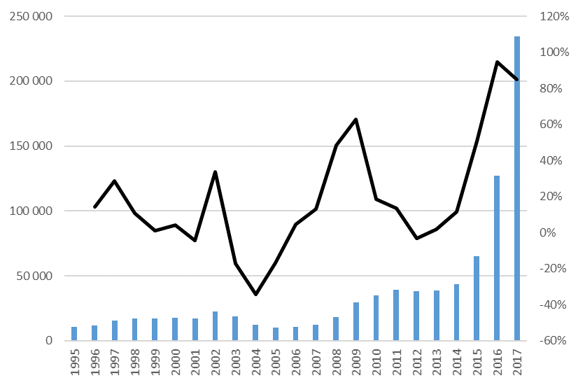
Statistical and analytical challenges: Migration flows
Number of work permits granted individually (A, B, C, E categories) and year-to-year dynamics, 1995-2017
Ukraine: 81%
Source: Own elaboration based on the Ministry of Family, Labour and Social Policy data

Slide 8
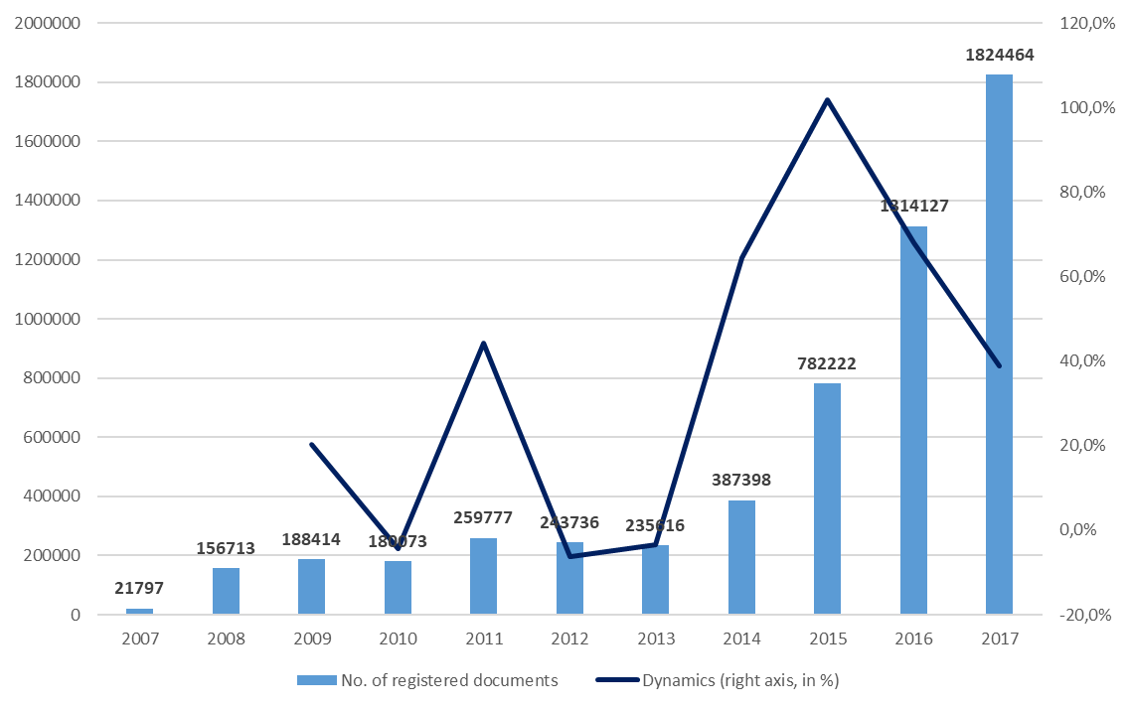
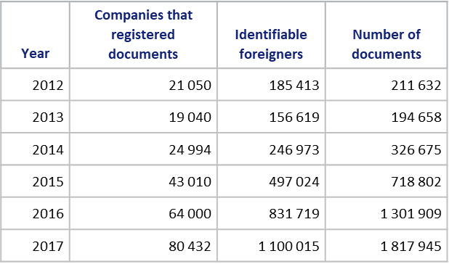
Statistical and analytical challenges: Migration flows
Number of declarations issued, 2007-2018
Ukraine: 94%
Source: Own elaboration based on the Ministry of Family, Labour and Social Policy data

Slide 9
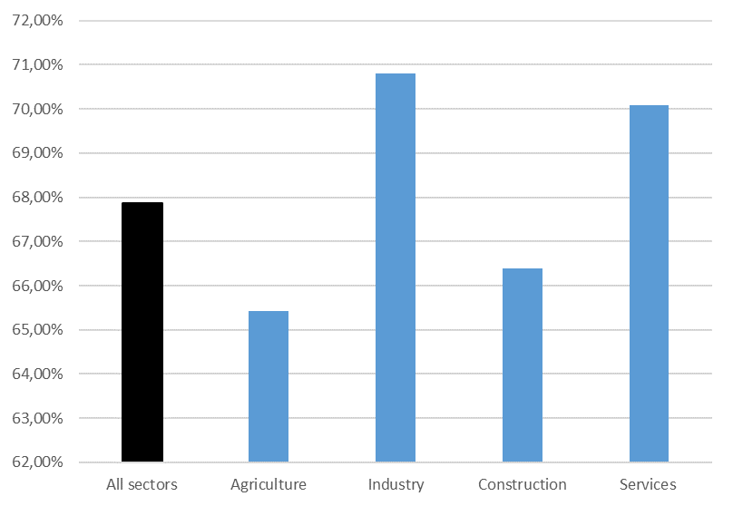
Register data and migration realities
Simplified procedure: correction scheme (2016)
Source: CMR and WISE EUROPA 2018

Slide 10
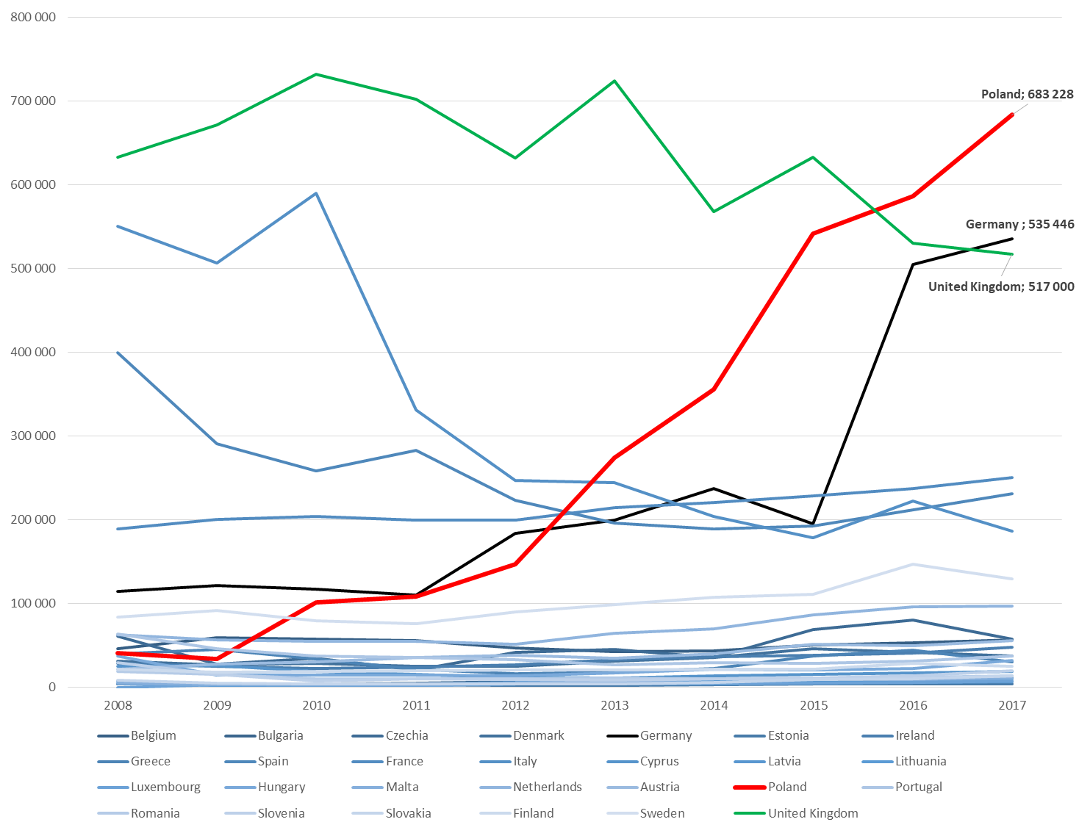
Statistical and analytical challenges: Migration flows
First residence permits issued in the EU countries, 2008-2017
Ukraine: ???
Source: EUROSTAT

Slide 11
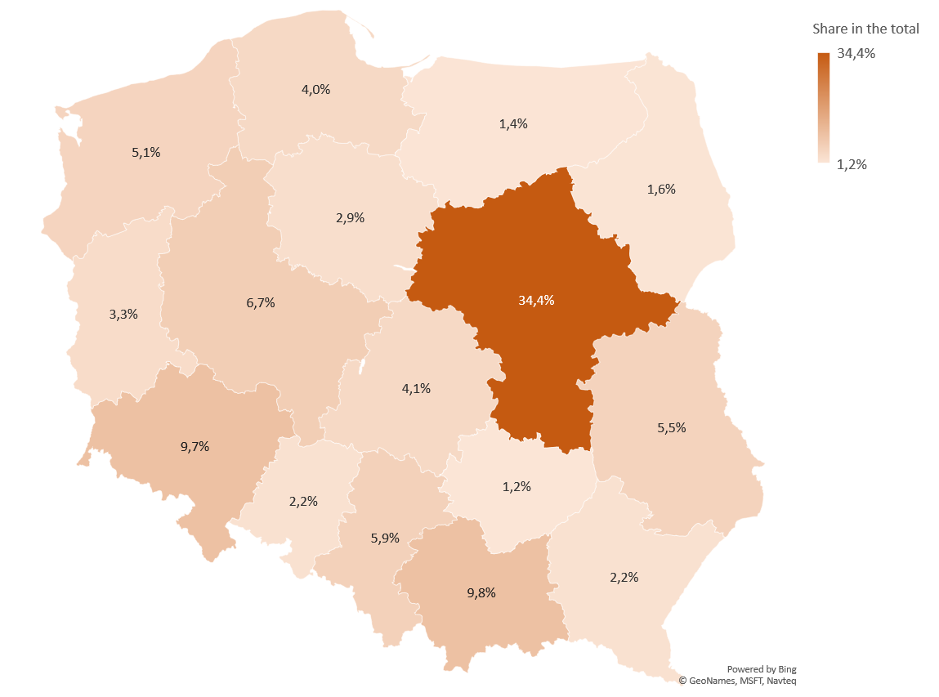
Statistical and analytical challenges: Migration stocks
Immigrants residing in Poland (18 years and older, 2016 → as for end of Dec.)
744 thousand
Males (67%)
Productive age (97%)
Ukrainians (61%)
2015: 284 thousand
2016: 455 thousand
70% up to 12 months
36% with tertiary education
Warsaw (22%)
Source: CSO 2018

Slide 12
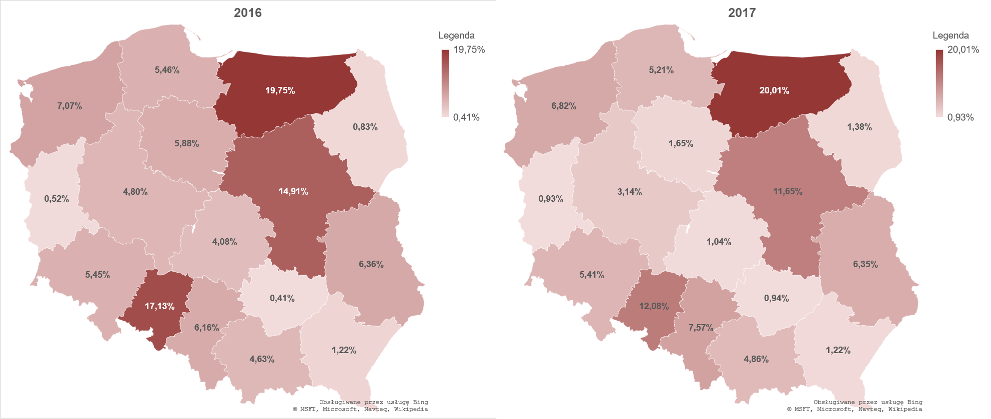
Challenges and opportunities: Foreign labour in Poland
Share of companies employing foreigners
Average: 6,8%
Average: 5,9%
Sector | 2016 | 2017
Agriculture | 7.74% | 0.63%
Industry | 11.1% | 11.3%
Construction | 5.58% | 6.13%
Trade | 3.96% | 2.91%
Market services | 8.48% | 6.72%
Non-market services | 3.14% | 4.42%
Size of the company | 2016 | 2017
0-9 employees (micro) | 6.22% | 5.14%
10-50 (small) | 11.8% | 12.9%
51-250 (medium) | 19.8% | 22.4%
over 250 (large) | 42.0% | 45.9%
Source: Górny et al. 2018

Slide 13
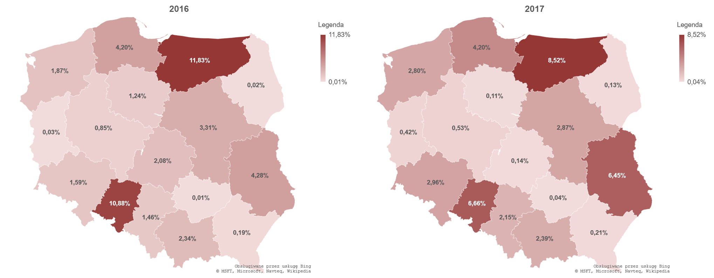
Challenges and opportunities: Foreign labour in Poland
Share in the total employment: approx. 2%
Source: Górny et al. 2018

Slide 14
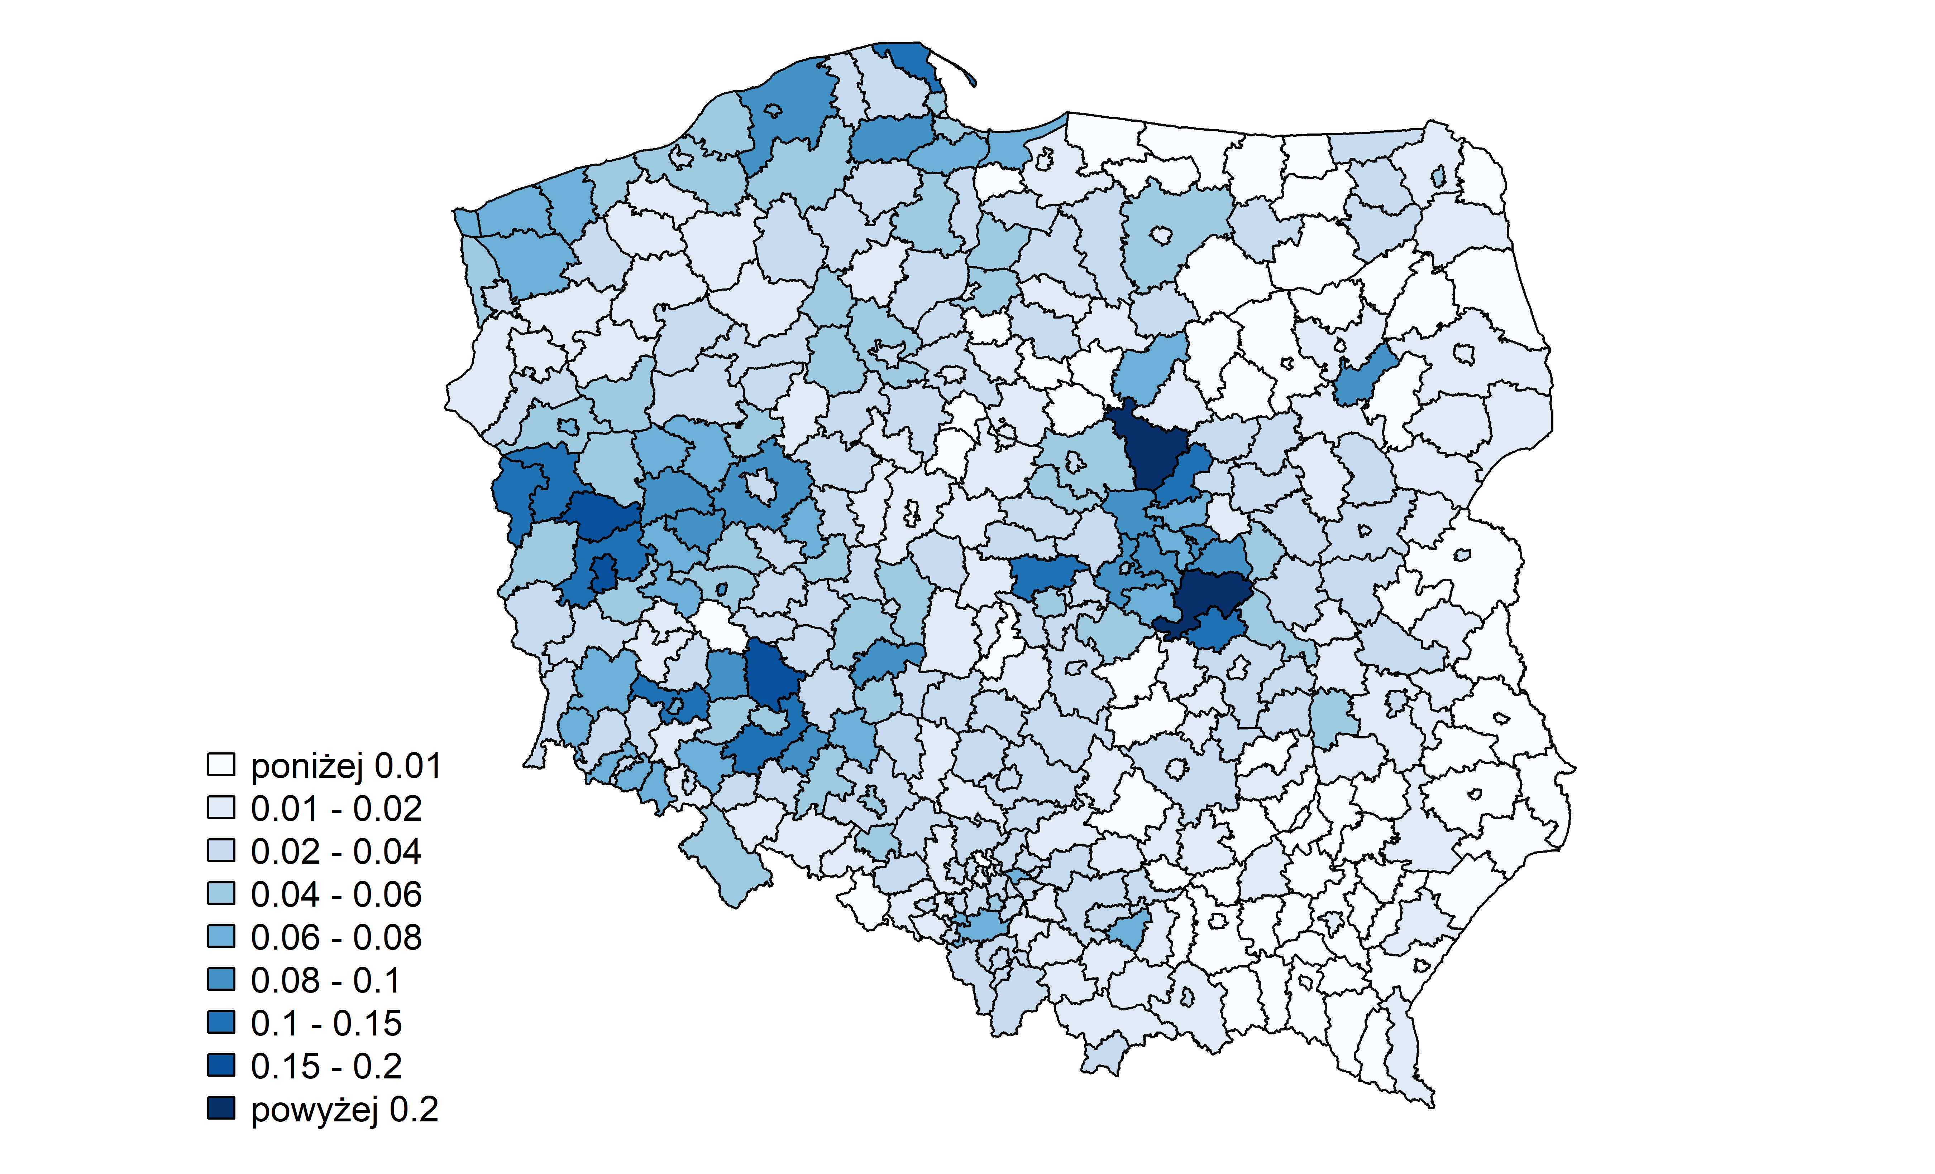
Challenges and opportunities: Foreign labour in Poland
Simplified procedure: share of seasonal workers in the total employment, 29.06.2017 and 29.06.2018
Source: Górny et al. 2018

Slide 15
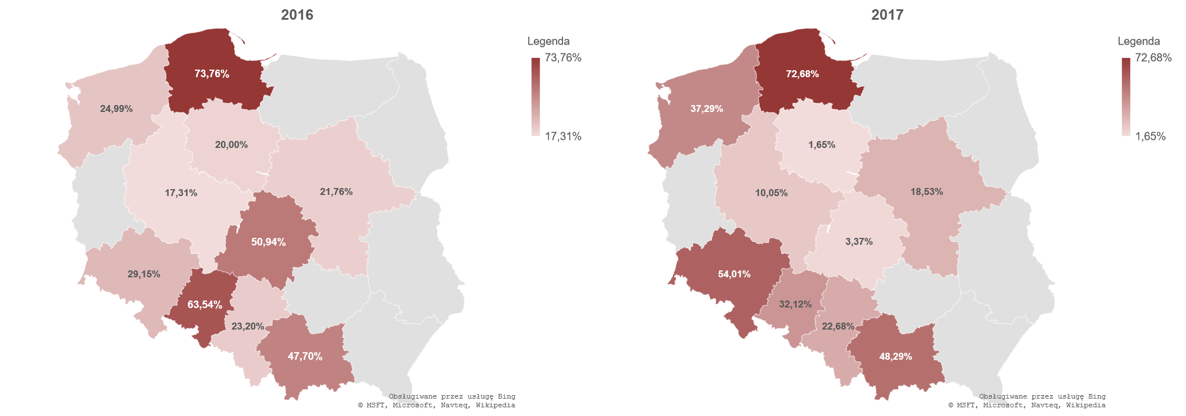
Challenges and opportunities: Foreign labour in Poland
Share in the total employment among those companies that employ foreigners
Average 2016: 34%
Average 2017: 31%
Source: Górny et al. 2018

Slide 16
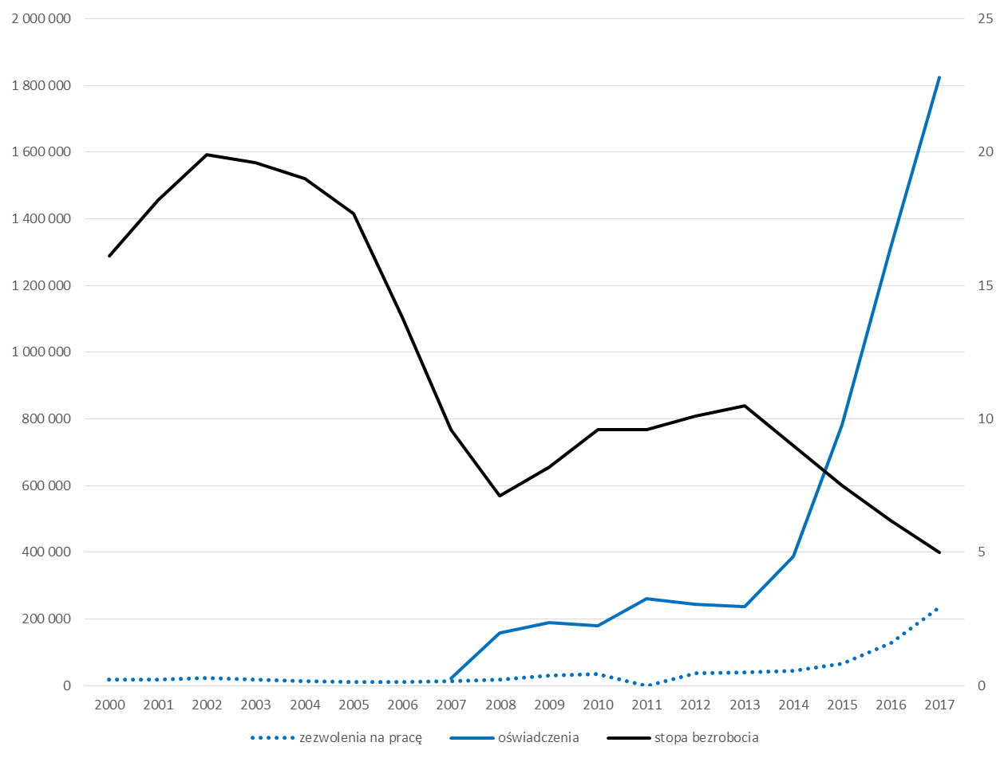
Challenges and opportunities: Foreign labour in Poland
Labour market: short-term effects
Source: Kaczmarczyk 2018

Slide 17
Challenges and opportunities: Foreign labour in Poland
Labour market: long-term effects
Unemployment rate (trend) and seasonal immigration
Employment rate (trend) and seasonal immigration
So far no significant impact on the wage level (wage compression) → Strzelecki 2018
Source: Stefańczyk 2018

Slide 18
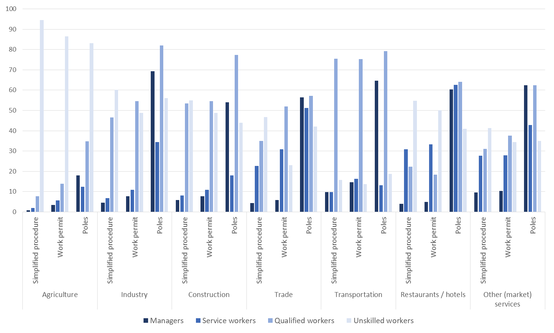
Challenges and opportunities: Foreign labour in Poland
Labour market: structural effects → segmentation → displacement effect?
Source: CMR and WISE EUROPA 2018

Slide 19
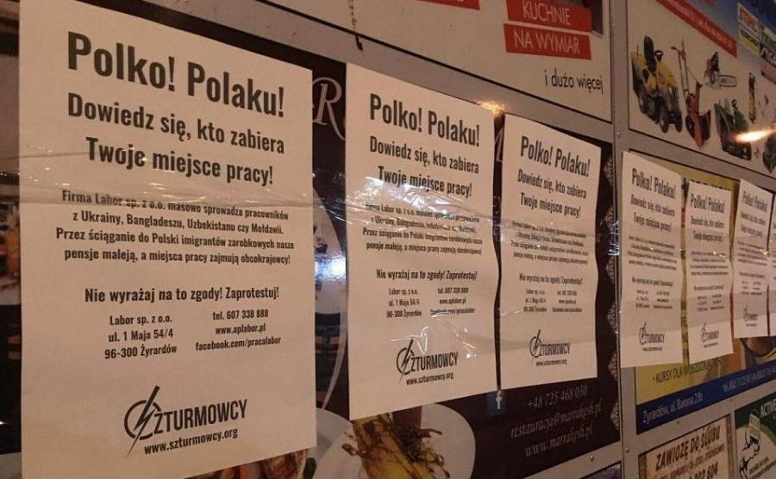
Challenges and opportunities: Foreign labour in Poland
Labour market: displacement effect?
Source: Dziennik.pl

Slide 20
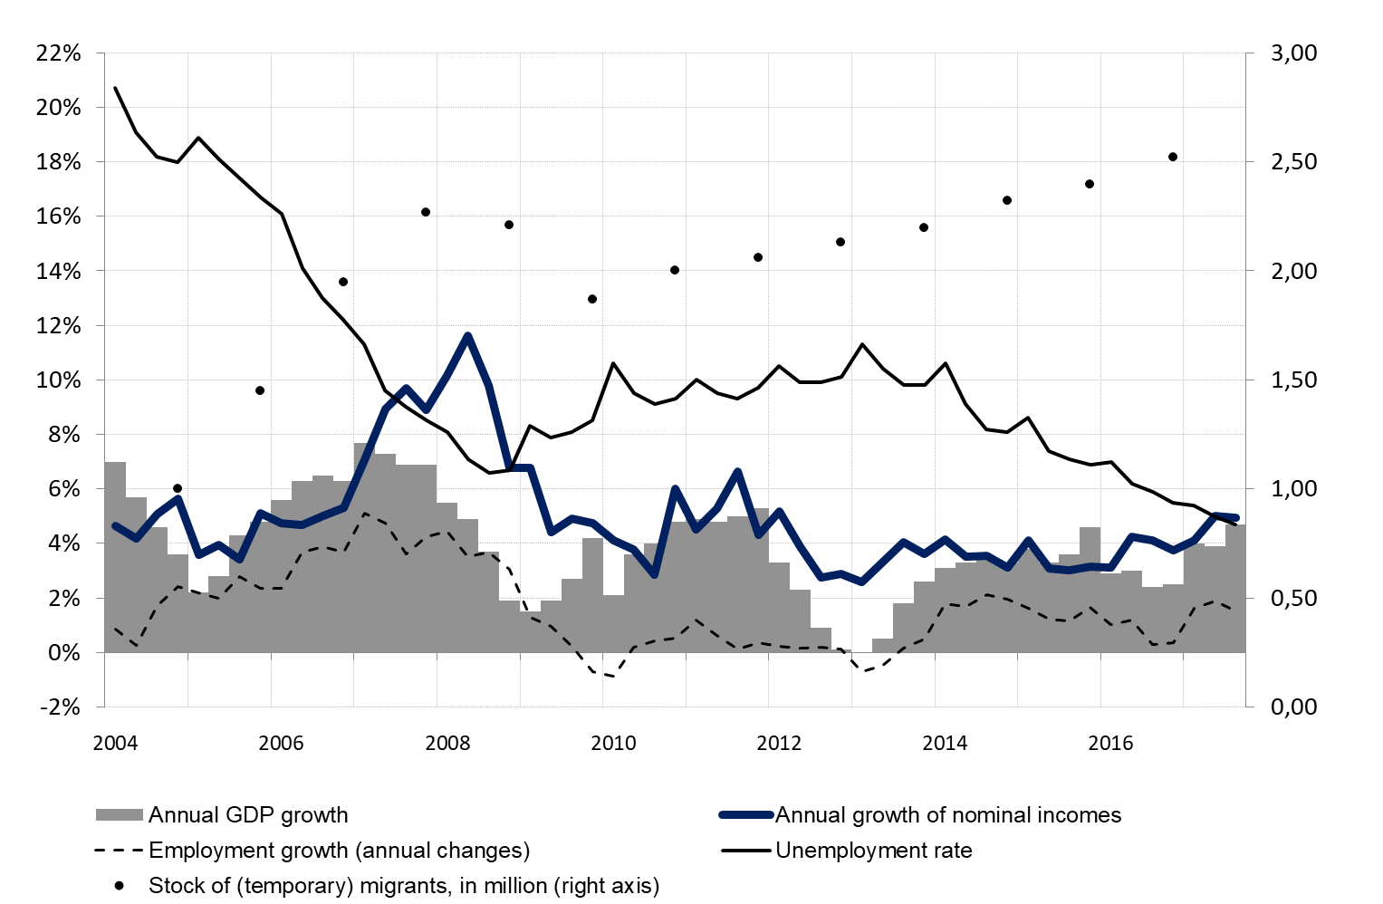
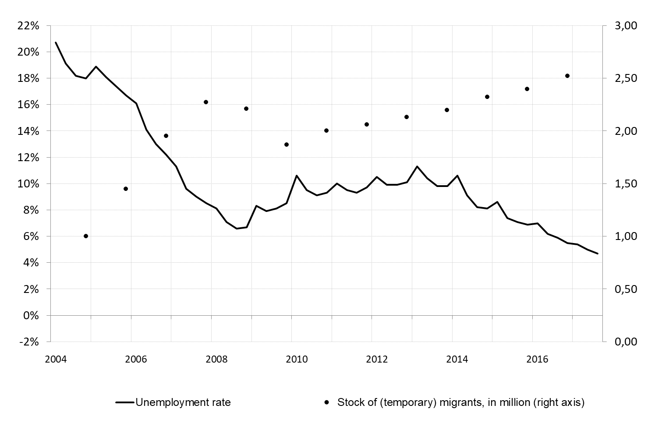
Challenges and opportunities: Emigration and the labour market – the case of Poland
Source: Kaczmarczyk 2018 based on CSO data and Roszkowska et al. (2017).

Slide 21
Challenges and opportunities: Emigration and the labour market – the case of Poland
Post-2004 migration and its effects:
As compared to a counterfactual scenario – labour force around 750-800 thous. smaller → impact in terms of labour market pressure
Effects: no clear impact on unemployment, vacancies, limited (and selective) impact on the wage level (Budnik 2008); some effects for selected professions and regional / local labour markets (Kowalska 2011)
Challenge – additional effects: educational system - absorption, self-employment, „accession effect”, low level of internal mobility, structural mismatches → general equilibrium models:
  Brücker et al. 2009: negative impact on the GDP, positive on the GDP per capita, neglibile in terms of unemployment and wage level
  NIESR 2011…

Slide 22
Challenges and opportunities: Emigration and the labour market – the case of Poland
Why so limited effects???
→ selectivity of migration and labour market structure (strong oversupply of labour)
Source: NIESR 2011

Slide 23
Challenges and opportunities: Integration of immigrants
Integration of immigrants: the case of Poland
(Empirically observed) MIGRATION PROJECT
(Economic and social) DETERMINANTS (CONDITIONS) OF INTEGRATION
Aspirations
Indicators e.g. long-term migration plans, household's point of orientation, marital status, etc.
Capabilities
Indicators e.g. legal status (in Poland and in the EU), legalization / naturalization options, networks, cultural / linquistic skills.
Economic / structural / institutional integration
Indicators, e.g. labour market status, wage level, access to education, fiscal position, etc.
OUTCOMES (EFFECTS)
Social / relational integration
Indicators, e.g. frequency and 'quality' of social interactions (with Poles, other migrants), social / political participation, etc.
Structure (Macro) Opportunities
Migration project
Agency (Micro) Aspirations Capabilities
Source: Kaczmarczyk et al. 2018

Slide 24
Challenges and opportunities: Integration of immigrants
Migration strategies of Ukrainian migrants in PL
 | Variable | „Regular” circulants | Circular transmigrants | Irregular circulants | Long-term immigrants
1 | Years since first arrival | 3 | 6 | 11 | 12
2 | Visits frequency (per year) | 2 | 1.5 | 1 | 0.2
3 | Average length of stay (in months) | 3 | 7 | 4 | 43
4 | Share of time spent in PL | 50% | 60% | 20% | 70%
5 | Time between the first arrival and stay longer than 2 months | 1 mies. | 1 mies. | 5 lat | 1 rok
6 | Share of visits shorter than 6 months | 99% | 20% | 92% | 5%
LLp
Share in the total
50%
19%
26%
5%
Source: Górny 2017

Slide 25
Inter-sectoral mobility of Ukrainian workers in Warsaw agglomeration, 2015
Challenges and opportunities: Integration of immigrants
Sector of employment: last stay
 | Agriculture | Construction | Domestic services | HoReCa | Other sector | Total
Agriculture | (41%) (83%) | 9% | 37% | 10% | 4% | 100%
Construction | 16%
Other sector | 2%
Total | 100%
Men:
Fluctuations (30%)
between agriculture and construction, but not a net-outflow.
Women:
Around 75% of those initially employed in agriculture left the sector (mainly to domestic services).
Sector of employment: first stay
In addition → the smallest share of first timers in aggriculture (11%) when compared to: HoReCa (49%), construction (46%), domestic services (11%).
Source: Górny 2017
Notes:
Z tych, którzy zaczęli migrację od pracy w rolnictwie, w sektorze rolnym pozostało tylko 41%. Najwięcej migrantów odpłynęło do sektora pomocy domowych (41%)….
Z tych, którzy pracowali w rolnictwie w momencie badania, 83% zaczęło swoją migrację od pracy w rolnictwie. Pozostali napłynęli głownie z sektora budowlanego (16%).

Slide 26
Challenge: Migration and demography
Migration and net migration (in thous.), 2015-2060
Source: Anacka and Janicka 2018

Slide 27
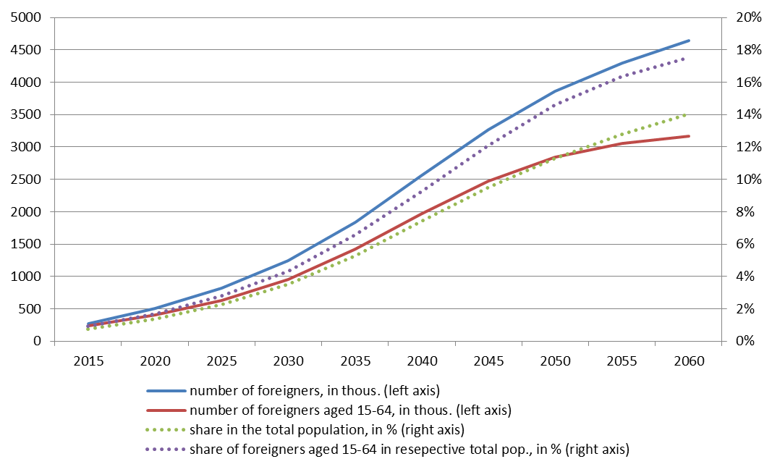
Challenge: Migration and demography
Foreigners in the total population, 2020-2060
Source: Anacka and Janicka 2018

Slide 28
Challenge: Migration and demography
Role of migration related assumptions: MIG/AGEING vs. other forecasts - size of the population
Source: Anacka and Janicka 2018

Slide 29
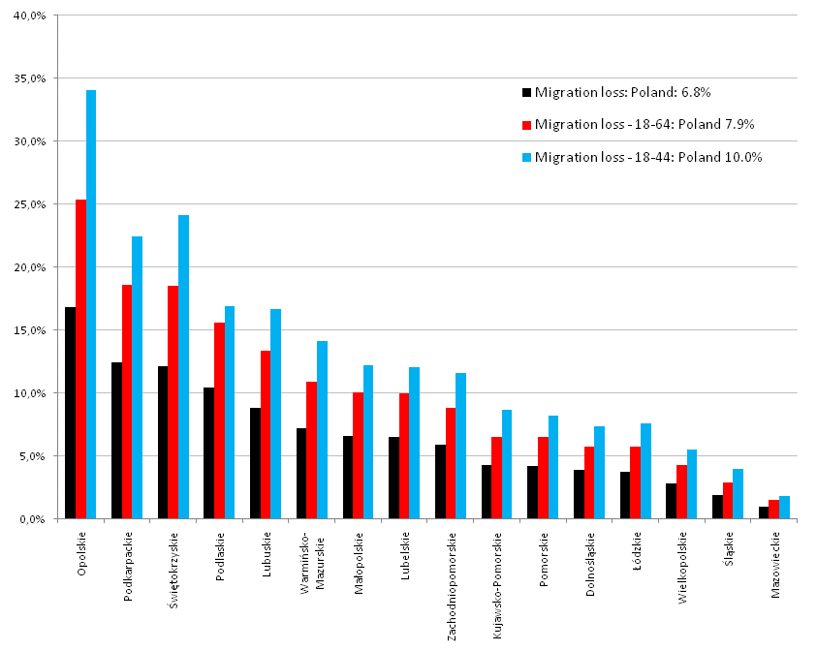
Challenge: Migration and demography
Aggregate and regional effects… ‘Migration loss’ due to the post-accession migration (2010)
Source: FOBM 2012

Slide 30
Concluding remarks
What we do not know (much) about?
  Migrants’ strategies and migration paths
  Labour market and social mobility
  Various spheres of integration (education, healts, access to public services)
  Impacts on various markets (e.g. housing market, financial market)
Key questions:
  How sustainable is the supply of (cheap) foreign labour?
  What will the role of recruiters / temporary work agencies in the inflow of foreign workers?
  What will be the role of external factors? (e.g. German-Ukrainian agreement)
  What will the long-term outcomes of recent flows? (for employers? for Polish workers? for foreigners? for the Polish economy? for the Ukrainian economy / society?)
  What are the long-term integration choices of Ukrainian immigrants?
  What will be the long-term effects for Ukraine as an origin country?

