Slide 1
XXVI Ukraine – Polish – Slovak Scientific Seminar
THE ROLE OF STATISTICS IN THE DEVELOPMENT OF THE MODERN ECONOMICS SYSTEM
The economics of data: implications for
the data-driven smart economy
Igor G.MANTSUROV

Slide 2
The aim of the presentation to be discussed on the Seminar is to demonstrate the global idea that the the data-driven economy is fundamentally different than what has come before. A fundamental point of differentiation of the “data-driven smart economic model” from the “knowledge-based economy model” lies in the assumption that knowledge is implicitly accessible by all, even if it is temporarily excludable by innovating institutions.

Slide 3
It is happening as result of the digital transformation process that is creating a new kind of economy based on the “datafication” of virtually any aspect of human social, political and economic activity as a result of the information generated by the digitally connected individuals, companies, institutions and machines.

Slide 4
I would like to demonstrate that the economics of this emerging data-driven smart economy can be situated in theoretical models of endogenous growth, which introduce research and development (R&D), human capital formation and the Schumpeterian creative destruction through business stealing as the main drivers of economic growth.

Slide 5
According to my point of view, this theoretical framework allows for differential rates of growth in different countries based on their policies to support innovation, such as subsidies for R&D and education to exploit knowledge externalitie needed to access technological developments generated elsewhere. Author is supposed to prove that the data-driven smart economy has several structural features that make a special case of the general endogenous growth model with such characteristics:

Slide 6
• pervasive information asymmetry;
• in terms of market structure and behavior, the data-driven economy features economies of scale and network externalities, which give rise to concentrated market structures, expanded economic rents and incentives for strategic managerial behavior;
• the industrialization of learning through artificial intelligence (AI). The larger implication of the industrialization of learning is the discounting of the value of human capital;
• systemic risks due to vulnerabilities in the information infrastructure;
new approaches to quantitative economic analysis to be carried out in the framework mentioned above

Slide 7
Open data has the capability to increase economic benefit through both individuals' and companies' use of the information.
According the Special UN Report, as of March 2018, it was estimated that open data FINALLY BEGAN TO GENERATE 0.5% more GDP compared to closed and paid data.
The creation of open data relies on either funding from government to create and maintain the data or funding in the form of grants and volunteers.^{[1]} Data made open by governments largely relies on the publication of public service research. Because the data has already been created for a purpose, there is no creation cost for it to be made available to the public.

Slide 8
Open Data and Economic Opportunity.
Open data gains additional economic value when governments support open data initiatives, although increased uptake and citizen engagement is vital to the economic success of open data. Greater economic impact depends on revenue growth, cost reduction, and job creation.

Slide 9
Revenue can be increased through the use of open data with the creation of new businesses, new good or services, or improved goods and services. When businesses profit from the creation of goods or services that rely upon open data not only does their company reap the financial benefits but the government does as well, through the increase of tax revenue

Slide 10
Cost reduction helps to increase revenue
for private sector businesses but is also an asset to government. Cost reduction in government, whether through reduction of services required or labor requirements, reduces government spending in some areas allowing for investment in others.

Slide 11
Open data can also increase economic benefit through the creation of jobs.
Jobs can be created through innovative entrepreneurship or through the requirement of skilled laborers to use and understand data.

Slide 12
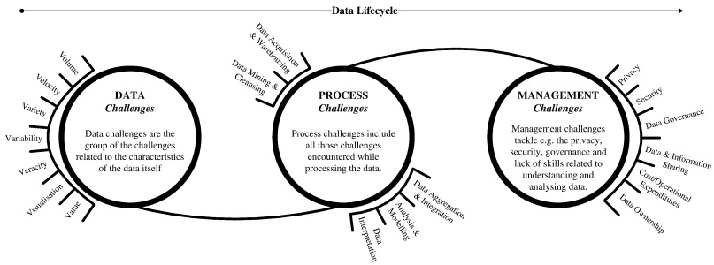

Slide 13
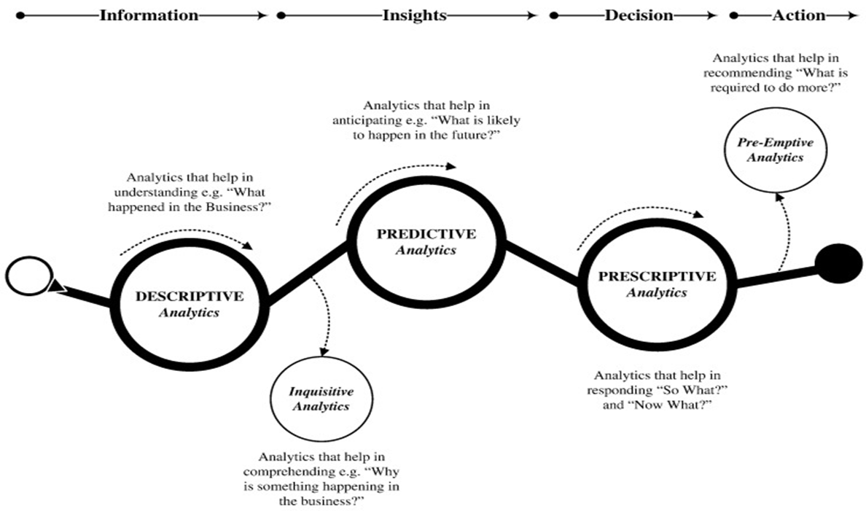

Slide 14
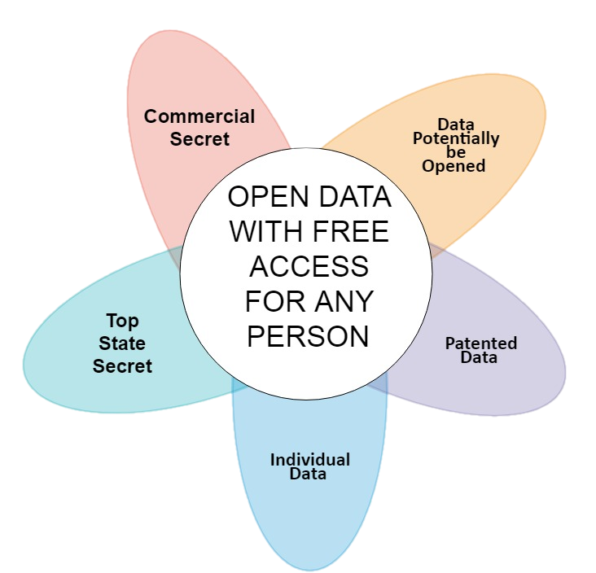
Breakdown of the World Big Data According
to the Public Access to its Sources

Slide 15
Breakdown of the World Big Data According
to the Public Access to its Sources

Slide 16
Breakdown of the World Big Data According
to the Public Access to its Sources

Slide 17
Breakdown of the World Big Data According
to the Public Access to its Sources

Slide 18
New technologies will have major impacts on future employment, productivity and incomes
The path of the global economy is undergoing significant changes in the rate and composition of productivity growth, investment and employment gains since the crisis, including from digitalisation and globalisation, with potential for large economic gains but also major reallocation of activity between sectors and countries. This note focuses on the current and future impacts of technological change itself, keeping in mind that it could amplify or mitigate the effects of other ongoing “megatrends”, including global economic integration as well as demographic and environmental challenges.

Slide 19
Digitalisation and technological innovations are changing the nature of production
A confluence of new technologies are already transforming the production and distribution of goods and services. Rapidly evolving technologies create considerable opportunities for productivity growth and improvements in well-being; but they also create considerable challenges for skills, employment, productivity diffusion and income distribution.
Among the main emerging technologies (Box 1; OECD, 2016a; OECD, 2017a):
• Digital technologies and data-driven innovation, based on big data analytics, increasingly permit machine functionalities that rival human performance in tasks such as pattern recognition. Cloud computing and the Internet of Things enable the development of autonomous machines and intelligent systems.

Slide 20
Disruptive production technologies
Many technological breakthroughs will disrupt the way goods and services are produced and distributed over the next 10 to 15 years, requiring potentially radical adaptation in business models, skills systems and policies. New advances in digital technologies, data science, new materials are already used in production and more transformational technologies are on the horizon in a range of industries (OECD, 2016a; OECD, 2017a).

Slide 21
The Internet of Things (IoT) is spreading rapidly and promises a hyper-connected, digitally responsive society. By 2030, it is estimated that 8 billion people and maybe 25 billion active “smart” devices will be interconnected and interwoven in one huge information network (OECD, 2015d). The largest impacts are expected in healthcare, manufacturing (with sensors enabling comprehensive supply chain intelligence) and network industries. According to Vodafone (2015), the IoT reduces industrial costs among industrial adopters by 15% on average. How fast and how effectively the IoT will evolve over the next 15 years depends to a large extent on the roll-out of fixed and mobile broadband and the decreasing cost of devices, as well as on the ability of businesses to build data analytics capacity.

Slide 22
Big data analytics is a set of techniques and tools to process and interpret large volums of data, including data mining, profiling, business intelligence, machine learning and visual analytics. The exploitation of big data, in combination with sensors and the IoT, will become a key determinant of innovation and competitiveness for individual firms.

Slide 23
It allows firms to closely monitor and optimise their operations, not only by gathering large volumes of data on their production processes or service delivery, but also on how customers approach them and place orders, allowing them to eliminate errors, reduce inventories and speed up delivery. It also provides consumers with more personalised products and services that are specifically tailored to their needs. Firm-level evidence suggests that using data-driven innovation can raise labour productivity by 5 to 10% relative to non-users (OECD, 2015d).

Slide 24
Artificial intelligence (AI) refers to the ability of machines and systems to perform a broad variety of cognitive tasks, such as sensing, processing oral language, learning, making decisions and manipulating objects accordingly – using a combination of big data analytics, cloud computing, IoT and machine-to-machine communication. AI is expanding the roles of robots, which have been traditionally limited to monotonous tasks requiring speed, precision and dexterity; more autonomous and agile AI-enabled robots are set to become increasingly central to logistics and manufacturing. Sectors that are likely to experience radical transformations include agriculture, chemicals, oil and coal, rubber and plastics, shoe and textile, transport, construction, defence, and surveillance and security. For instance, autonomous drill rigs could increase mining productivity by 30% to 60% (Citigroup-Oxford Martin School, 2015). AI will also be increasingly deployed in a wide range of services including entertainment, medicine, marketing and finance.

Slide 25
These technologies build on and feed into each other. For instance, cloud computing enables the IoT, which generates large amounts of data for big data analytics, in turn fuelling advances in machine learning and AI, etc. Many of these technologies are still at an early stage of commercial application compared to the potential they offer, but the IoT, big data analytics and artificial intelligence are – or will likely become in the near-future – pervasive enabling technologies, which could accelerate the pace of change. Besides technical constraints, some of the challenges that will need to be met are dealing with privacy and security risks and filling gaps in IT and data science skills.

Slide 26
NUMERICAL CHARACNERISTICS
OF THE DIGITALIZATION PROCESS
AND ITS INFLUENCE
ON THE ECONOMIC DEVELOPMENT

Slide 27
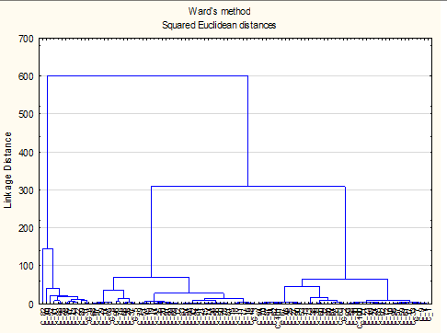
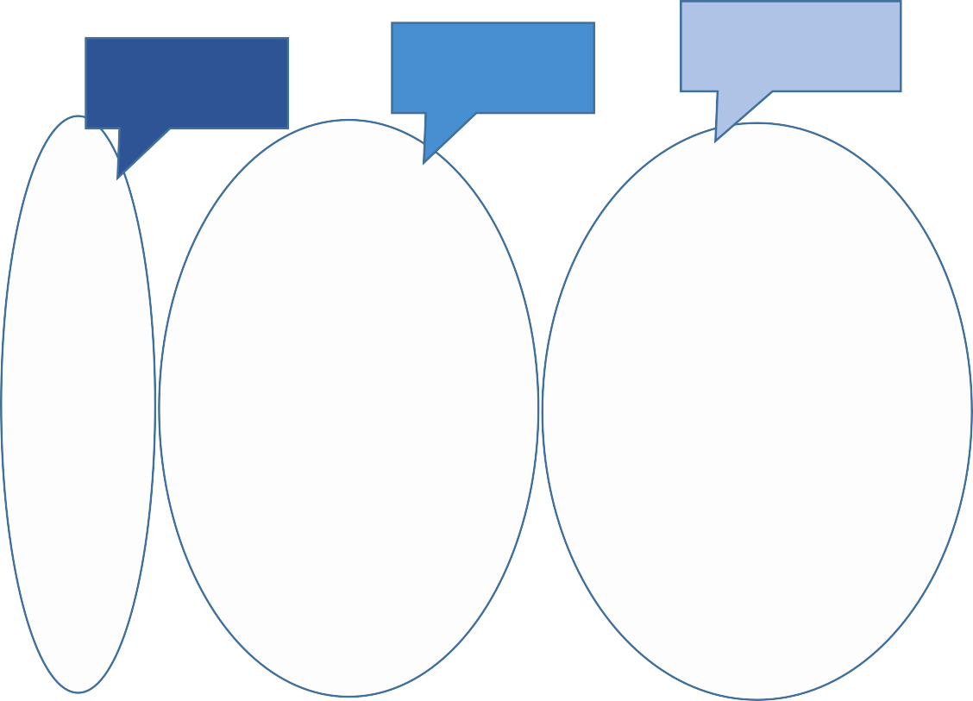
Claster B**, Industry – 3.0
Claster C***, Іndustry - 2.0
ClasterА*, Industry – 4.0

Slide 28
Результати кластеризації країн світу за обраними показниками розвитку кібернетичної і технологічної підсистем (метод Уорда, квадрат евклідової відстані)
CLASTER A
Австрія; Данія; Фінляндія; Німеччина; Ірландія; Ізраїль; Японія; Корея, Rep.; Сінгапур; Швеція; Швейцарія; Сполучені Штати;
CLASTER B
Аргентина; Австралія; Бельгія; Бразилія; Болгарія; Канада; Чилі; Китай; Коста-Ріка; Хорватія; Кіпр; Чеська Республіка; Естонія; Франція; Гонконг, Китай; Угорщина; Італія; Йорданія; Казахстан; Латвія; Литва; Малайзія; Нідерланди; Нова Зеландія; Норвегія; Польща; Португалія; Румунія; Російська Федерація; Сербія; Словаччина; Словенія; Іспа- нія; Таїланд; Об'єднане Королівство; Уругвай;
CLASTER B
Албанія; Вірменія; Азербайджан; Боснія і Герцеговина; Бурунді; Ефіопія; Грузія; Греція; Індія; Індонезія; Кенія; Киргизька Республіка; Мексика; Молдова; Монголія; Мозамбік; Намібія;; Філіппіни; Сенегал; Південна Африка; Танзанія; Туреччина; Уганда; Україна; В'єтнам; Замбія.

Slide 29
6 000
60 000
5 000
51248
50 000
4 000
40 000
3 000
30009
30 000
2 000
20 000
1 000
8980
8301
10 000
0
0
Кластер А Кластер В Кластер С Україна
Цифрова економіка, $ на душу населения, ПКС
Високотехнологічний експорт, $ на душу населення, ПКС

Slide 30
Thank you!

