Slide 1
Return from the EU: patterns and profiles in Argentina, Romania, Senegal and Ukraine
Inmaculada Serrano (CSIC)
Ukrainian society: the emigrational dimension
PTOUKHA Institute
Kiev, 27 November 2018

Slide 2
introduction

Slide 3
Motivation
Increasing policy attention to return, and circulation as a potential new way of managing migration (EU perspective: e.g. GAMM 2015)
Still limited and fragmented knowledge on return migration and circular migration

Slide 4
The TEMPER Origin Surveys
TEMPER (Temporary vs. Permanent Migration)
EU FP7 funded (2014-2018)
Coordinated by the CSIC in Spain
9 Work Packages (high-skilled, seasonal, etc.) → 2 WP on the determinants and impacts of return & circular migration
Comparative surveys conducted in 4 origin countries: Argentina, Romania, Senegal and Ukraine

Slide 5
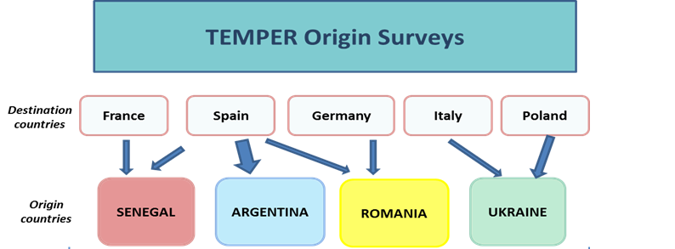
Return migrants
(aprox. 250 per flow)
Non-migrants
(aprox. 250 per flow)
Permanent return
Temporary return / repeated or circular migration
Notes:
WHY selected: cultural regions – legal regime regarding access to EU

Slide 6
% Returnees over total population
 | AR | RO | SN | UA
All RETs | 0.2% | 0.5% | 0.56% | 1.32% (labour migrants) <Aza<<z
Specific destinations | ES: no more than 1/4 (USA, Italy, Latinamerica) | ES: 0.05% DE: 0.015% | ES: 0.02% FR: 0.05% | PL: 0.48% IT: 0.11%
Source | Census 2010 | Census 2011 | Census 2013 | LMS 2017

Slide 7
Definitions
RETURNED MIGRANT
persons who moved from one of our EU destinations (after staying there for at least 3 [2 UA] months)
back to his/her country of birth (and stayed there at least 3 months)
regardless of the reasons for migration and return [UA work or study during stay]
(last migration: min. 1996)
(last return: min. 2000)
3-MONTH limit: to ensure we capture circular migrants

Slide 8
Definitions
CIRCULAR MIGRANT (strict definition)
sequence of migration between two main countries within a year that is repeated in at least two consecutive loops: UA-IT-UA-IT
CIRCULAR MIGRANT (wide definition)
three or more returns to the country of birth after staying in any EU country in a period of 10 years: UA-IT-UA-PL-UA-IT-UA
(In line with UNECE 2016 definitions)

Slide 9
Caveats
Returnees → selected out of the migrant population (cannot say anything about migrants, or about this selection/drivers to return) → expost merging with datasets in destination
Migrants
Cannot say anything about:
Relative size
Common or distinct? E.g. time of arrival, reason for migration, etc.
Returnees

Slide 10
Caveats
Circular migrants → mobile by definition, they could be at origin or destination at the time of the interview → we don’t expect large differences between the two sub-populations
Migrants
AR July 2017- Aug 2018
RO Nov 2017- Mar 2018; May-Aug 2018
SN Oct 2017-Jan 2018; Apr-May 2018
UA Oct 2017-Feb 2018; Mar-Jul 2018
Circular migrants at destination
Circular migrants at origin

Slide 11
RESULTS

Slide 12
High incidence of short-term migration among returnees
Unexpected finding: almost half of the total sample of returnees are short-term migrants (<3 months) – significant in all flows
Implications: significant part of international mobility overlooked in most migration studies (standard definition of migrants as changes of residence / min. 1 year)

Slide 13
Short-term migration (among returnees): migrant profiles
Sex, age, education: no significant differences
Reasons for migration: no significant differences
AR-ES: + study, - family
SN-FR: - study, + economic
Preliminary conclusion: similar migrants
Different migration projects
Different results/endings of migration experience

Slide 14
Short-term migration (among returnees): reasons of return
Reasons for return: less weight of family
+ studies AR-ES
+ economic RO, UA
+ administrative SN-ES, UA
Voluntariness of return: no significant differences
RO-ES: + voluntary
SN-ES: - voluntary
Notes:
Some failure component – but also many can be part of the project (ej. Studies, business)
Voluntariness not perfect reflection either, but “mixture” gives an idea

Slide 15
Short-term migration (among returnees): circularity
Short-term migrants more likely to be circular. Although no large differences: except SN (highest levels of circularity)

Slide 16
Short-term migration (among returnees): circularity
Short-term migrants ALSO more likely to remigrate soon. Large differences, except AR, UA-IT , UA-PL(-)
ALSO more likely to intend
short-term remigration (UA-PL -)
BUT less likely to remigrate to same
destination
Notes:
Maybe no time yet…
More circularity, and more potential for circularity
LOOK at general levels per country

Slide 17
Circularity: incidence
1-migration cycles dominant in all returnee flows (exception SN) – also UA-PL!

Slide 18
Circularity: a matter of short stays?
68% of all circular migrants had short stays abroad (what we miss when long-term migration considered only)
Even higher percentages per flow: RO-DE, UA-PL > 90%

Slide 19
Return migrants: satisfaction
Large levels of satisfaction with life: above 70%, except UA
Also with return decision, although lower levels (UA in middle levels, PL>IT)

Slide 20
Return migrants: change of plans
Significant proportions change their initial plans: at the moment of return they expected to remigrate, but at the time of the interview they consider unlikely to remigrate
In AR also 9% expected to remigrate but thought it unlikely at the time of interview

Slide 21
Return migrants: financial situation
Capacity to cover household’s basic needs: most returnees had sufficient resources at the time of return and still have sufficient at the time of the interview, except in UA

Slide 22
Return migrants: activity
Most returnees were working before their return (almost all in UA)
Much higher levels of inactivity and unemployment at the time of interview: particularly high in UA and RO-DE

Slide 23
Return migrants: type of jobs
Most returnees worked in formal economy before returning, except for UA
The level of formality increases further at origin, except for SN-ES

Slide 24
Return migrants: subjective impact
Returnees with minor children overwhelming think return had a positive impact on children
Most think return had a positive impact on the capacity to cover care needs, educational needs and healthcare needs (except AR)

Slide 25
Return migrants: comparing origin and destination (EU)
The majority of returnees considered that success in destination (EU) is a matter of work, whereas at origin it’s a matter of luck and connections
Significant proportions still consider luck and connections matter more also in destination: highest for SN

Slide 26
Return migrants: where is home?
Significant proportions of returnees in all flows felt at home in the country of destination: lowest levels in UA, highest in AR-ES
The immense majority feel at home in the country of origin: lowest levels in AR

Slide 27
Thank you for your attention! ☺
inmaculada.serrano@cchs.csic.es
http://temperproject.eu/

