Slide 1
Demographic Shifts in Ukraine
Ella Libanova, professor,
Academician of National Academy of Sciences of Ukraine,
Director of the Ptoukha Institute for Demography and
Social Studies of National Academy of Sciences of Ukraine

Slide 2
Important note
Assessment of the demographic situation in Ukraine lacks reliable information due to the fact that:
The census was in December 2001
The events in the Crimea and, especially, in the Donbas (2014) caused very serious demographic changes
At least over the past 20 years, large-scale labor migration has taken place in the country
People of Ukraine are not motivated to register a change of residence

Slide 3
Population size and structure

Slide 4
General characteristics
The population of Ukraine has continuously decreased since 1993 as a result of:
low birth rate
high premature mortality, especially among men
large-scale labor migration
In recent years, the rate of depopulation has slowed down somewhat, but it is possible that this is the result of statistical errors.
Ukraine also has a high level of demographic aging, especially in rural areas

Slide 5
Depopulation: decline of 9,7 mln in comparison with historical maximum (01.01.1993)
  01.01.1959 – 41,9 mln
  01.01.1993 – 51,9 mln
  01.01.2014 – 45,5 mln
  01.01.2015 – 42,8 mln (without Crimea, part of Donetsk and Luhansk oblasts)
  01.01.2019 – 42,2 mln (without Crimea, part of Donetsk and Luhansk oblasts)
Sex composition levelling: 100 males accounted for 116 women; in rural areas – 113 (age 60+ – 188)
  1959 – 125
  1989 – 117
  2018 – 116
Ageing: proportion of people 60+ increased
  1959 – 12,0%
  1989 – 18,0%
  2014 – 21,4%
  2015 – 21,8%
  2018 – 22,1%

Slide 6
Resident population by selected age group, as of 1 January; mln
Source: State Statistics Service of Ukraine; Since 2014: excluding the temporarily occupied territories of the Autonomous Republic of Crimea, the city of Sevastopol and data calculated excluding Donetsk and Luhansk regions

Slide 7
Resident population by selected age group, as of 1 January; ths
Source: State Statistics Service of Ukraine; Since 2014: excluding the temporarily occupied territories of the Autonomous Republic of Crimea, the city of Sevastopol and data calculated excluding Donetsk and Luhansk regions

Slide 8
The ratio of men to women,
1897-2018 (men per 100 women)

Slide 9
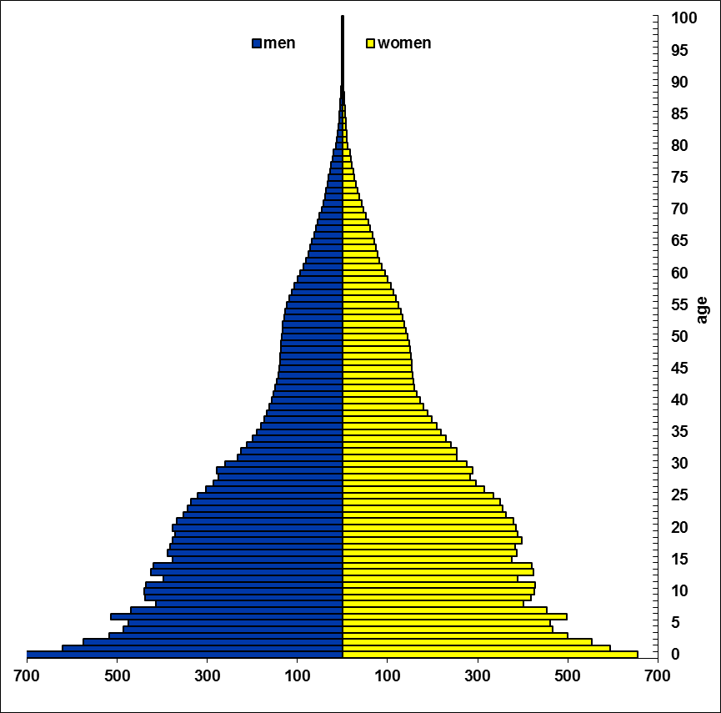
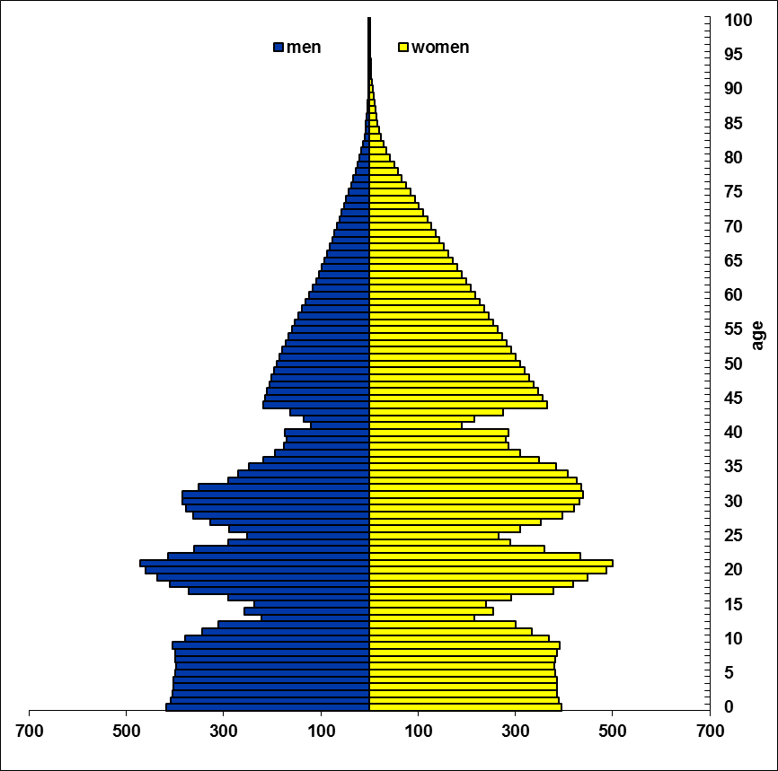
Age-sex pyramids
(modern borders, thousand)
1914
1959

Slide 10
Social catastrophes of the first part of the 20th century
Russian-Japanese war | 1904-1905
Cholera epidemics | 1910
World War I | 1914-1918
Revolutions and Civil War | 1917-1921
Famine | 1921-1923
Holodomor (Great Famine) | 1932-1934
Great Terror | 1937-1938
World War II | 1939-1945
Famine | 1946-1947

Slide 11
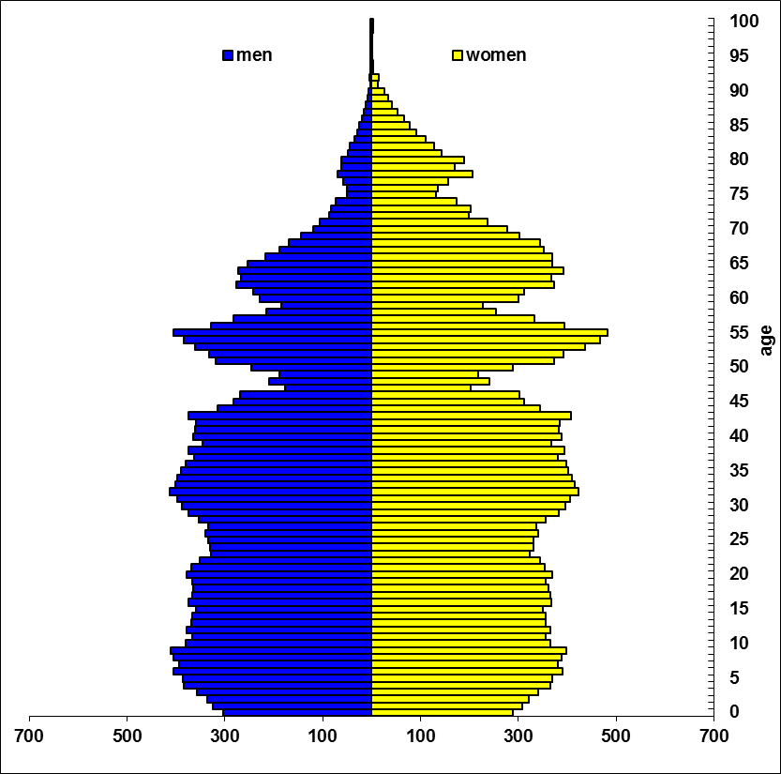
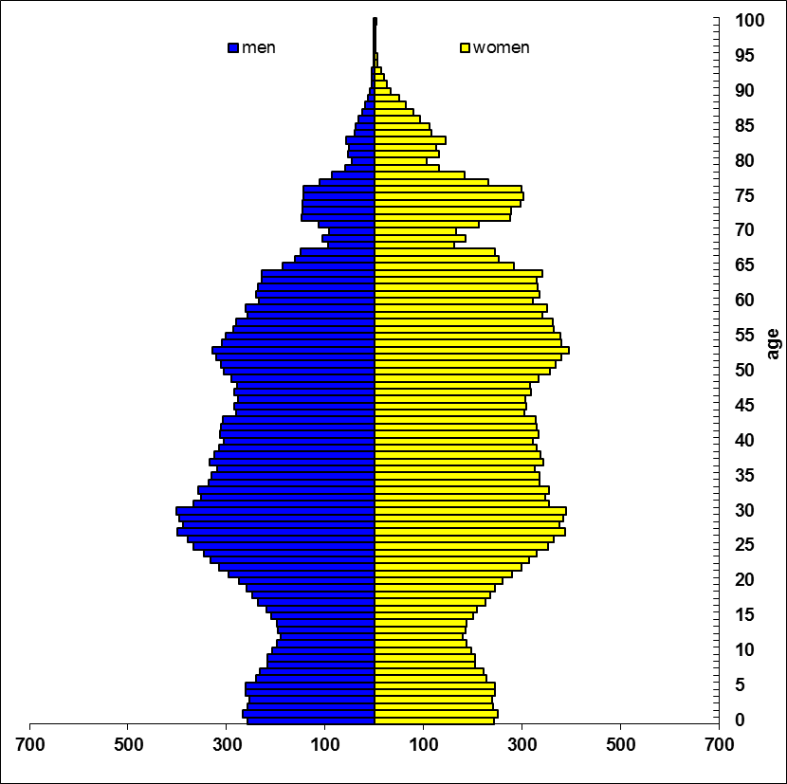
Age-sex pyramids
(modern borders, thousand)
1993
2014

Slide 12
Natural population movement, ‰
Source: State Statistics Service of Ukraine; Since 2014: excluding the temporarily occupied territories of the Autonomous Republic of Crimea, the city of Sevastopol and data calculated excluding Donetsk and Luhansk regions

Slide 13
Fertility

Slide 14
The birth rate is about the same as in Europe
The differences in reproductive behavior of urban and rural populations are quite significant
Over the past 25 years, the birth rate has decreased most noticeably among young (up to 20 years) womenin young (up to 20 years) and older (after 30 years) women; fertility in women 20-24 and 25-29 years, on the contrary, increased
After the “failure” at the end of the 1990s, the birth rate increased slightly, but in recent years it has decreased again
However, the similarity of the Ukrainian fertility rates with European ones is not grounds to count on their noticeable growth in the near future

Slide 15
Total Fertility Rate, 1897-2017

Slide 16
Total fertility rate
Source: State Statistics Service of Ukraine; Since 2014: excluding the temporarily occupied territories of the Autonomous Republic of Crimea, the city of Sevastopol and data calculated excluding Donetsk and Luhansk regions

Slide 17
Total fertility rate
Sourse: Eurostat

Slide 18
Age-specific fertility rates, ‰
Source: State Statistics Service of Ukraine; Since 2014: excluding the temporarily occupied territories of the Autonomous Republic of Crimea, the city of Sevastopol and data calculated excluding Donetsk and Luhansk regions

Slide 19
Most families with children in Ukraine are single-parent. The massive spread of one-childhood has become characteristic of the country during the Soviet Union, but during the years of independence, the process of reducing the rates of children's families continued, the spread of one-childhood, there was a significant reduction in the number of large families. In 2017, 75.9% of families with children were single-parent, and only 2.9% of families raised three or more children.
Distribution of households with children by the number of children,%
 | 2004 | 2010 | 2014 | 2015 | 2017
1 child | 65,7 | 73,7 | 76,0 | 75,6 | 75,9
2 children | 29,0 | 23,1 | 20,7 | 21,4 | 21,2
3 children | 3,8 | 2,8 | 3,0 | 2,4 | 2,5
4+ children | 1,5 | 0,4 | 0,3 | 0,6 | 0,4

Slide 20
The distribution of Ukrainian youth by the desirable number of children, %
 | As a result of the socio-demographic survey «Youth of Ukraine 2010» | According to the results of a sociological study of the situation of youth, 2016
Child free | 1,5 | 1,5
1 child | 14,9 | 16,8
2 children | 54,2 | 54,8
3 children | 11,9 | 10,2
4+ children | 2,0 | 1,7
Not determined | 15,5 | 15,0

Slide 21
Family values ​​are traditionally very important for Ukrainians, especially for young people

Slide 22
Mortality

Slide 23
In contrast to the trends in the birth rate, the mortality trends are almost the opposite of Europe
The positive shifts since 2005 do not guarantee the absence of a new deterioration
There is an unreasonably large difference in mortality between men and women, urban and rural populations
Particularly high mortality among men of working age
«Conservative» structure of death causes
There are powerful reserves of reducing mortality in Ukraine

Slide 24
Life expectancy at birth, years
Source: State Statistics Service of Ukraine; Since 2014: excluding the temporarily occupied territories of the Autonomous Republic of Crimea, the city of Sevastopol and data calculated excluding Donetsk and Luhansk regions

Slide 25
Infant mortality, ‰
Source: State Statistics Service of Ukraine; Since 2014: excluding the temporarily occupied territories of the Autonomous Republic of Crimea, the city of Sevastopol and data calculated excluding Donetsk and Luhansk regions

Slide 26
Life expectancy at birth, years

Slide 27
Life expectancy at 60, years
Source: State Statistics Service of Ukraine; Since 2014: excluding the temporarily occupied territories of the Autonomous Republic of Crimea, the city of Sevastopol and data calculated excluding Donetsk and Luhansk regions

Slide 28
Life expectancy at birth
Source: Eurostat

Slide 29
Life expectancy at birth, 2013
Source: Eurostat

Slide 30
Life expectancy difference of referent countries and Ukraine, 2013
 | Males |  | Females
 | at birth | at 60 | at birth | at 60
Russian Federation | -1.8 | -0.1 | -0.4 | 0.3
Kazakhstan | -1.5 | -0.7 | -1.9 | -1.0
Belarus | 0.9 | -0.2 | 1.6 | 0.7
Lithuania | 2.8 | 1.6 | 3.7 | 2.7
Latvia | 3.0 | 1.1 | 3.3 | 2.3
Bulgaria | 4.3 | 1.5 | 1.3 | 0.5
Hungary | 5.8 | 1.9 | 2.7 | 1.3
Estonia | 6.0 | 2.7 | 5.3 | 3.6
Slovakia | 6.8 | 5.7 | 3.8 | 4.9
Poland | 7.4 | 3.7 | 5.4 | 3.6
Germany | 11.4 | 5.8 | 6.6 | 4.4
France | 13.0 | 7.6 | 9.2 | 7.1
Spain | 13.6 | 7.4 | 9.4 | 6.8
Italy | 13.9 | 7.5 | 8.8 | 6.1
Sweden | 14.1 | 7.1 | 8.0 | 4.8
Switzerland | 14.6 | 8.1 | 8.9 | 6.3
Source: UN World Population Prospects, the 2015 Revision

Slide 31
Probability of death, 2013, ‰
 |  | Males |  | Females
 | q(20-60) | q(20-40) | q(40-60) | q(20-60) | q(20-40) | q(40-60)
Switzerland | 65.4 | 10.8 | 55.2 | 37.9 | 5.2 | 32.9
Sweden | 65.9 | 14.5 | 52.1 | 43.0 | 6.6 | 36.6
Italy | 67.7 | 11.3 | 57.1 | 38.8 | 5.3 | 33.7
Spain | 78.5 | 9.7 | 69.4 | 38.8 | 5.0 | 34.0
United Kingdom | 83.0 | 15.6 | 68.5 | 52.8 | 8.0 | 45.1
Germany | 92.1 | 12.9 | 80.3 | 50.6 | 6.5 | 44.4
France | 104.2 | 17.6 | 88.1 | 49.8 | 7.1 | 43.0
Czech Republic | 118.5 | 18.4 | 102.0 | 55.8 | 7.2 | 49.0
Slovakia | 154.3 | 21.3 | 135.9 | 64.9 | 8.3 | 57.1
Estonia | 167.4 | 34.7 | 137.5 | 65.9 | 10.9 | 55.5
Poland | 171.6 | 27.3 | 148.4 | 66.4 | 7.6 | 59.2
Hungary | 180.8 | 17.6 | 166.1 | 85.0 | 8.2 | 77.4
Bulgaria | 182.4 | 25.7 | 160.9 | 80.8 | 11.3 | 70.3
Latvia | 240.1 | 43.9 | 205.2 | 93.1 | 15.5 | 78.8
Lithuania | 262.6 | 57.5 | 217.6 | 89.8 | 15.1 | 75.8
Belarus | 271.3 | 56.5 | 227.7 | 94.1 | 17.1 | 78.3
Ukraine | 289.4 | 67.3 | 238.1 | 109.8 | 22.9 | 88.9
Source: UN World Population Prospects, the 2015 Revision

Slide 32
Ratio of death probability (Ukraine = 1000)
 |  | Males |  |  | Femals
 | q(20-60) | q(20-40) | q(40-60) | q(20-60) | q(20-40) | q(40-60)
Switzerland | 226 | 160 | 232 | 345 | 228 | 370
Sweden | 228 | 216 | 219 | 391 | 289 | 412
Italy | 234 | 168 | 240 | 353 | 232 | 379
Spain | 271 | 145 | 292 | 353 | 216 | 382
United Kingdom | 287 | 231 | 288 | 481 | 349 | 508
Germany | 318 | 192 | 337 | 461 | 284 | 500
France | 360 | 262 | 370 | 453 | 308 | 484
Czech Republic | 410 | 274 | 428 | 508 | 313 | 551
Slovakia | 533 | 316 | 571 | 591 | 360 | 642
Estonia | 579 | 516 | 577 | 600 | 476 | 625
Poland | 593 | 406 | 623 | 605 | 332 | 666
Hungary | 625 | 262 | 698 | 774 | 358 | 871
Bulgaria | 630 | 382 | 676 | 736 | 493 | 791
Latvia | 830 | 652 | 862 | 848 | 677 | 887
Lithuania | 907 | 855 | 914 | 818 | 660 | 853
Belarus | 938 | 841 | 956 | 857 | 744 | 881
Source: UN World Population Prospects, the 2015 Revision

Slide 33
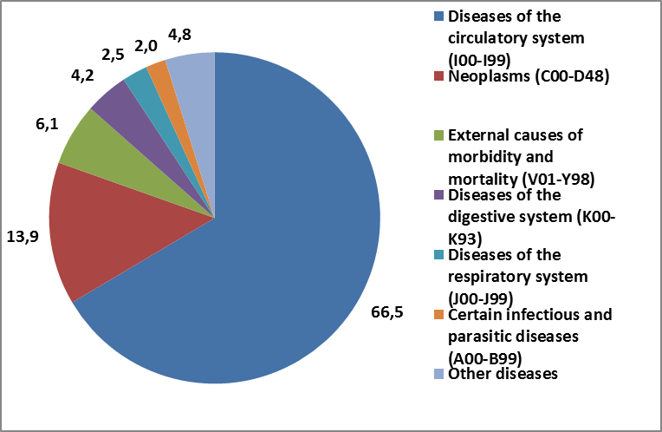
Cause-of-death structure of mortality, 2013

Slide 34
Migration

Slide 35
In-migration flows compensate a mortality excess over birth rate in developed countries. The situation in Ukraine is the opposite.
Net permanent migration is relatively small (except for some years), but net labor migration is much higher.
During 2014-2015 1,8 mln Ukrainians forcedly changed their place of residence

Slide 36
Net migration, ths
Source: State Statistics Service of Ukraine; Since 2014: excluding the temporarily occupied territories of the Autonomous Republic of Crimea, the city of Sevastopol and data calculated excluding Donetsk and Luhansk regions

Slide 37
Estimation of current, returned & potential migrants, 2016, ths
Source: Migration as an Enabler of Development in Ukraine. A study on the nexus between development and migration-related financial flows to Ukraine (2016). IOM in Ukraine. 116

Slide 38
Estimates of the total number of the Ukrainian labour migrants simultaneously working abroad range from 1.5 to 5.0 million persons. Considering the number of active taxpayers in Ukraine, the magnitude of unregistered employment and possible calculation errors, the most accurate estimate of the number of Ukrainians simultaneously working abroad would probably be 3.0 million persons.
The lowest estimates are traditionally made by the State Statistics Service that defines labour migrants as only those staying abroad for less than 1 year (others do not comply with the permanent population criteria of the country of origin and are considered emigrants): according to their data, during 2005-2008 there were over 1.1 million persons working abroad for under 1 year, during 2010-2012 – 1.2 million, during 2015-2017 – 1.3 million. The majority of other data sources do not pose such limitations; therefore, their studies produce higher estimates.

Slide 39
Structure of the Ukrainian labor migration by destination, %
Source: Labor migration survey

Slide 40
Migration is not a problem that needs to be solved, but a reality that needs to be considered and deployed
Migration is a key manifestation of the process of globalization, it is objective in nature and can hardly be stopped, at least in a democratic way
The emigration guidelines implemented (to a certain extent, and potential) are the most complete and accurate reflection of public sentiment:
  low evaluation of their own lives and the current situation in the country (region, settlement)
  despair and a vision of bad prospects for themselves, families and descendants
  persistent belief in the highest quality of life abroad
  demand for emigrants confidence in their ability to integrate into a new society (to find work, housing, learn a language, adapt to lifestyle, etc.)
  dissemination in the society of the guidelines for emigration (stationary, labor, educational)
An assessment of the consequences of large-scale migrations should be made from the position of the:
  migrant
  donor countries (region, settlement)
  recipient country (region, settlement)
  civilization in general

Slide 41
Monthly wages in 2016 (US$ by PPP 2011).
Source: ILO stat

Slide 42
A person who is dissatisfied with his life, social status and income hopes to improve his fate as a result of moving to a more developed society - migration is seen by many as a kind of "social lift”
Ukrainian society is divided according to the migration. The desire to change the place of residence is much more common than the actual move
Economic factors operate in a specific mental environment of a specific society (population group)
Poland is the leader of Eastern Europe in terms of the pace and quality of reforms, on the parameters of economic development in general, on the scale of migration, while Hungary, which is lagging behind in reforms, and in terms of living standards, and in terms of economic dynamics, does not demonstrate high mobility of the population

Slide 43
Public Sentiment on Migration,%
Source: Institute of sociology of the NAS of Ukraine

Slide 44
Consequences of large-scale migrations: the key to the economy and labor market of the sending country is the return / non-return of migrants
  Shortage of labor in local labor markets (first in separate occupations, and then in total deficit); brain drain
  Demographic aging, the burden on the working population
  An increase in depopulation, whose pace for a quarter century is the highest in Europe
  Remittances amounted to 9.3 billion dollars vs. 2.3 billion FDI (2017); it provides up to 4% of Ukraine's GDP (without taking into account the multiplier effect)
  Development of the financial and banking system (53% of households with long-term migrants have bank accounts, 44% - with short-term and 21% - without migrants)
  Returning migrants have experience of living in a democratic country and behavior in a market economy, new knowledge and experience (often acquired experience of communication, but not up-to-date skills - 36.1% worked in non-qualifying work (55 in Italy, 6%, in Poland - 45.6%, in the Czech Republic - 34.5%))
  Even with short-term returns, migrants affect the outlook and lifestyle of the immediate environment

Slide 45
Remittances, $ bln
Source: National bank of Ukraine, 2018

Slide 46
Projection

Slide 47
Main features of the future demographic situation
continuing depopulation
large-scale migration outflow
with the improvement of the economic situation, the formation of migration flows
low birth rate
reduced mortality, especially premature male mortality
aging

Slide 48
Population projection, calculated excluding the temporarily occupied territories of the Autonomous Republic of Crimea, the city of Sevastopol and data calculated excluding Donetsk and Luhansk regions, ths

