Slide 1
Soviet Americana: Russia’s Love-Hatred Relations with America and Ukraine
Sergei I. Zhuk

Slide 2
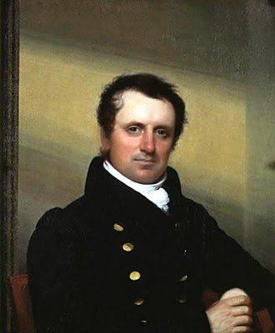
Romantic Fascination with America in Imperial Russia
James Fenimore Cooper (1789-1851)
In 1825-1832, all Cooper’s novels were translated in Russian and published in imperial Russia. Cultural fixation on American Indians (Native Americans) and pirates (privateers) in imperial Russia and the Soviet Union.

Slide 3
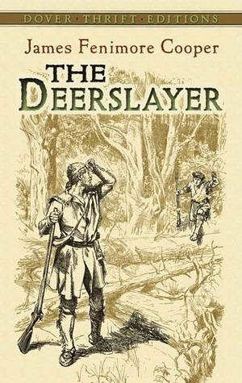
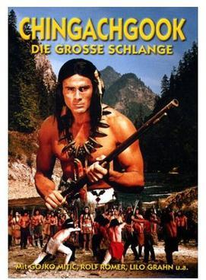
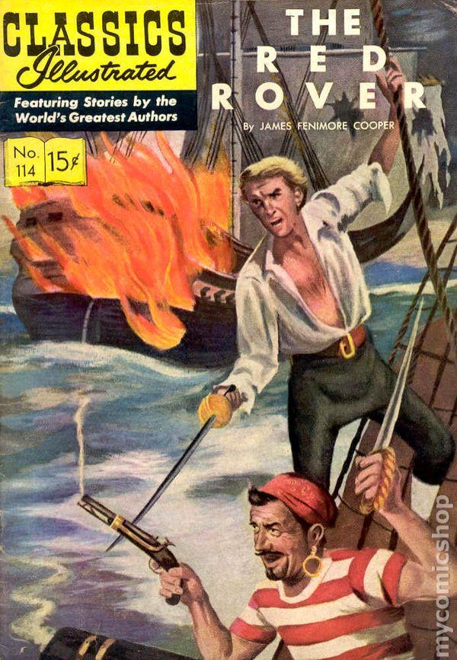

Slide 4
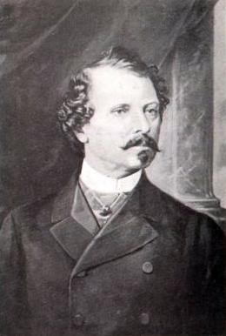
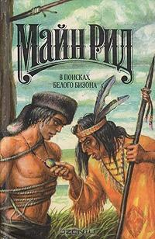
Romantic Fascination with America in Imperial Russia Cont.
Thomas Mayne Reid (1818-1883)

Slide 5
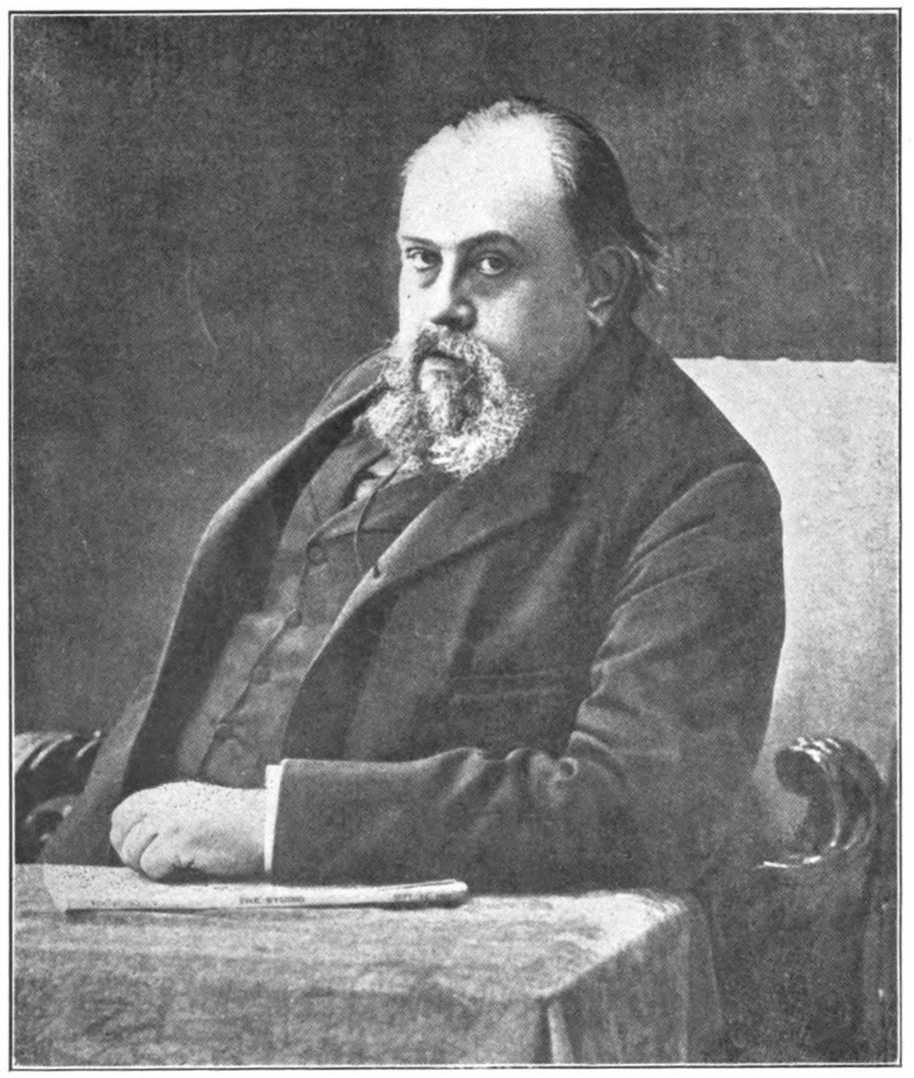
First Russian Studies of America
Maksim Kovalevsky (1856-1916)
Russian-Ukrainian historian who studied U.S. history.

Slide 6
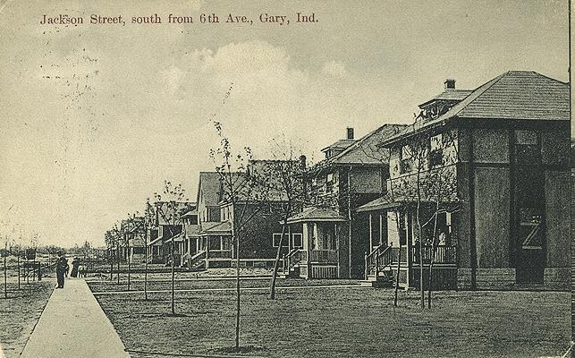
The United States as a Model of Modernity for Soviet Socialism
The company town of Gary, Indiana, as a model for the Urals steel town of Magnitogorsk. Stalin’s industrialization was completely modelled on American industrial projects, and assisted by the American businessmen and engineers.
The best examples of such models were Magnitogorsk and DneproGES in Zaporizhie, Soviet Ukraine

Slide 7
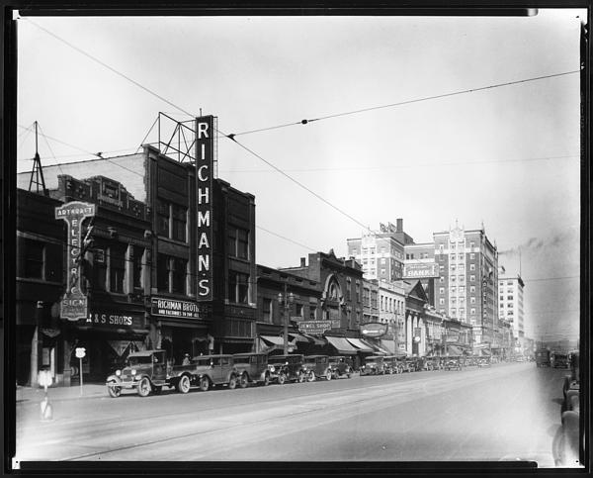
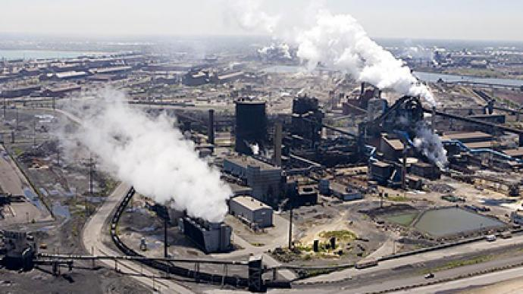
The United States as a Model of Modernity for Soviet Socialism Con.

Slide 8
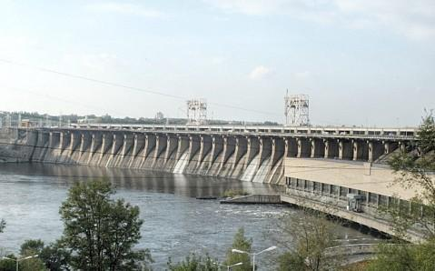
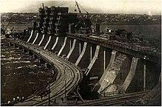
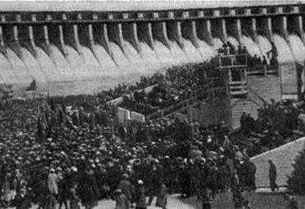
The United States as a Model of Modernity for Soviet Socialism Con.

Slide 9
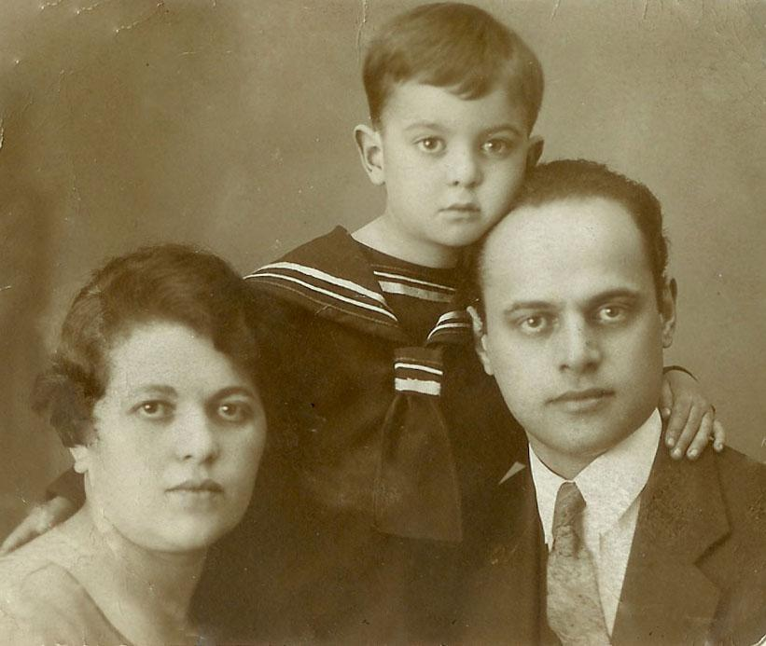
Stalinism produced the Soviet experts in studies of US history, politics, economy and culture
(known as Soviet Americanists)
The First Soviet “Stalinist” Americanists:
Jewish (American-Ukrainian-Russian) Communist Lev Zubok
Russian Orthodox Christian (from Russian nobility) Aleksei Efimov
Lev Zubok (1894-1967) with his family

Slide 10
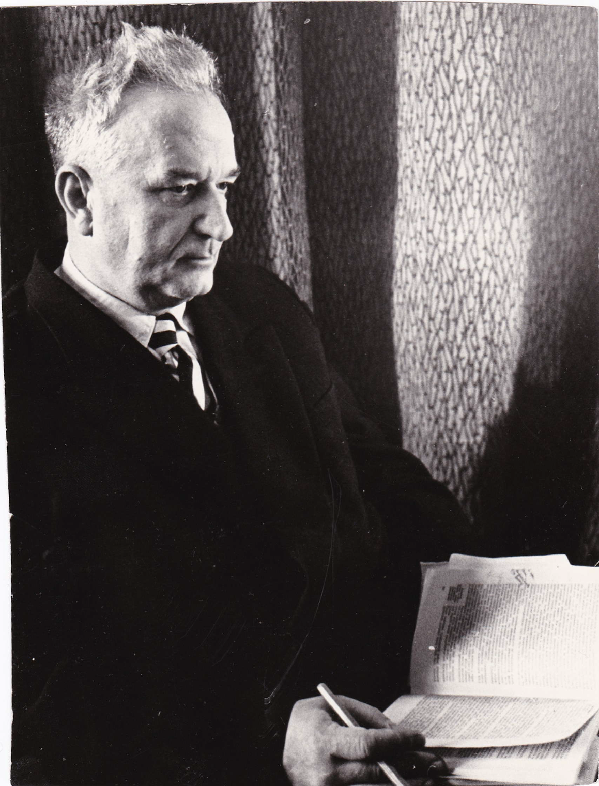
Aleksei Efimov (1896-1971), a pioneer of US history in Soviet Russia

Slide 11
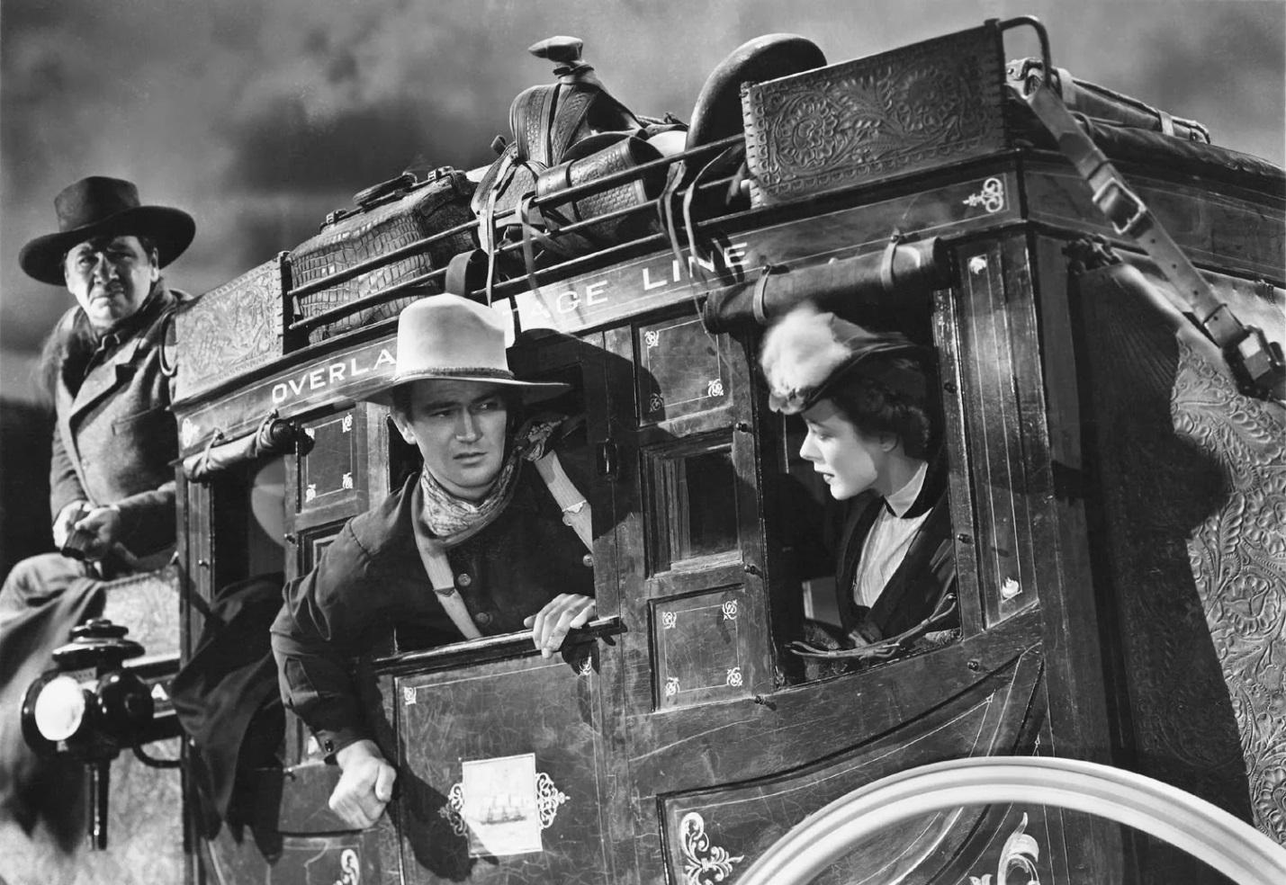
The First Wave of Americanization in the USSR after WWII
American “Trophy Films”
American Cultural Influences: American Western John Ford’s Stagecoach (1939) with John Wayne

Slide 12
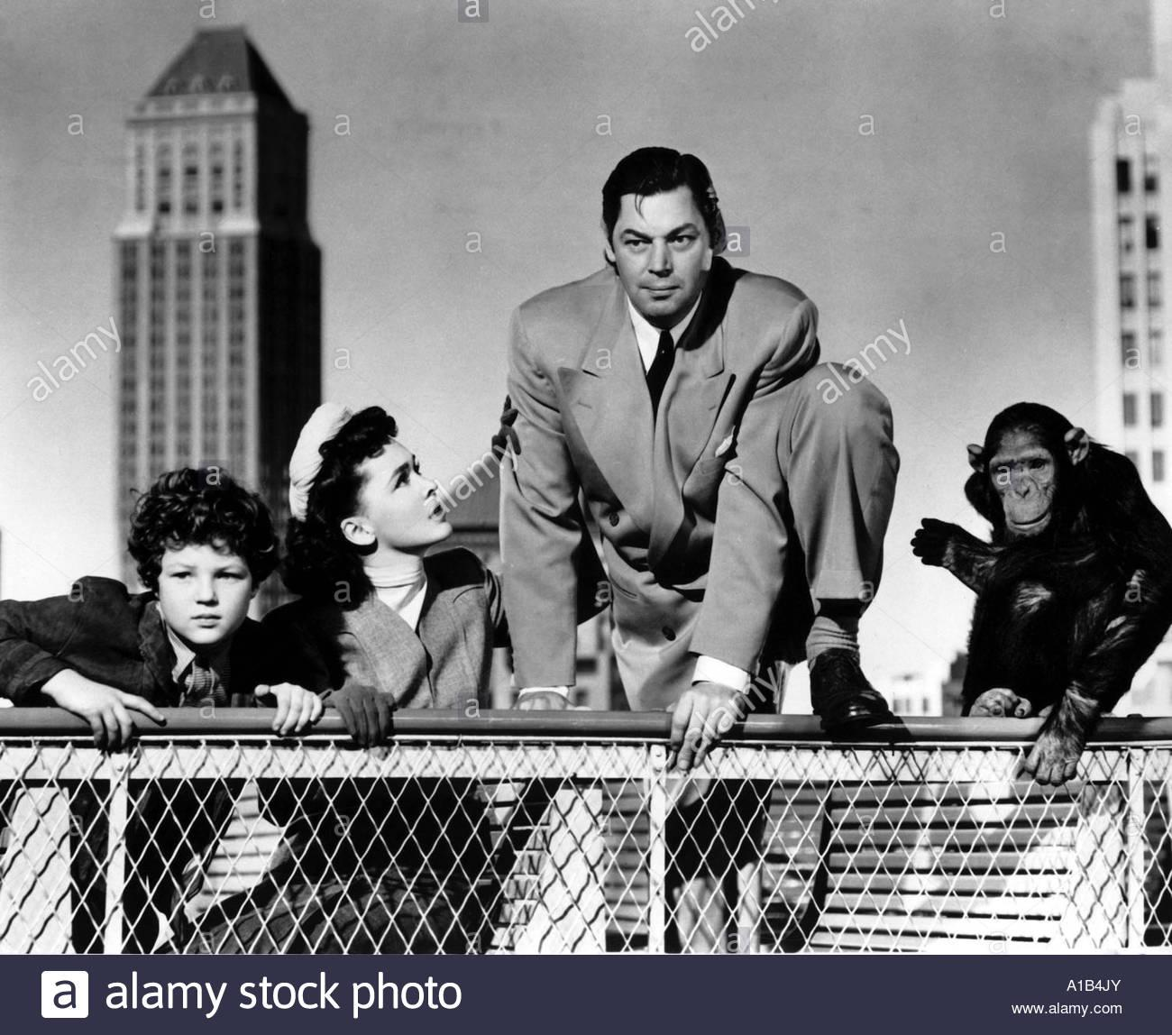
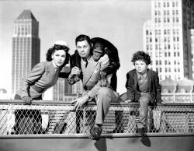
Cult (“trophy”) film for the Soviet Last Stalin’s Generation: Tarzan’s New York Adventure (1942)

Slide 13
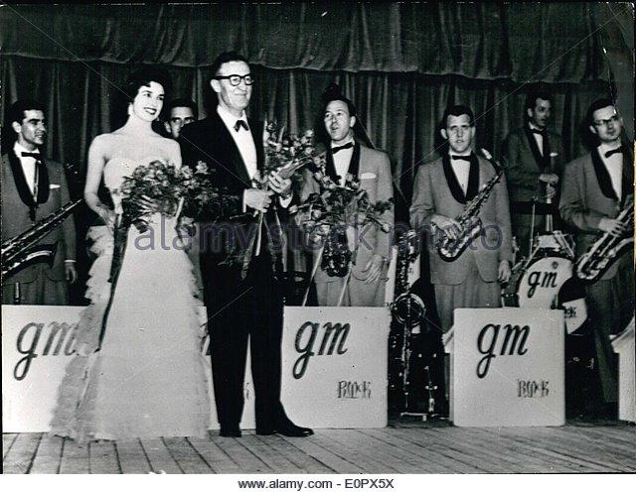
Glenn Miller Orchestra became a cult for the Soviet youth after another “trophy” film Sun Valley Serenade (1941)

Slide 14
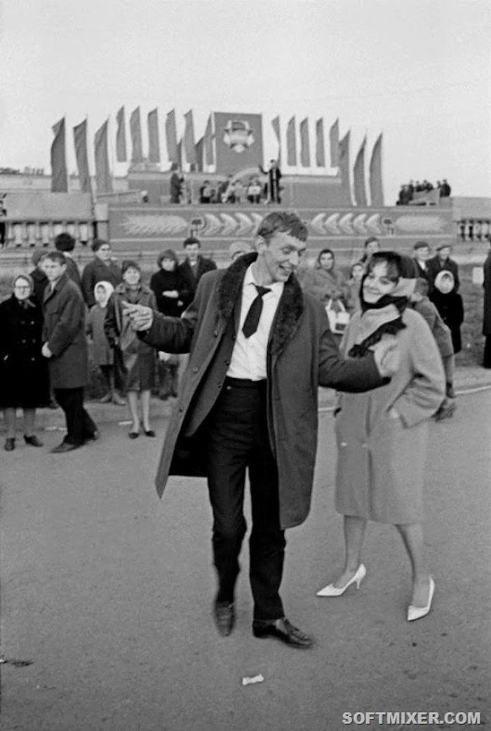
A few followers of American fashions became known (as early as 1949) as the “stylish boys and girls” – Stilyagi

Slide 15
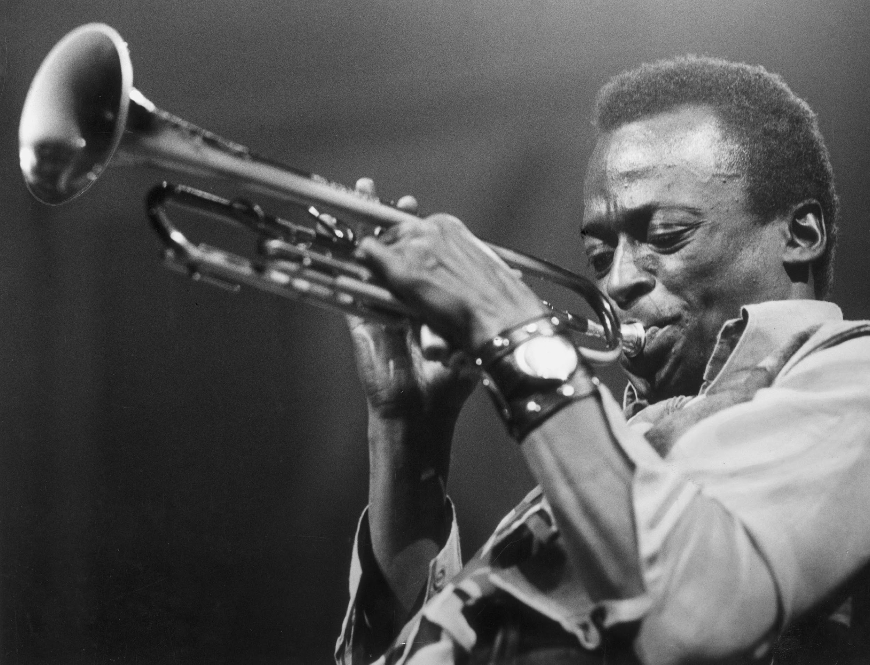
The Second Wave of Americanization in the USSR under Khrushchev (1953-1964)
Experimental American jazz became a point of “cultural fixation” for a Soviet youth in the 1950s, especially “cool jazz” of Miles Davis

Slide 16
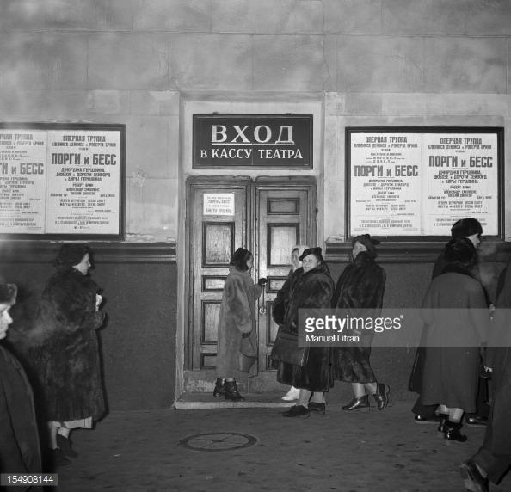
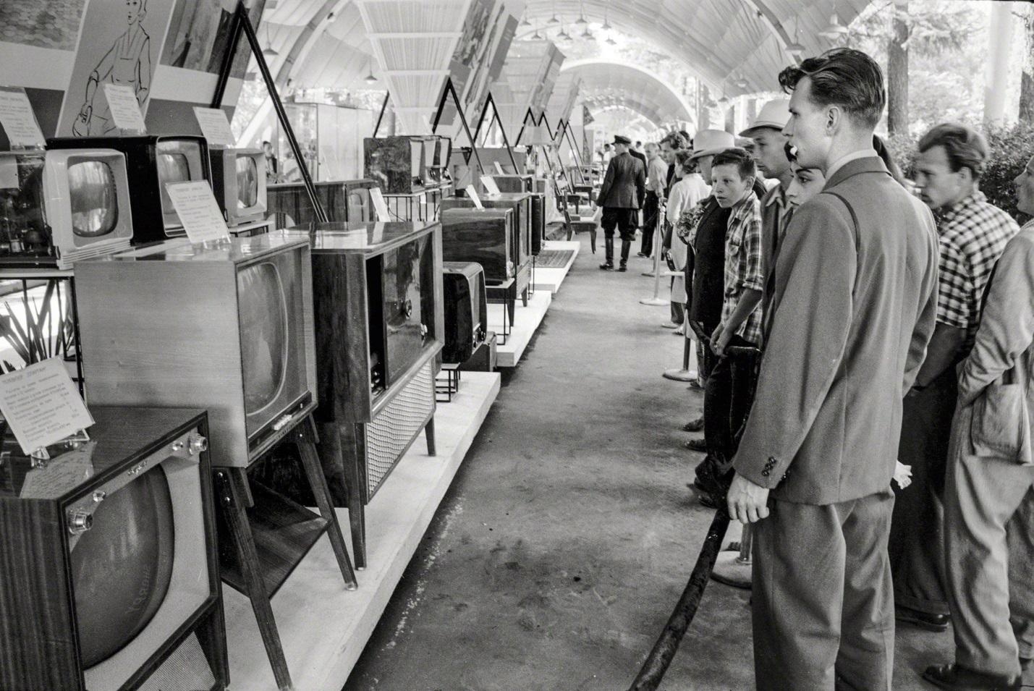
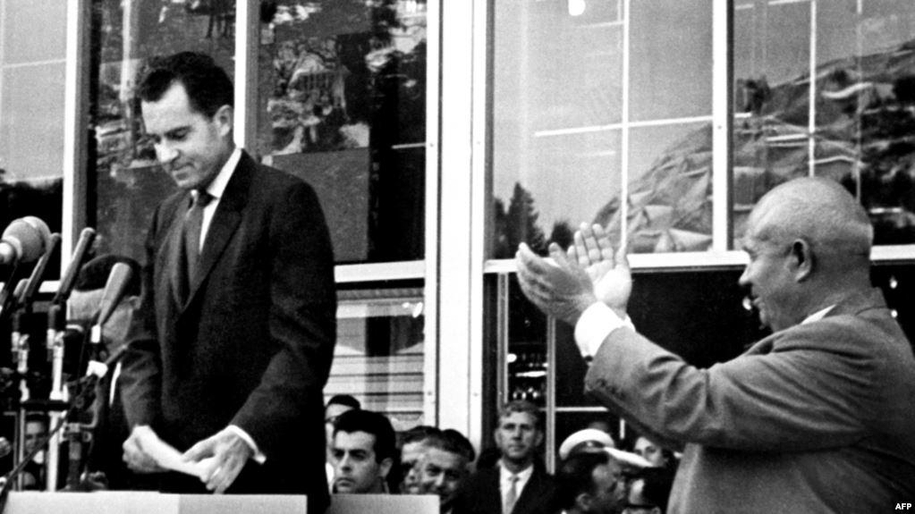
The USA Everyman Opera showed Porgy and Bess in Moscow in 1956
The American National Exhibition in 1959 in Moscow

Slide 17
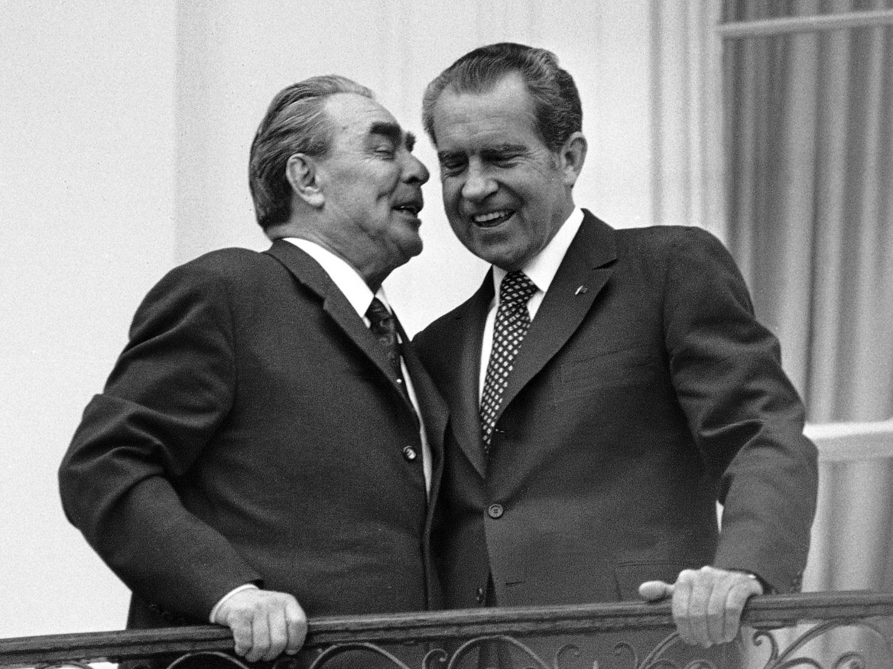
The Third Wave of Americanization in the USSR under Brezhnev (1964-1982)
Détente – Relaxation of International Tensions under Brezhnev and Nixon

Slide 18
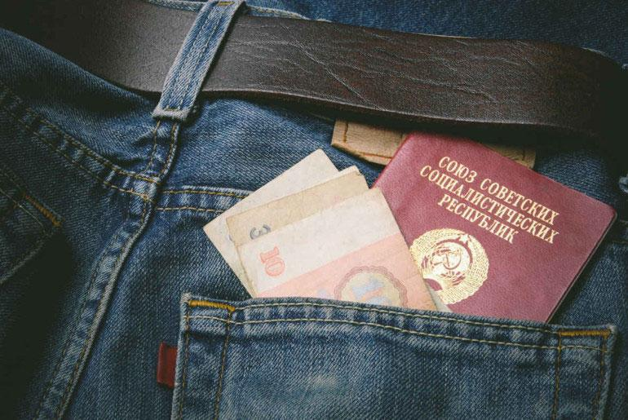
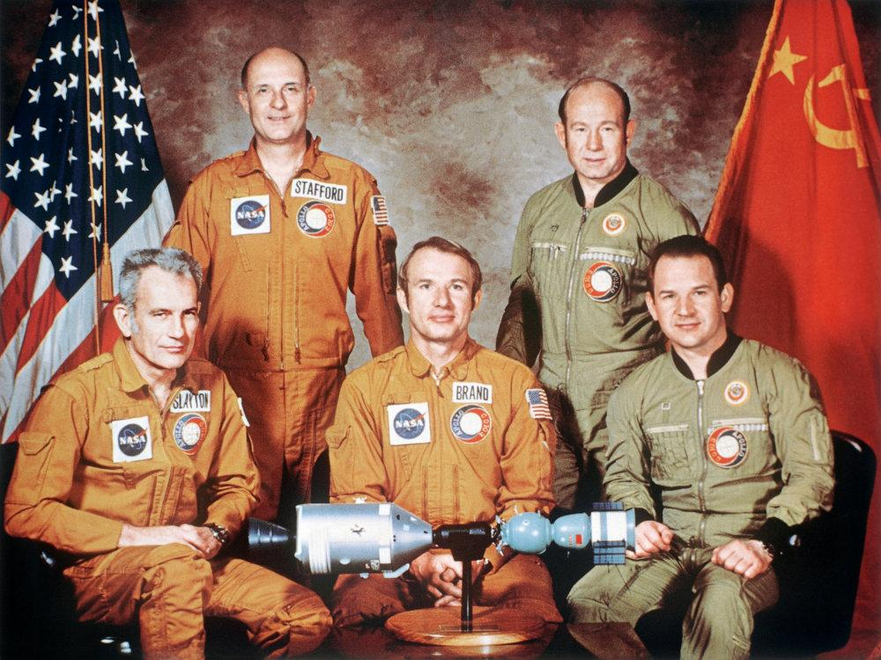
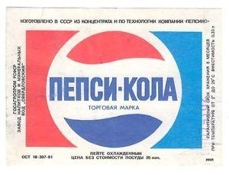
Soviet-American Cooperation in Space and in Food Industry:
Apollo Soyuz Project
Americanization of Soviet Fashions: American Jeans
Production of Pepsi-Cola in the USSR

Slide 19
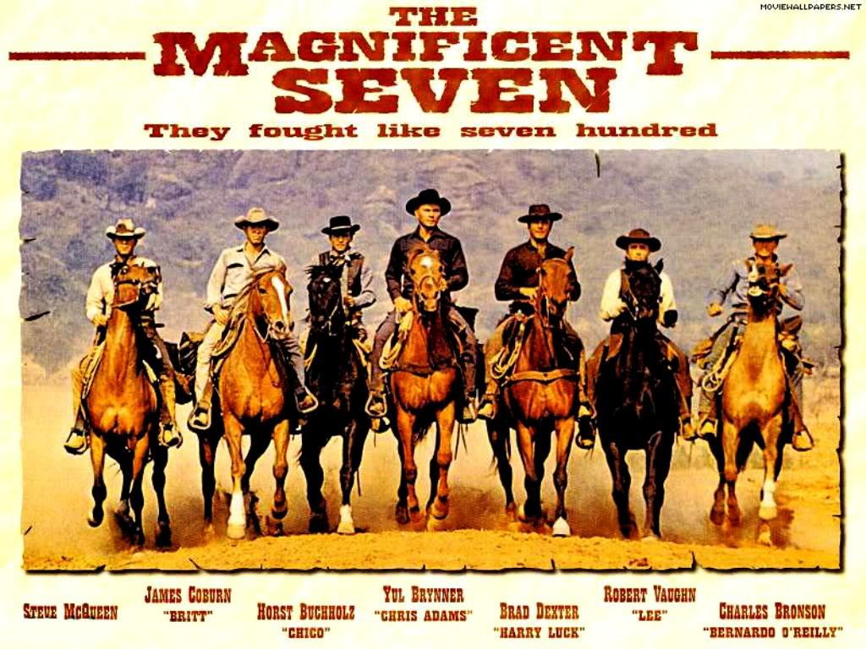
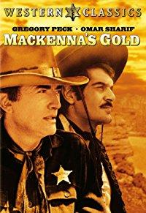
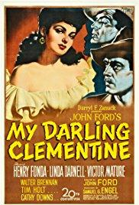
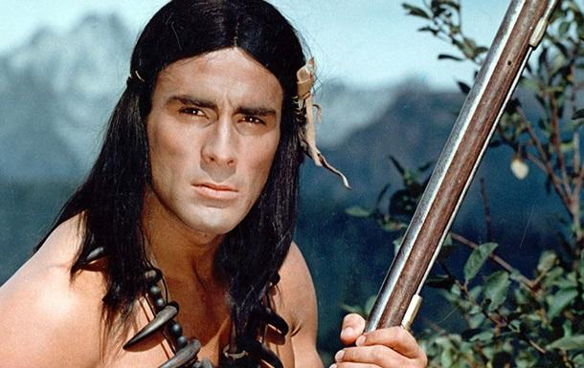
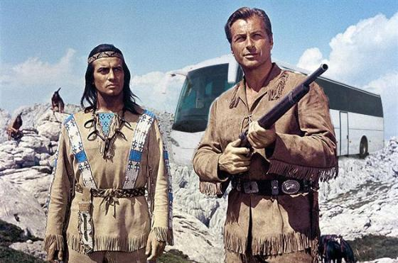
Cult of Western Genre in Soviet Cultural Consumption
Cult Western of 1962: The Magnificent Seven and Popular Westerns of the 1970s

Slide 20
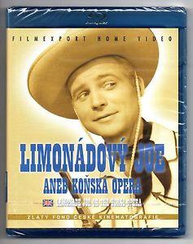
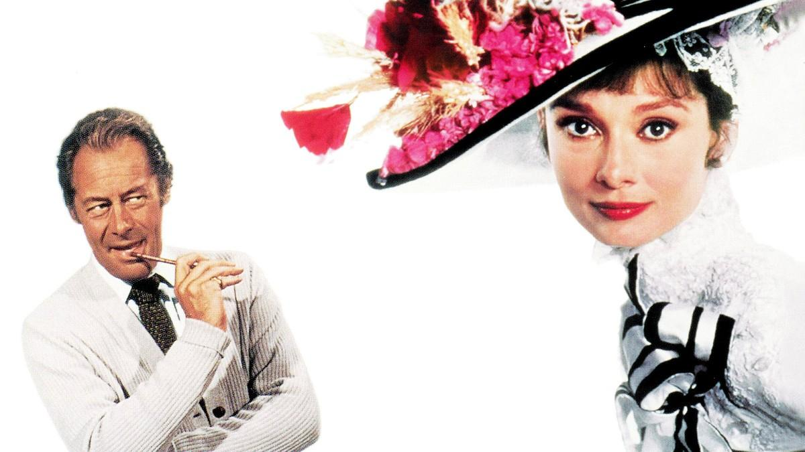
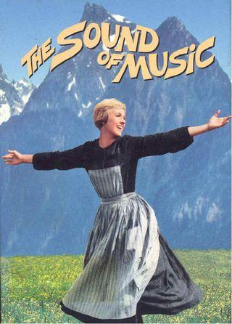
Musical: Another Popular Film Genre from the United States

Slide 21
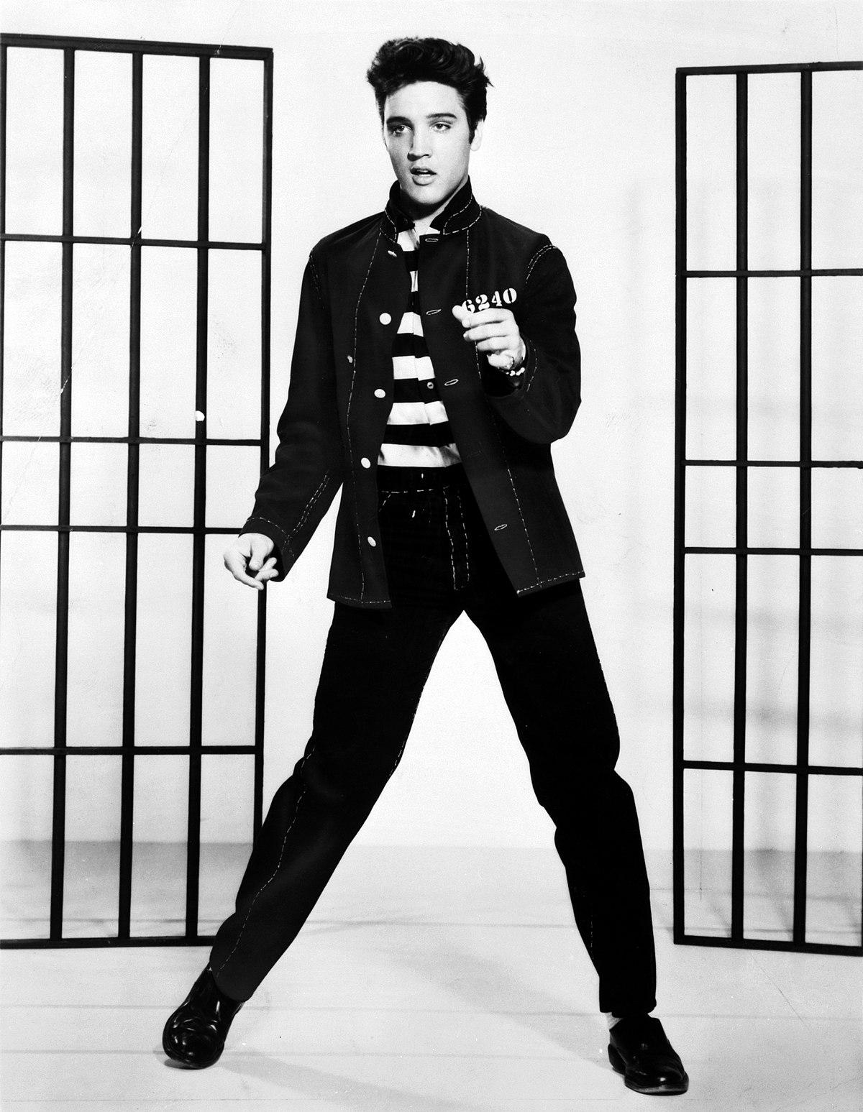
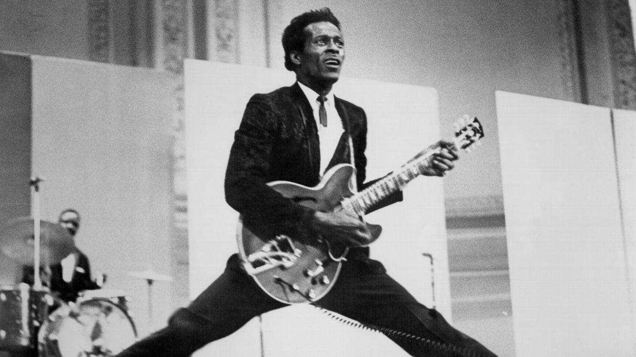
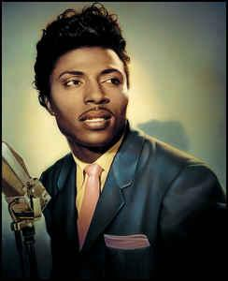
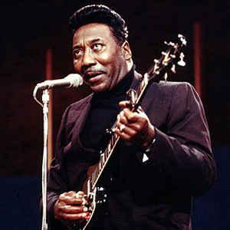
Popular Music: After 1958, American rock and roll gradually replaced jazz
The most popular American rockers in the USSR: Elvis Presley, Chuck Berry, Little Richard, Muddy Waters, and during the 1970s – Creedence Clearwater Revival and Grand Funk Railroad

Slide 22
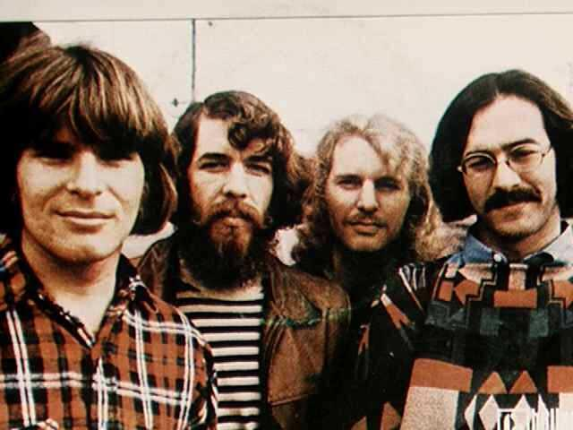
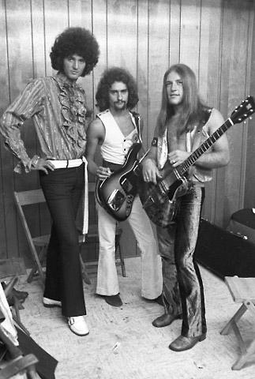

Slide 23
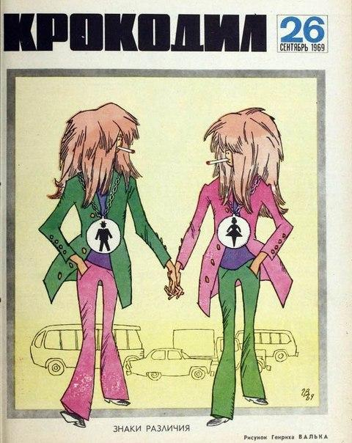
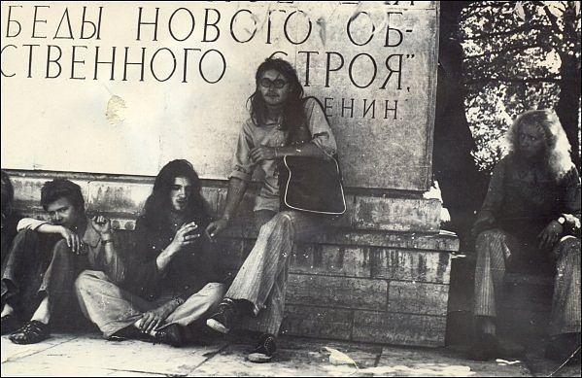
Soviet imitations of American hippies (1969-1975)

Slide 24
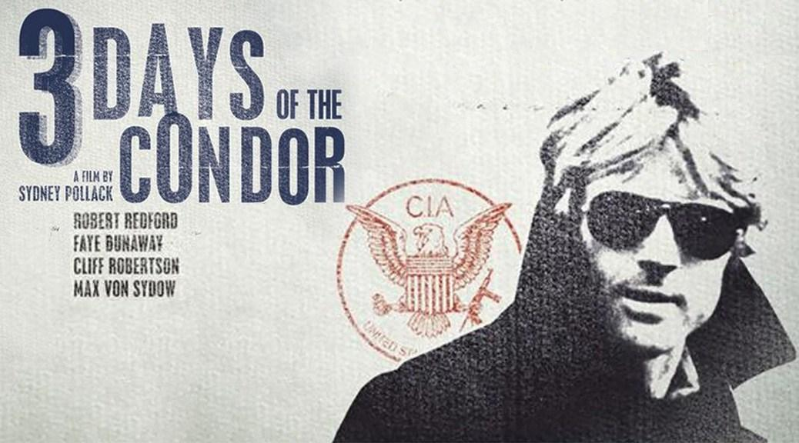
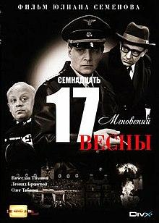
Unreliability of the United States as the Allies of the Soviet Union
Soviet TV-series Seventeen Moments of Spring (1972)
Three Days of the Condor (1975) as a proof of political corruption and CIA conspiracy

Slide 25
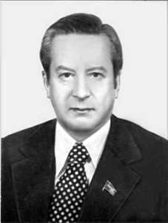
Soviet Americanists as Advisers and Researchers
Nikolai Inozemtsev (1921-1982), an IMEMO director (1966-1982)

Slide 26
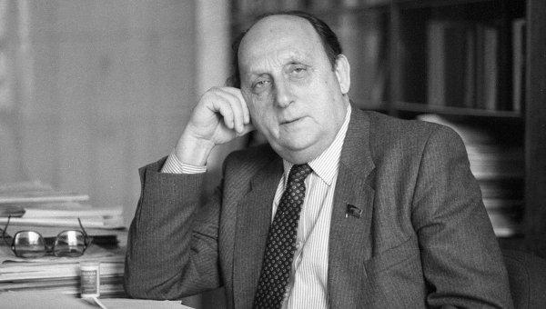
Georgii Arbatov (1923-2010), an ISKAN director (1967-1995)

Slide 27
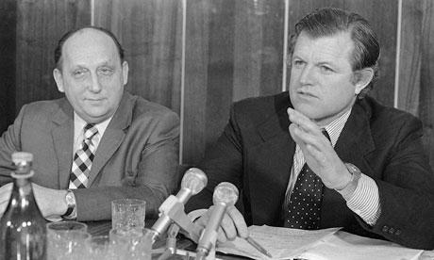
Arbatov and Edward Kennedy in 1973

Slide 28
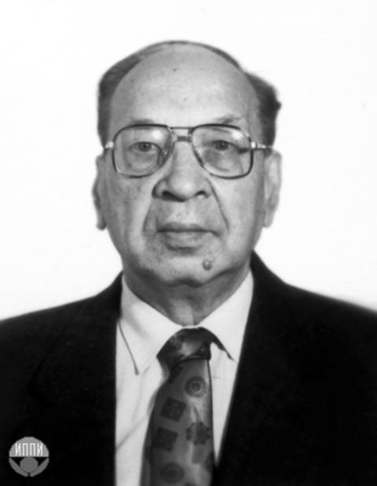
Grigorii Sevostianov (1916-2013), an official leader of a sector of US and Canadian History (1953) at the Institute of World History in Moscow (1968-1988), and non-official leader of the same sector, Nikolai Bolkhovitinov (1930-2008)
Nikolai Sivachev (1934-1983), a founder of the Americanist school at MGU in 1977

Slide 29


Nikolai Sivachev (1934-1983), a founder of the Americanist school at MGU in 1977

Slide 30


Aleksandr Fursenko (1927-2008), a founder of Leningrad school of Soviet Americanists
Arnold Shlepakov (1930-1996), a founder of Ukrainian school of Soviet Americanists in Kyiv

Slide 31
Leonid Leshchenko – Ukrainian Americanist (1931-2013)
I could remember Fursenko (from Leningrad), Sivachev, Dementiev and Krasnov (from Moscow), who traveled to the United States together with their Ukrainian colleagues, (and I met them sometimes during those trips), always distanced themselves from the Soviet Ukrainians, showing only condescension and disrespect to us, the scholars from Kyiv… Of course, I knew about Shlepakov’s official complaint regarding Fursenko’s and Sivachev’s Great Russian chauvinism and their anti-Semitism.

Slide 32

The first publication in the Soviet Union of Mario Puzo’s novel The Godfather in the Ukrainian journal Vsesvit in 1973-1974 (sponsored by Arnold Shlepakov)

Slide 33

This most popular publication during the détente era led to a cultural fixation on a history of Mafia. Together with Italian feature films by Damiano Damiani, it led to massive popularity in the USSR of a notion of Mafia as “organized crime” during the 1970s

Slide 34

Yulia Averkieva (1907-1980), a founding mother of Soviet Indianistika

Slide 35



Aleksandr Vashchenko and Soviet enthusiasts of Pow-Wow in 1981-986

Slide 36

Soviet historian Andrei Znamenski with American Indian in 1989

Slide 37

Valery Tishkov, a successor of Yulia Averkieva in the field of Native American history and culture

Slide 38




Post-Soviet American Studies in Russia
Vyacheslav Nikonov and Andranik Migranian – Valdimir Putin’s advisers
Andrei and Sergei Fursenko – personal friends of Vladimir Putin

Slide 39
Soviet Americana, Or How Russians Learned to Love and Hate America
Sergei I. Zhuk

