Slide 1
“European aspirations” versus “the Russian world”: opportunities and threats for Ukraine
Andrzej Szeptycki, University of Warsaw

Slide 3
EU model versus Russian model
EU
Russia
Peace
No military conflict since war in Algeria
Democracy and respect for human rights
Rule of law
Social market economy
Regional/cohesion policy
Internal and external military conflicts
Chechnya, Georgia, Ukraine, Syria
Authoritarian political system
Corruption
Oligarchisation, strong regional inequalities

Slide 5
EU model versus Russian model
EU
Russia
Weakness of European identity (growing Euroscepticism)
Brexit, Orban, Kaczyński)
International economic crisis and its consequences
Migration crisis
Tolerance, multiculturalism
Political stability & high social support for state authorities
Strong national identity supported by great power policy
Quick economic growth (until 2013)
“Traditional values”

Slide 7
EU policy versus Russian policy
EU
Russia
Cooperation based on EU values
Association agreement, DCFTA, visa free regime, financial aid
at least 16.5 billion EUR in 2014-2020
No membership perspective (⬄ colonialism?)
Ukraine as a part of the ”Russian world”: language, history, media, religion (⬄ empire)
Post-Soviet, authoritarian, undeveloped, corrupted…
From soft power to hard power (2014)

Slide 9
Assesment
EU
Russia
Positive, long-time consequences
Implementation of large part of EU law
”Central European” path of development
High political and economic costs
90 billion EUR (World Bank 2006)
Uncertain perspective
DCFTA implementation in 2017-2018: 41-52% (Ukrainian government)
Apparent attractiveness of the Russian model (until 2013)
”Life in Russia is better than in Ukraine” (Razumkov 2005)
Potentially easy implementation
Yanukovych presidency, 2010-2013
Negative consequences (in both cases)
Post-Soviet development (-2013)
War with Russia (2014-)

Slide 10
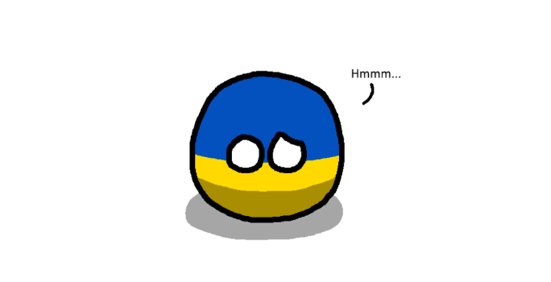

Slide 11
EU, Ukraine and Russia at a glance
 |  | EU | Ukraine | Russia
State | Democracy and human rights (Freedom House) | Free | Partly free | Not free
 | Corruption (Corruption Perception Index, 2018) | 42 – 88 | 32 | 28
Economy | Well-being (GDP per capita in thousand EUR, 2016) | 29 | 1.98 | 8.07
 | Economic growth (average for 2005 – 2016) | 0.7 | 0.1 | 2.64
Society | Social inequalities (Gini index, 2015-2016) | 25.4-37.7 | 25.5 | 37.7
 | Criminality (homicides per 100,000 people, 2016) | 0.3 – 4.5 | 6.2 | 9.2
 | Healthcare (% of people living with HIV (15–49 years) ) | 0.2 | 1.5 | 1.2

