Slide 1
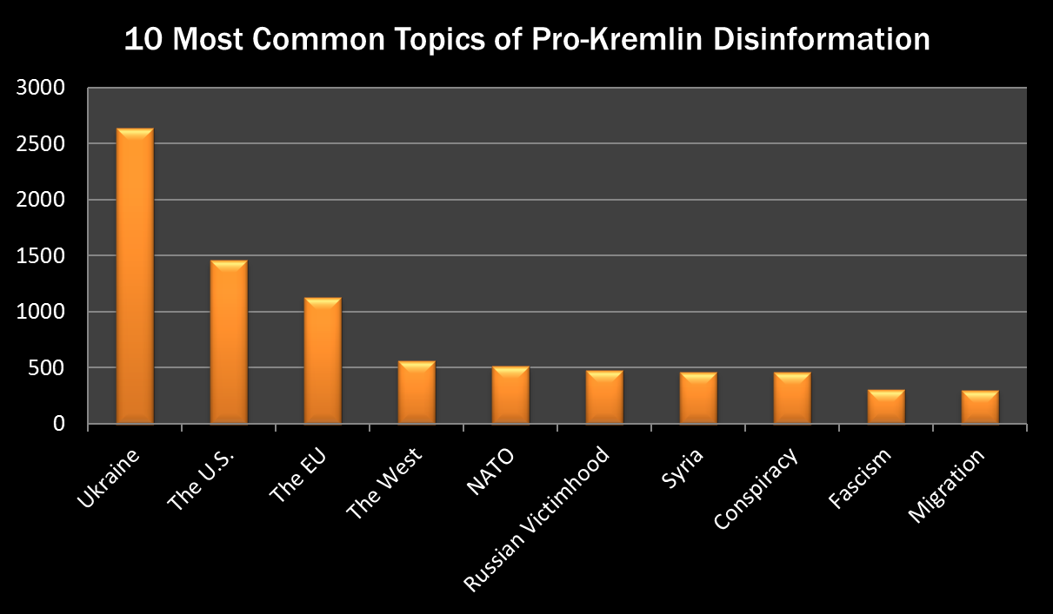

Slide 3
Monument to Kyiv Rus Grand Prince Volodymyr Unveiled in Moscow in 2016
Grand Prince ruled Kyiv Rus from 980-1015
Moscow was founded in 1147

