Slide 1
Nationalist Violence in Ireland and Ukraine: Contexts and Patterns
Róisín Healy
Dept. of History
NUI Galway
Ireland, Ukraine and Empire: Colonialism, Dependence, Conflict, 1800-2017
Kyiv, 14-17 November 2019

Slide 2
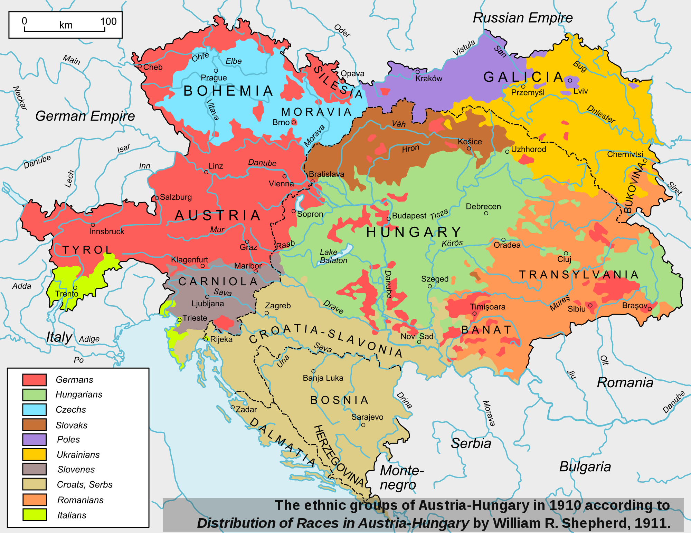

Slide 3
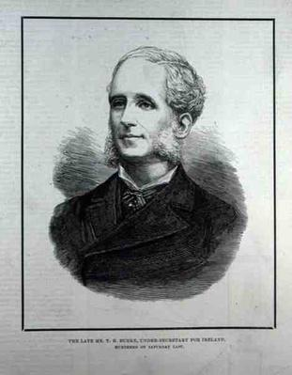
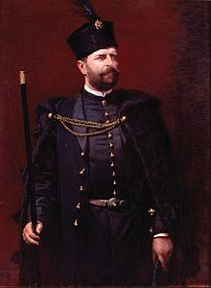
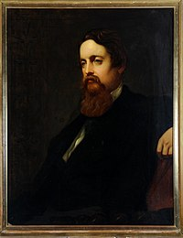
Potocki
Burke and Cavendish

Slide 4
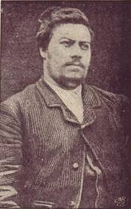
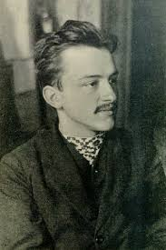
Joe Brady
Myroslav Sichynsky

Slide 5
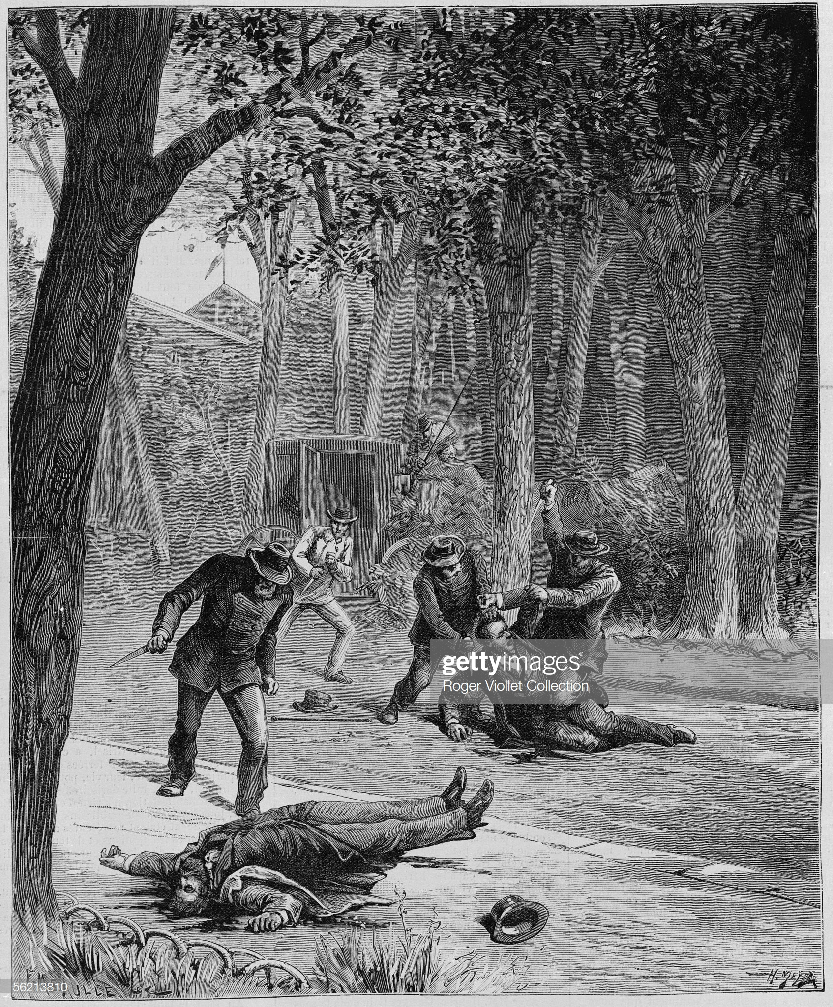

Slide 6
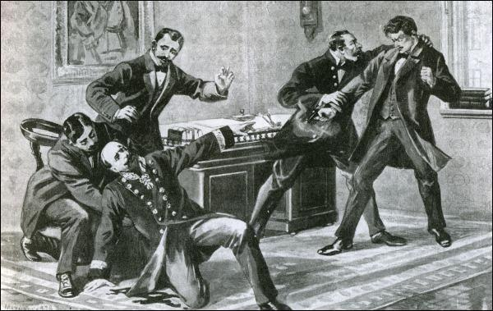

Slide 7
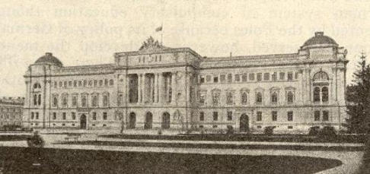

Slide 8
Joe Brady
Myroslav Sichynsky

Slide 9
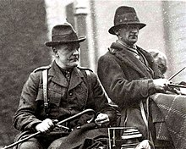
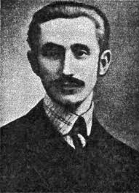
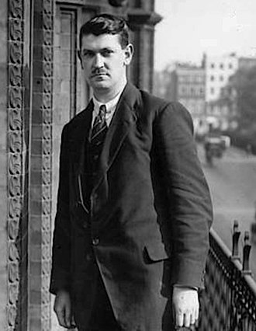
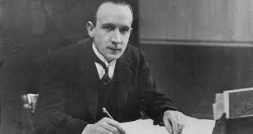
Sean Hales
Michael Collins
Kevin O’Higgins
Sydir Tverdokhlib

Slide 10
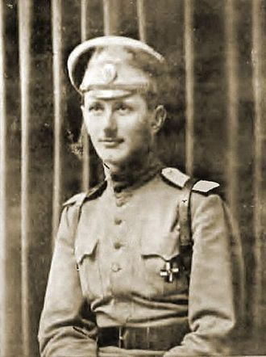
Wolodymyr Oskilko

Slide 11
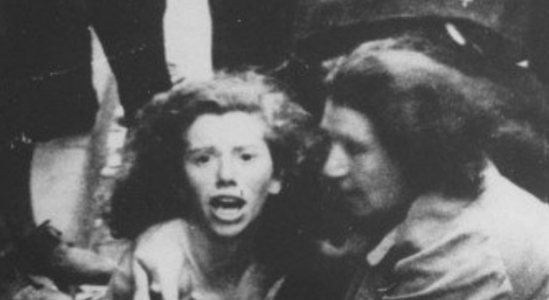
Attacks on Jews in Lviv, 1941

