Slide 1
INTERNATIONAL ACADEMIC CONFERENCE
IRELAND, UKRAINE AND EMPIRE:
DEPENDENCE. CONFLICT. MEMORY
2019, November 15–17
Kyiv, Ukraine
Demographic losses
of Ireland and Ukraine
Oleksandr Gladun
Ptoukha Institute for Demography and Social Studies
of the National Academy of Sciences of Ukraine
Evhen Kravchenko
Oles Honchar Dnipro National University

Slide 2
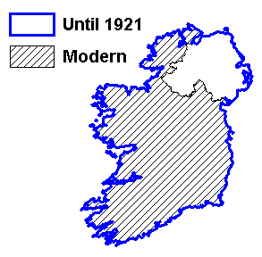
Borders of Ireland

Slide 3
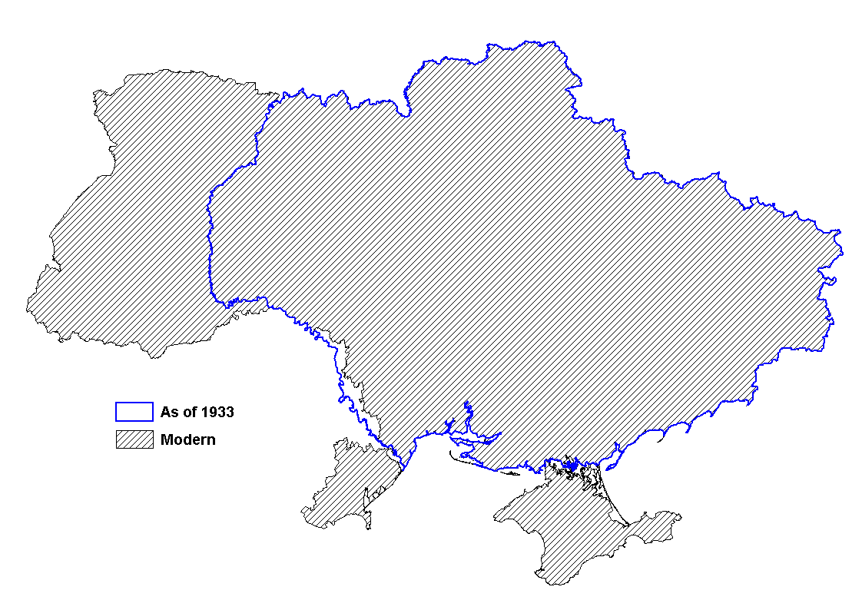
Borders of Ukraine

Slide 4
Structure of the demographic losses
Demographic losses:
direct losses:
excess deaths
migration losses
indirect losses (deficit of births)

Slide 5
Excess deaths
Excess deaths are estimated as the difference between the actual (reconstructed) numbers of deaths and its hypothetical numbers assuming there was no catastrophic event

Slide 6
Deficit of births
Deficit of births are estimated as the difference between the hypothetical numbers assuming there was no catastrophic event and actual (reconstructed) numbers of births

Slide 7
Number of emigrants from Ireland,
1841–1861, in 1,000s

Slide 8
Net migration in Ukraine,
1927–1938, in 1,000s

Slide 9
Demographic losses, in absolute numbers
 | Ukraine | Ireland
direct losses
excess deaths | 3,9 millions | 1 million
migration losses | net migration 183 thousands | emigration 1,2 millions
indirect losses (deficit of births) | 600 thousands | 300 thousands

Slide 10
Excess deaths in Ukraine,
1932 – 1934, per 1000 population

Slide 11
Age-sex structure of excess deaths,
Ukraine, 1932-1934, %

Slide 12
Demographic losses, relative to the population before the famine
 | Ukraine |  | Ireland
 | years | % | years | %
excess deaths | 1932-1934 | 13,0 | 1845-1849 | 12,1
migration losses | 1932-1933 | 0,4 | 1845-1854 | 14,5
deficit of births | 1932-1934 | 1,9 | 1845-1849 | 3,6

Slide 13
Population of Ireland,
1821–1914, in millions

Slide 14
Population of Ukraine,
1927–1959, in millions
Ukraine in borders as of 1933

Slide 15
Thank you!

