Slide 1
Revolution before Colour The Irish Republic and Ukrainian National Republic
Dr. Darragh Gannon

Slide 2
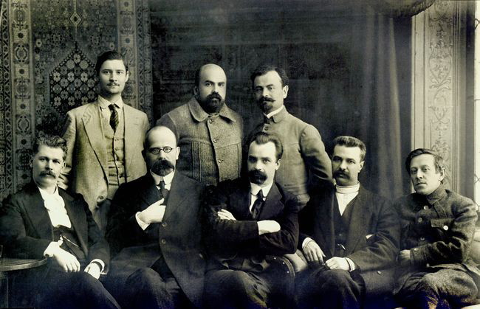
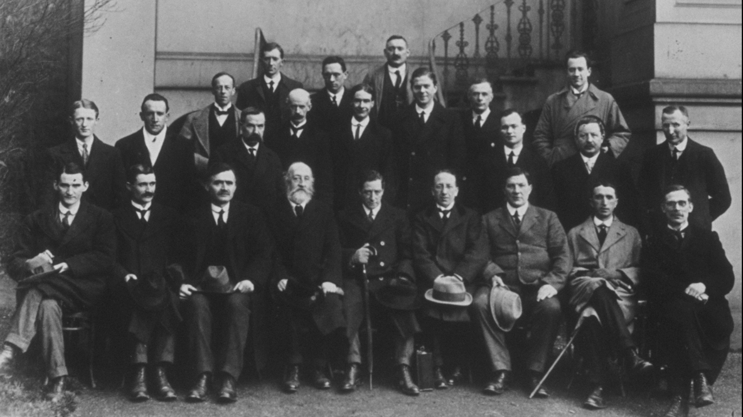
Revolutionary government in comparative perspective
The First General Secretariat of the Central Rada (1917)
Members of the first meeting of Dáil Éireann (1919)

Slide 3
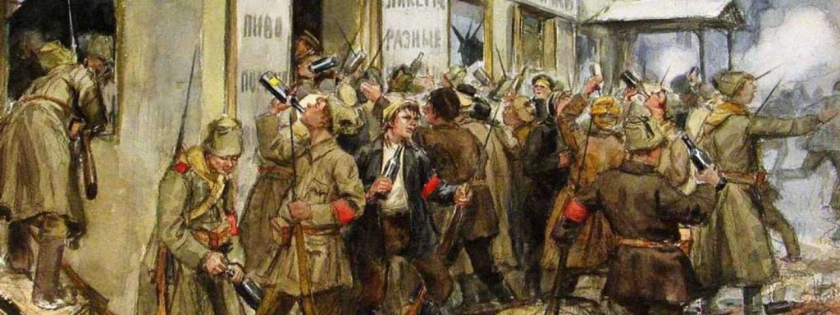
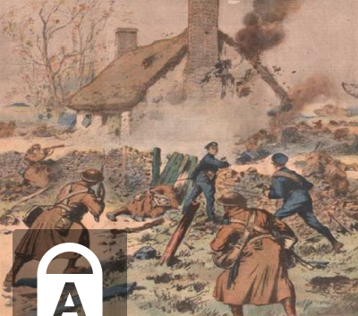
Revolutionary violence in comparative perspective
‘Between the “Whites” and the “Reds” (1920)
The Irish War for Independence (Le Monde Illustré)

Slide 4
Email: D. Gannon@qub.ac.uk
Twitter: @DGannon2016

