Slide 1
Factors affecting the health of the Slovak population Assoc. Prof. Dipl. Ing. Mária Vojtková, PhD. 26th Ukrainian-Polish-Slovak scientific seminar 8.- 9. October 2019, Kyiv
The role of statistics in the development of the modern economic systems

Slide 2
EHIS – source of data
The European Health Interview Survey (EHIS) aims at measuring on a harmonised basis and with a high degree of comparability among Member States (MS) the health status (including disability), health determinants (including environment) and use and limitations in access to health care services of the EU citizens.
The general coverage of the survey is the population aged 15 or over living in private households residing in the territory of the country.
EHIS was developed between 2003 and 2006. It consists of four modules on health status, health determinants, health care, and background variables.
The first wave of EHIS (EHIS wave 1 or EHIS round 2008) was conducted between 2006 and 2009 in 17 EU Member States as well as Switzerland and Turkey.
The second wave (EHIS wave 2 or EHIS round 2014) was conducted between 2013 and 2015 in all EU Member States, Iceland and Norway.

Slide 3
The aim of the presentation is to identify factors that affect human health in Slovakia. We will characterize human health based on the respondent's opinion whether he suffers from a long-term health problem – dependent variable. Selected health determinants will be independent variables.
Methods used:
logistic regression
decision trees
Both of these models will be created in the SAS EM 12.1 (Enterprise Miner)

Slide 4
Health determinants
Height and weight
Physical activity/exercise
Consumption of fruits, vegetables and juice
Smoking behaviour and exposure to tobacco smoke
Alcohol consumption
Social support
Provision of informal care or assistance (only in the second wave)
Illicit drug use (only in the first wave)
Environment (home and workplace exposures, criminality exposure) (only in the first wave).

Slide 5
Life expactancy in EU- 28 +

Slide 6
Life expactancy vs GDP in EU-28 +

Slide 7
Perceived healt status
SUB_STATE | Frequency | Percent | Cumulative Frequency | Cumulative Percent
1 | 1134 | 20.66 | 1134 | 20.66
2 | 2196 | 40.00 | 3330 | 60.66
3 | 1378 | 25.10 | 4708 | 85.76
4 | 620 | 11.29 | 5328 | 97.05
5 | 162 | 2.95 | 5490 | 100.00

Slide 8
Health problem by income

Slide 9
Selected variables from EHIS
Social-economic variables:
Sex
Age of respondent
Legal marital status
Highest level of educational attainment
Status of respondents in terms of employment
Health care - based variables:
Hospitalization in hospital over the last 12 months
Last visit in general (practice) doctor
The respondent could not afford drugs over the last 12 months on prescription
Life style-based variables:
The number of days a week the respondent is engaged in sports
Frequency of fruit consumption
Frequency of vegetable consumption
Frequency of alcohol consumption
The average number of cigarettes smoked per day
Genetic -based variables:
BMI (weight/height²)
General health condition perceived by the respondent

Slide 10
Process flow diagram in SAS EM 12.1

Slide 11
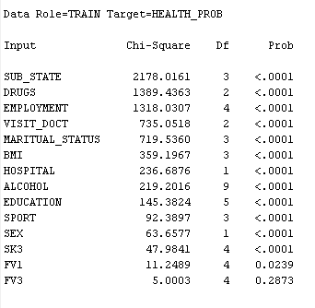
Node: StatExplore

Slide 12
Nodes: Data partition and Impute

Slide 13
Stepwise logistic regression
Testing Global Null Hypothesis: BETA=0
Test | Chi-Square | DF | Pr > ChiSq
Likelihood Ratio | 2256.1751 | 16 | <.0001
Score | 1876.4279 | 16 | <.0001
Wald | 915.1768 | 16 | <.0001
H₀: Model of LR is not significant
H₁: Model of LR is significant
H₀: βj = β0j = 0
H₁: βj ≠ 0
Summary of Stepwise Selection
Step | Effect |  | DF | Number In | Score Chi-Square | Wald Chi-Square | Pr > ChiSq
 | Entered | Removed
1 | SUB_STATE |  | 3 | 1 | 1503.8054 |  | <.0001
2 | DRUGS |  | 2 | 2 | 342.0971 |  | <.0001
3 | AGE |  | 1 | 3 | 91.1625 |  | <.0001
4 | VISIT_DOCT |  | 2 | 4 | 37.4329 |  | <.0001
5 | HOSPITAL |  | 1 | 5 | 9.8606 |  | 0.0017
6 | BMI |  | 2 | 6 | 13.1248 |  | 0.0014
7 | SEX |  | 1 | 7 | 9.1719 |  | 0.0025
8 | EMPLOYMENT |  | 4 | 8 | 14.8053 |  | 0.0051

Slide 14
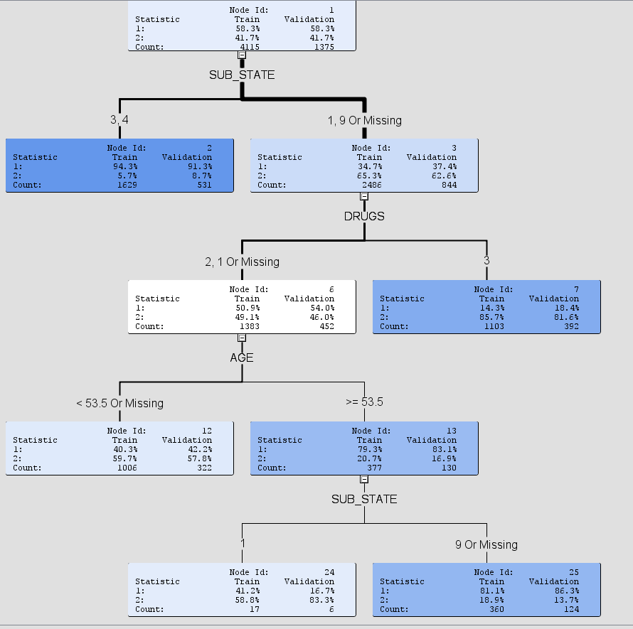
Node: Decision tree

Slide 15
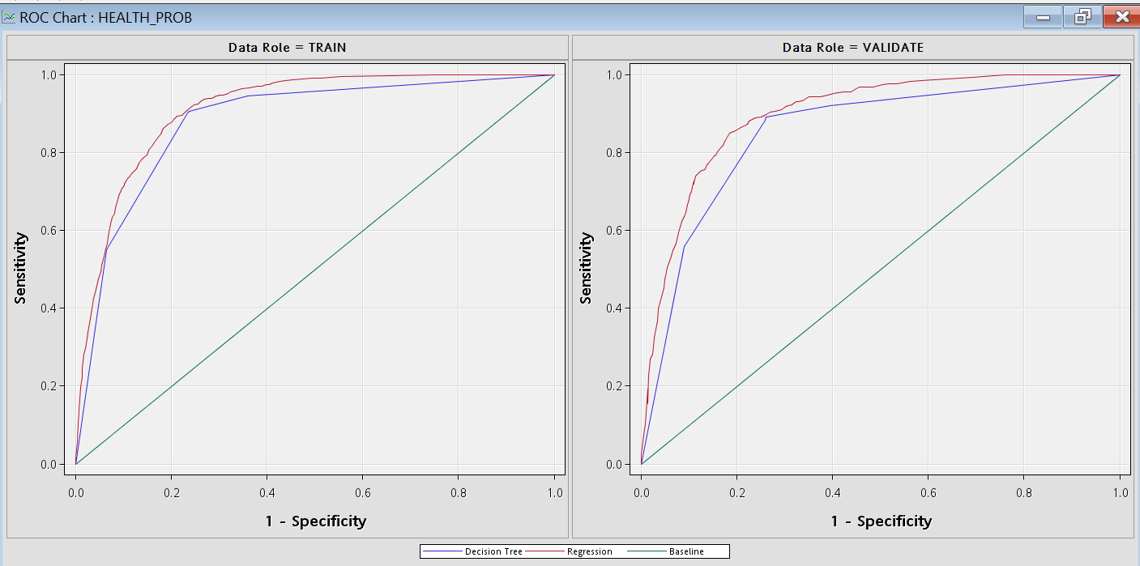
Model comparison

Slide 16
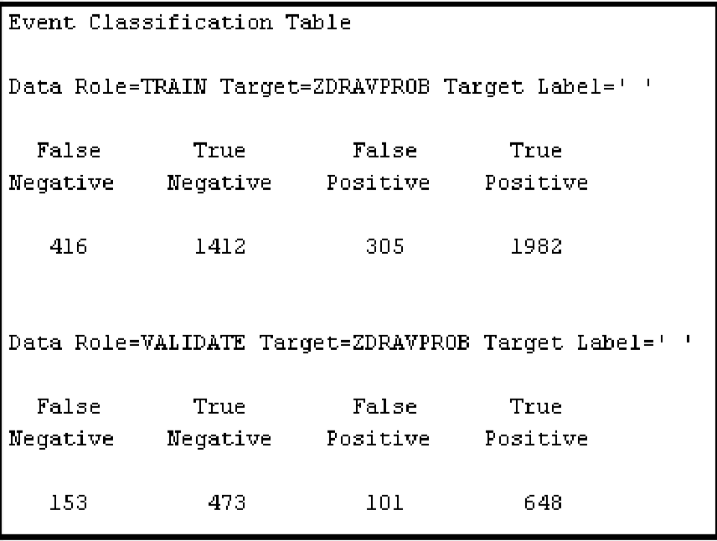
Evaluation of model LR
Total error = $\frac{FP+FN}{TP+TN+FP+FN}$ = $\frac{101+153 }{648+473+101+153}$ = 0,1847
Overall accuracy = $\frac{TP+TN}{TP+TN+FP+FN}$ = $\frac{648+473}{648+473+101+153}$ = 0,8153

Slide 17
Categories of selected variables

Slide 18
Results of model logistic regression
Analysis of Maximum Likelihood Estimates |  |  |  |  |  |  | Odds Ratio Estimates
Parameter |  | DF | Estimate | Standard | Wald | Pr > ChiSq | Effect | Point Estimate | 95% Wald
 |  |  |  | Error | Chi-Square |  |  |  | Confidence Limits
Intercept |  | 1 | -0,1873 | 0,3445 | 0,2958 | 0,5866
AGE |  | 1 | 0,0237 | 0,00558 | 18,1404 | 0,0001 | AGE | 1,024 | 1,013 | 1,035
SEX | 1 | 1 | -0,1491 | 0,0523 | 8,1349 | 0,0043 | SEX 1 vs 2 | 0,742 | 0,605 | 0,911
EMPLOYMENT | 20 | 1 | -0,3339 | 0,1357 | 6,0554 | 0,0139 | EMPLOYMENT 20 vs 99 | 1,018 | 0,771 | 1,343
EMPLOYMENT | 31 | 1 | 0,0567 | 0,2781 | 0,0416 | 0,8385 | EMPLOYMENT 31 vs 99 | 1,504 | 0,779 | 2,902
EMPLOYMENT | 32 | 1 | 0,0738 | 0,1888 | 0,1525 | 0,6961 | EMPLOYMENT 32 vs 99 | 1,530 | 1,072 | 2,183
EMPLOYMENT | 33 | 1 | 0,5548 | 0,2768 | 4,0175 | 0,0450 | EMPLOYMENT 33 vs 99 | 2,475 | 1,263 | 4,849
SUB_STATE | 1 | 1 | -2,5511 | 0,1812 | 198,1461 | 0,0001 | SUB_STATE 1 vs 9 | 0,209 | 0,150 | 0,293
SUB_STATE | 3 | 1 | 0,6594 | 0,1568 | 17,6943 | 0,0001 | SUB_STATE 3 vs 9 | 5,189 | 4,037 | 6,669
SUB_STATE | 4 | 1 | 2,8787 | 0,3856 | 55,7362 | 0,0001 | SUB_STATE 4 vs 9 | 47,741 | 17,437 | 130,708
HOSPITAL | 1 | 1 | 0,3175 | 0,0952 | 11,1236 | 0,0009 | HOSPITAL 1 vs 2 | 1,887 | 1,299 | 2,741
VISIT_DOCT | 2 | 1 | 0,0157 | 0,1475 | 0,0114 | 0,9151 | VISIT_DOCT 2 vs 9 | 0,562 | 0,447 | 0,706
VISIT_DOCT | 3 | 1 | -0,6086 | 0,2648 | 5,2809 | 0,0216 | VISIT_DOCT 3 vs 9 | 0,301 | 0,138 | 0,657
BMI | 1 | 1 | -0,1803 | 0,2481 | 0,5280 | 0,4674 | BMI 1 vs 9 | 0,965 | 0,463 | 2,010
BMI | 3 | 1 | 0,3245 | 0,1366 | 5,6416 | 0,0175 | BMI 3 vs 9 | 1,598 | 1,293 | 1,975
DRUGS | 1 | 1 | 0,426 | 0,2183 | 3,8065 | 0,0511 | DRUGS 1 vs 3 | 3,810 | 1,973 | 7,359
DRUGS | 2 | 1 | 0,4857 | 0,1202 | 16,3304 | 0,0001 | DRUGS 2 vs 3 | 4,044 | 3,231 | 5,062

Slide 19
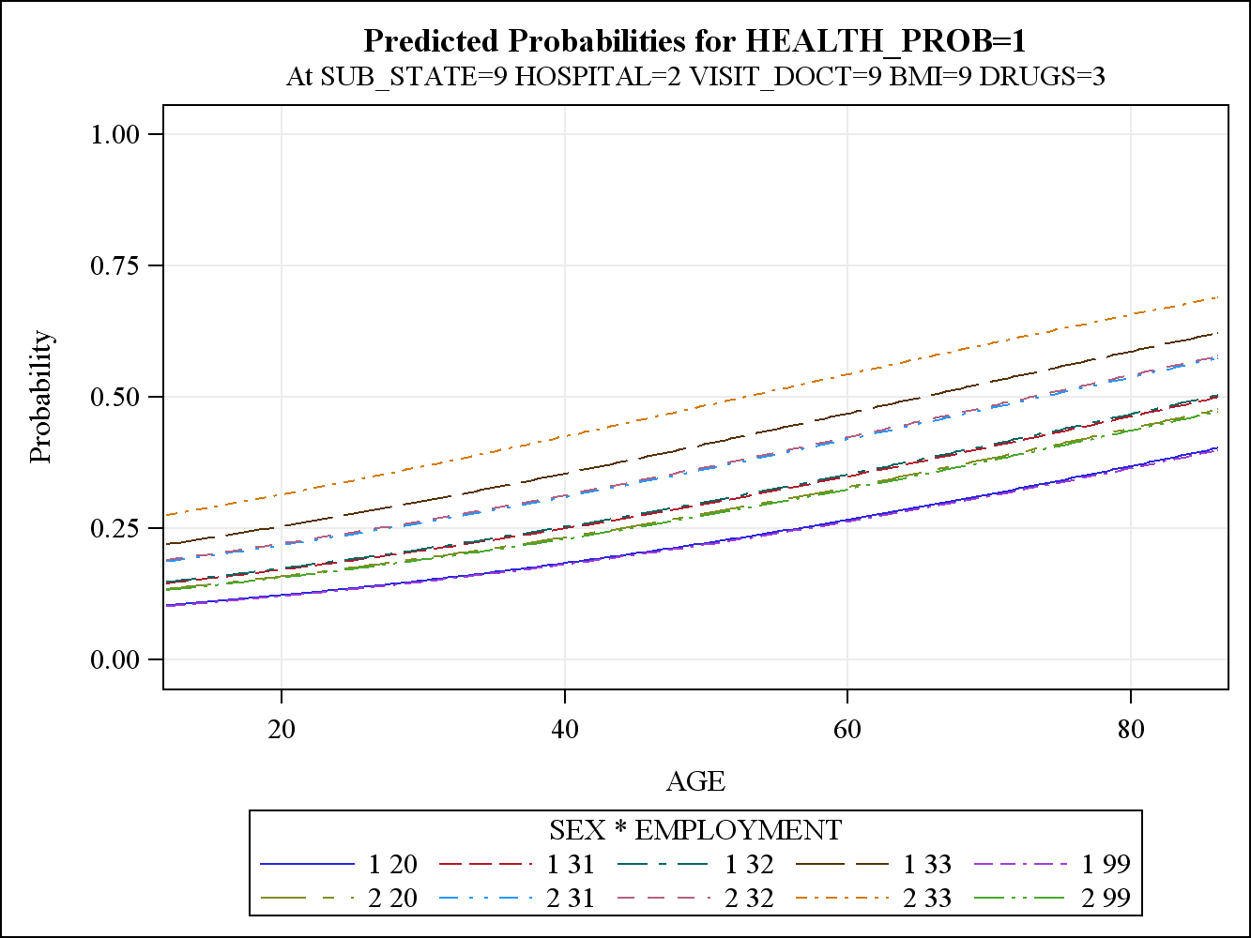
Simulated case

Slide 20
Conclusions
The highest risk that a person will suffer from a long-term health problem is in an older women who is in the category of employment other (doing housework, disabled, soldier), perceives her subjective condition as bad or very bad, visited the doctor less than 12 months ago , could not afford prescription drugs, she is overweight and obese.

Slide 21
Conclusions
Social-economic variables:
Sex
Age of respondent
Legal marital status
Highest level of educational attainment
Status of respondents in terms of employment
Life style-based variables:
are proved to be insignificant
Health care - based variables:
Hospitalization in hospital over the last 12 months
Last visit in general (practice) doctor
The respondent could not afford drugs over the last 12 months on prescription
Genetic -based variables:
BMI (weight/height²)
General health condition perceived by the respondent

Slide 22
Thank you for attention ...

