Slide 1
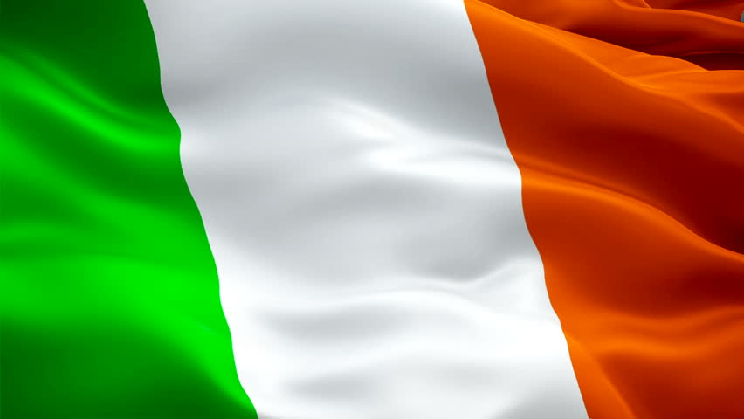
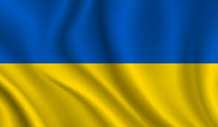
Ireland Ukraine & Empire Colonialism Dependence Conflict 1800-2017 Images of Self & Other in Irish and Ukrainian Famine Fictions (Kyiv 14-17 November 2019)

Slide 2
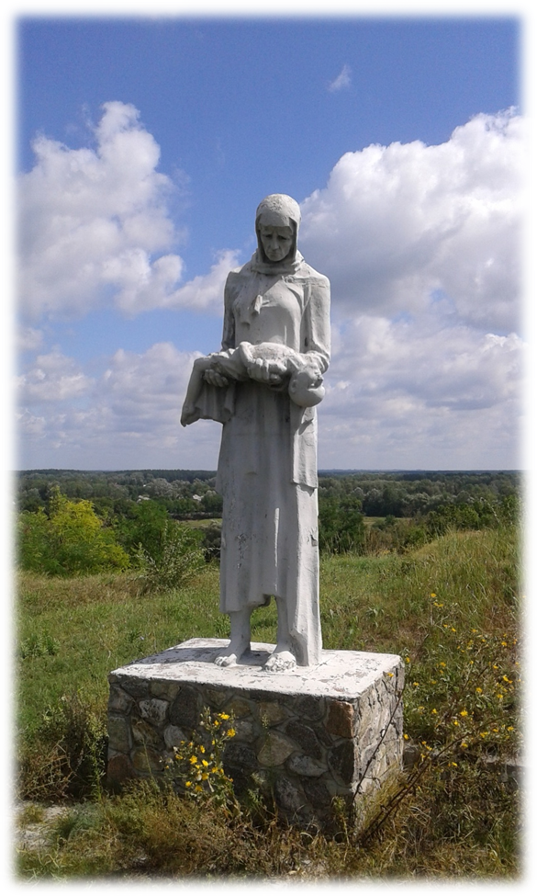
The Great Famines
An Gorta Mór (1845-1852)
the Holodomor (1932-1933)

Slide 3
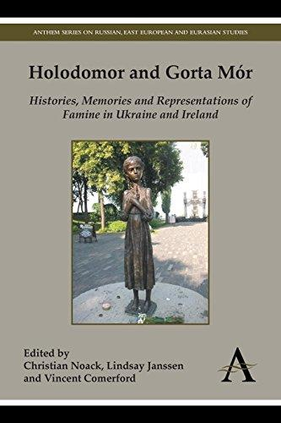

Slide 4
A Comparative Imagological Study of the Irish and Ukrainian Great Famines in Novels by Samchuk, Macken, Motyl and Mullen
Irish fiction: ‘books of fiction by Irish authors and foreign authors writing about Ireland or the Irish’*
Ukrainian fiction: books of fiction by Ukrainian and foreign authors writing about Ukraine or the Ukrainians.
*Rolf Loeber and Magda Stouthamer-Loeber quoted by Raphaël Ingelbien, in ‘Elizabeth Gaskell’s “The Poor Clare” and the Irish Famine’, Irish University Review, Vol. 40, No. 2 (Autumn/Winter 2010), pp. 1-19, p. 16.

Slide 5
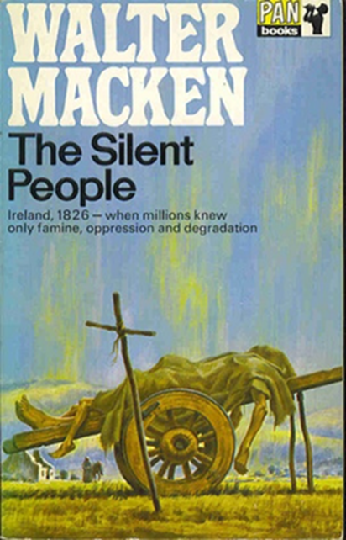
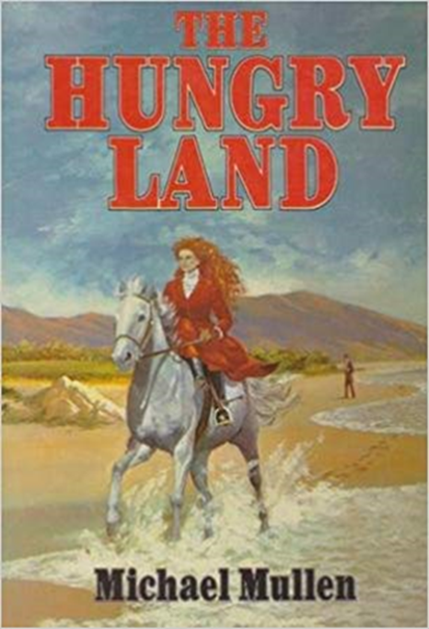
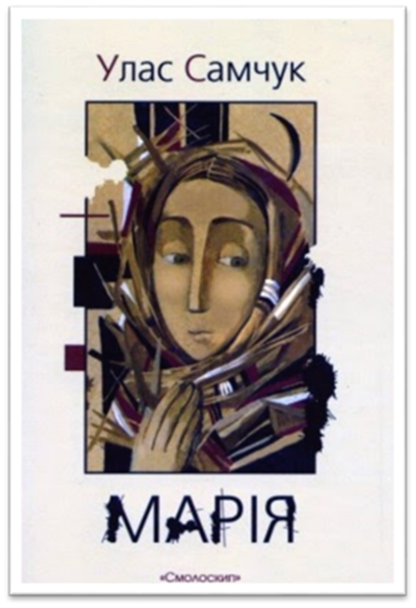
Images of Self & Other in Irish and Ukrainian Famine Fictions

Slide 6
Features within narrative texts that emphasize cultural differences between the Self and the Other:
the adoption of a specific stance common to a certain genre and deployment of a narrative voice appropriate to the content;
2) the deployment of semanticization of space;
3) a suitable choice of character constellation;
4) the right choice of plot.

Slide 7
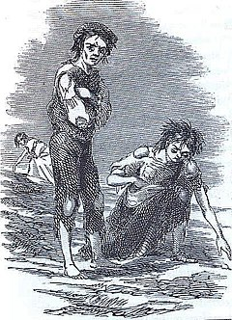
the adoption of a specific stance
‘Time and poverty and the feeling of that he was on the forgotten edge of Europe had destroyed all his hopes.’
(The Hungry Land: 7)
We are the silent people.
How long must we be still,
to nurse in secret at our breast
an ancient culture?
Let us arise and cry then;
Call from the sleeping ashes
of destiny a chieftan who
will be our voice.
He will strike the bras
and we will erupt
from our hidden caves
into the golden light of new-born day.
(The Silent People: 5)

Slide 8
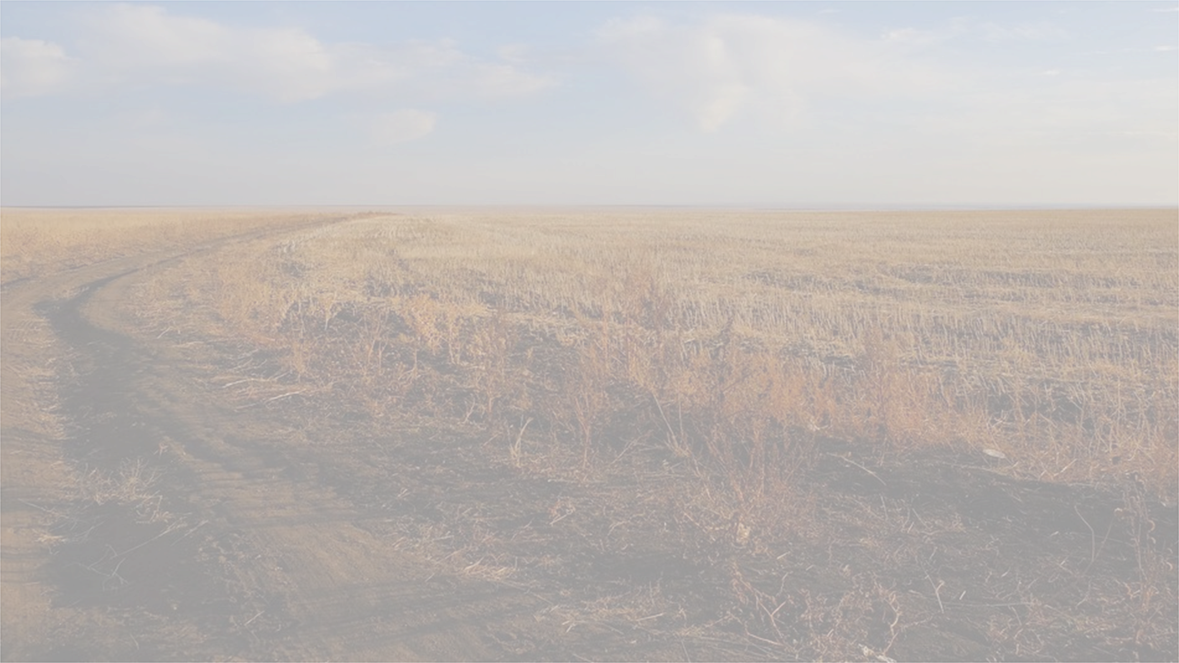
Semanticization of space
‘Russia is rich in people, but the expansive fields are covered in weeds from one to the other, and there is no one left to rescue the soil.’
(Maria: A Chronicle of A Life: 175)

Slide 9
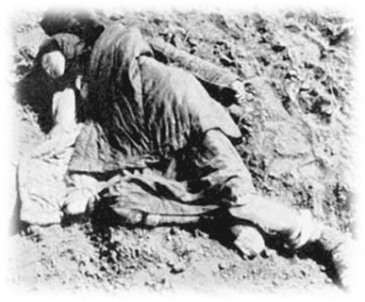
Five minutes later, they chanced upon a bloated corpse lying face up in the ice. It was a girl, no more than fifteen years old, with coal-black hair tied in two braids and a sack-like beige dress made of some coarse material. She was barefoot and her arms lay along her sides, with the palms of her small hands facing upward near the surface of the ice. Her gaunt yellow face had remained well preserved: she had green eyes, long lashes, and what must have at some time been full lips. Only the tip of her nose, which extended above the ice, had begun to rot, creating an unsettling effect that reminded the count of a painting by Kirchner or Dix.
(Sweet Snow: 59)

Slide 10
Character constellation
organized in terms of a rhetoric of “us” and “them” ─ ‘to insistently dramatise cultural difference’
the Self/Other duality
polarity between the Ukrainians and the Russians in the Ukrainian novels;
between the Irish and the English in the Irish texts.
↓
the positive Self: love of the land, religiosity, diligence;
↓
the corrupt nature of the Other: indolence, use of bad language, cruelty.

Slide 11
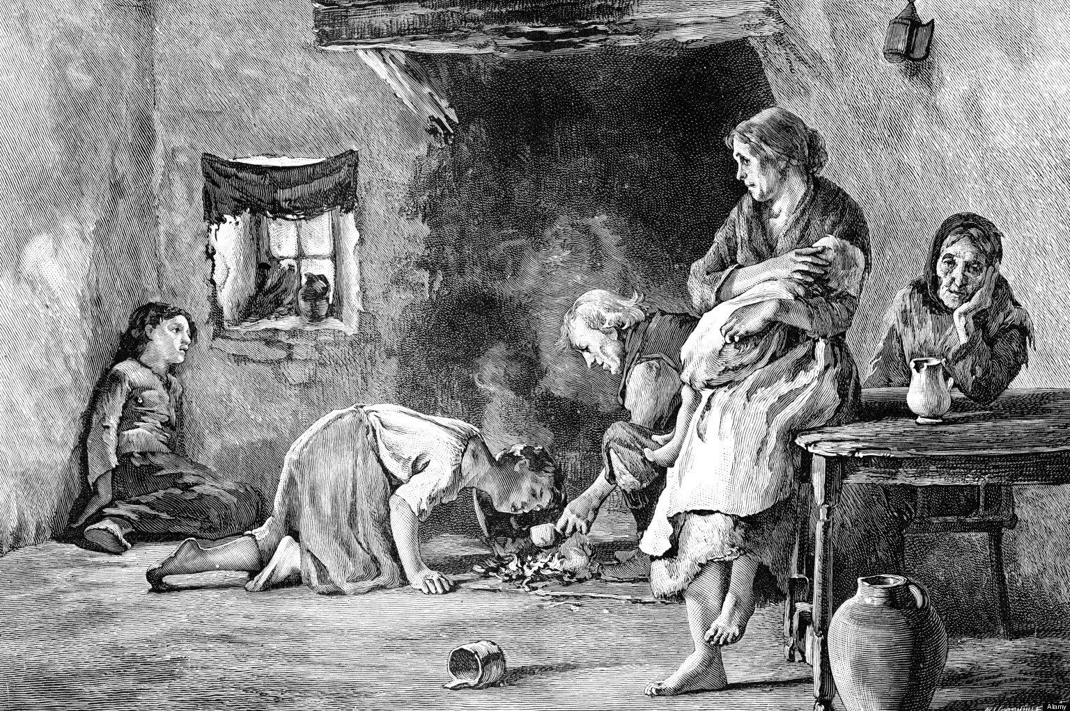
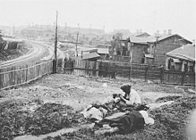
Plot
the characters’ efforts to survive at a time of tyranny and hunger ̶ narrated through the prism of contemporary political, ideological, and religious developments.
National differences → ‘asymmetrical binary oppositions’: generate the reader’s sympathy and empathy with the Self, and condemnation of the Other.

Slide 12
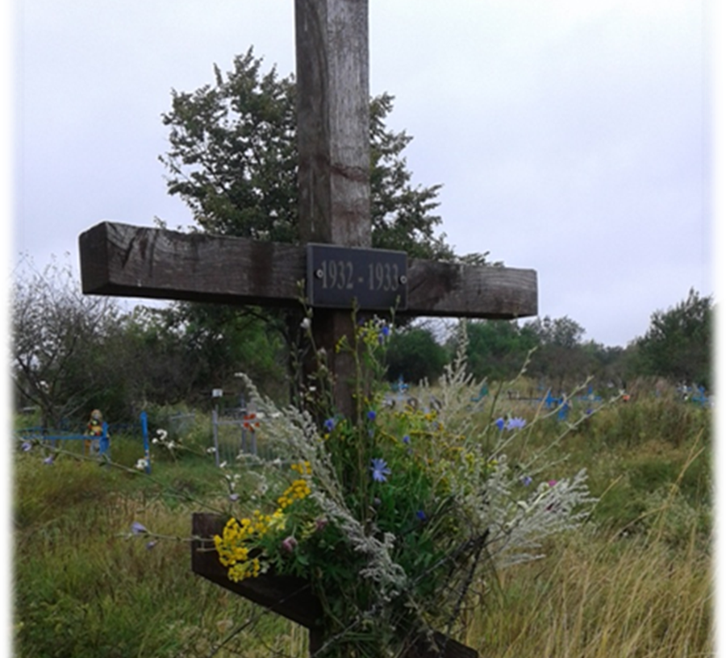
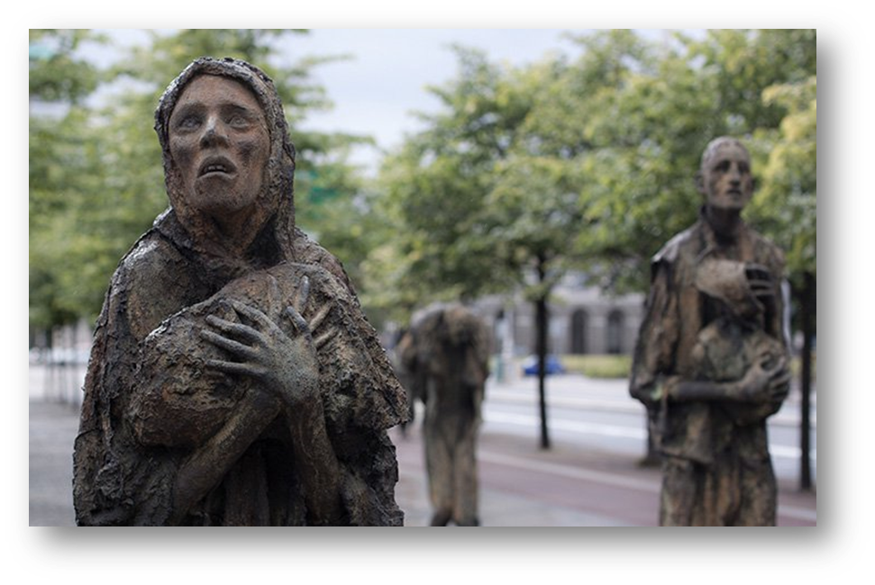
‘The literature of a nation is far more revealing than all the official histories ever written.’
(John Broderick quoted by Gunilla Bexar, The Great Irish Famine in History-Writing and Prose Fiction: “The Mutual Interplay of Two Narrative Genres”, p. 1)

